Slide 3
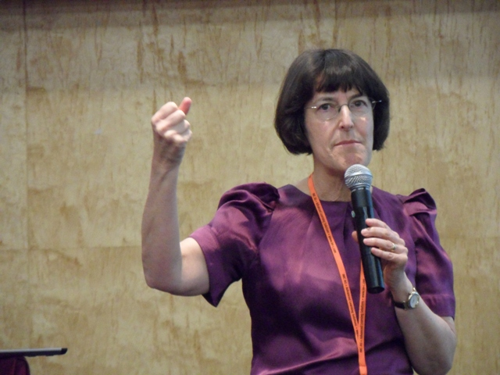
Keynote – Judy Kay

Slide 4
Best paper
Myroslava O. Dzikovska et al: Content, Social, and Metacognitive Statements: An Empirical Study Comparing Human-Human and Human-Computer Tutorial Dialogue pp. 93–108.

Slide 5
Design
Three conditions:
ITS that asks students for explanations
ITS that gives away correct answer
Human tutor in computer-mediated setting
Explored the role of:
Student produced content to predict learning
Social and metacognitive utterances

Slide 6
Learning environment
Constructed a computer mediated learning environment in which students work on exercises and human tutor can help them
Based on the human-human interaction data, they created a tutorial dialog system that replaces human tutor with automatically generated feedback

Slide 7
Dialog coding
Content:
There is a batter and bulb in circuit 1.
Metacognition
Positive: I get it. ; Oh, o.k.
Negative: I don’t understand.
Social
Positive: Haha; Hi, how are you doing?
Negative: Because I said so.; No.; You’re stupid.

Slide 8
Results – content words
H-H: 5.68 words per turn
Percentage of content words positively correlated with learning gain
H-C: 6.13, 5.66 words per turn
content words BASE:not / FULL:positively correlated with learning gain
In BASE, students may be struggling with terminology; is the tutor’s feedback important or trivial?

Slide 9
Results – metacognitive/social
H-H: mostly positive (acks, rapport)
Positive statements negatively correlated with learning gain
H-C: mostly negative (frustration; interpret.)
BASE:almost none; FULL:mostly negative; Both negative and positive were negatively correlated with learning gain
Avg. learning gain of students who generated any negative social dialog (52%) vs those that did not (67%) …

Slide 10
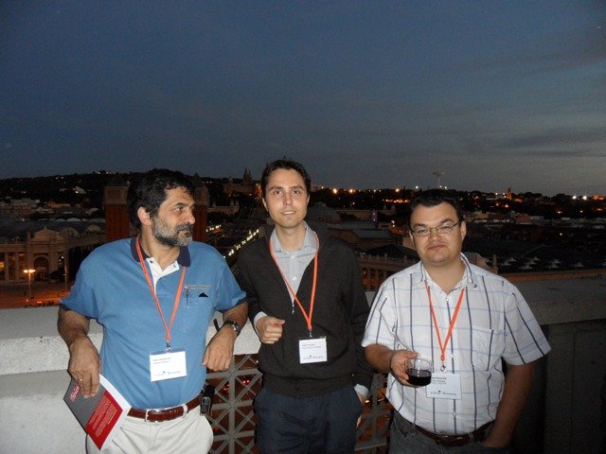
Poster session

Slide 11
Selected paper (1)
Phillip Scholl et al: Extended Explicit Semantic Analysis for Calculating Semantic Relatedness of Web Resources (pp. 324–339)
Explicit Semantic Analysis (ESA) – similarities between documents or terms based on similarities to documents of a reference corpus.
Extended ESA uses further semantic properties of Wikipedia (link structure and categorization)

Slide 12
Typically we do term similarity
What if you don’t know the domain’s terminology used by experts … concepts similarity
Crokodil – learning materials organized in Knowledge Network (Semantic Network)
Snippets (more specific that pages, 120 vs 1600 terms)

Slide 13
Extended ESA
Extension of ESA:
Utilize Wikipedia’s article link graph
7% improvement
Utilize Wikipedia’s category structure
5.4% improvement
Combination of these two
-5% to -8% improvement
ESA results:
avg. precision: 0.595 (sd=0.252)

Slide 14
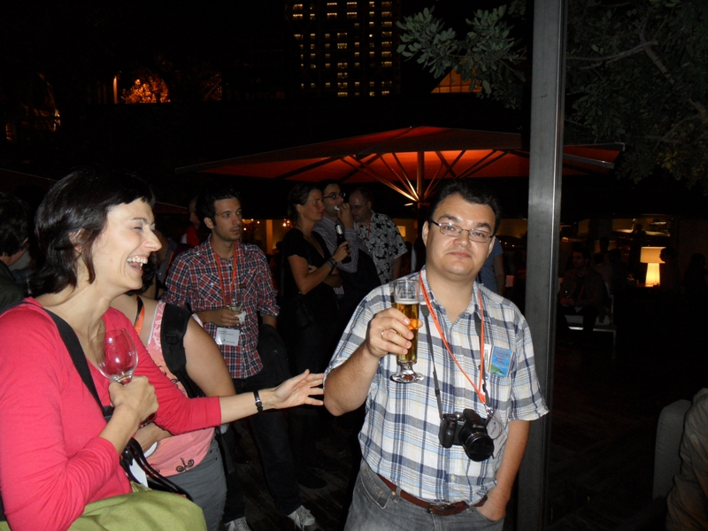
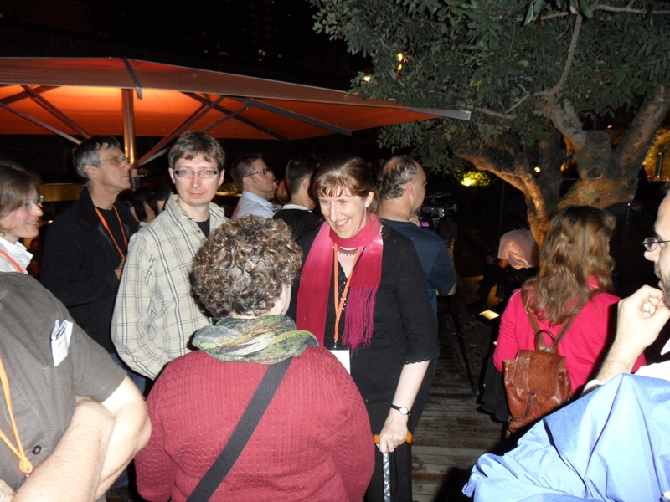
Conference dinner

Slide 15
Selected paper (2)
Dimitra Tsovaltzi et al: Learning from Erroneous Examples: When and How Do Students Benefit from Them? (pp. 357–373)
Erroneous examples are worked solutions that include one or more errors that the student is asked to detect and/or correct.
Teachers are reluctant to discuss errors in classroom to prevent assimilation as good.
TIMMS, Japan outperforms western world.

Slide 16
Internet as a learning resource

Slide 17
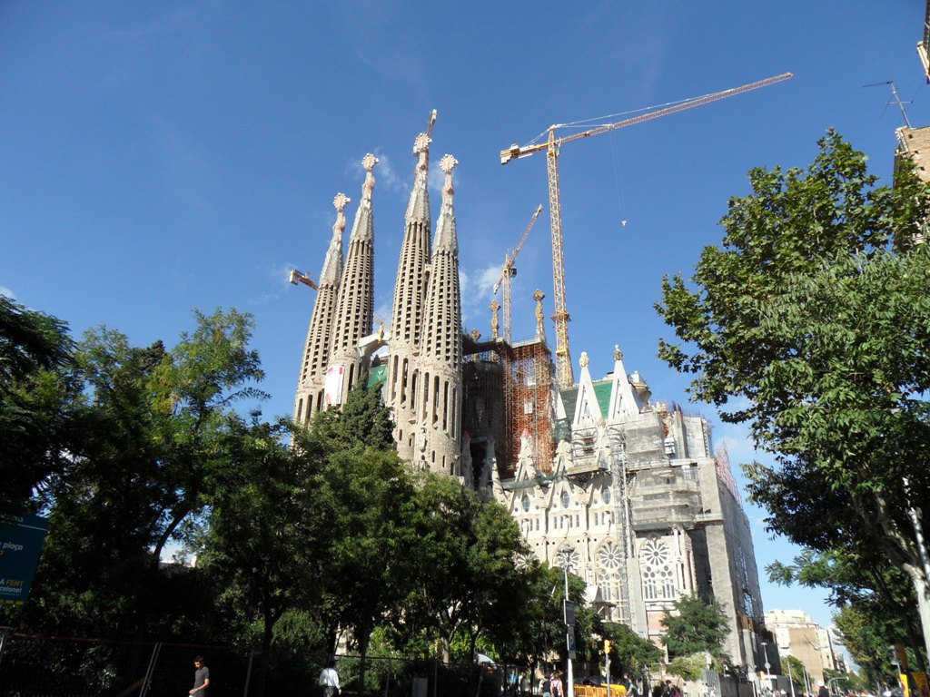

Slide 18
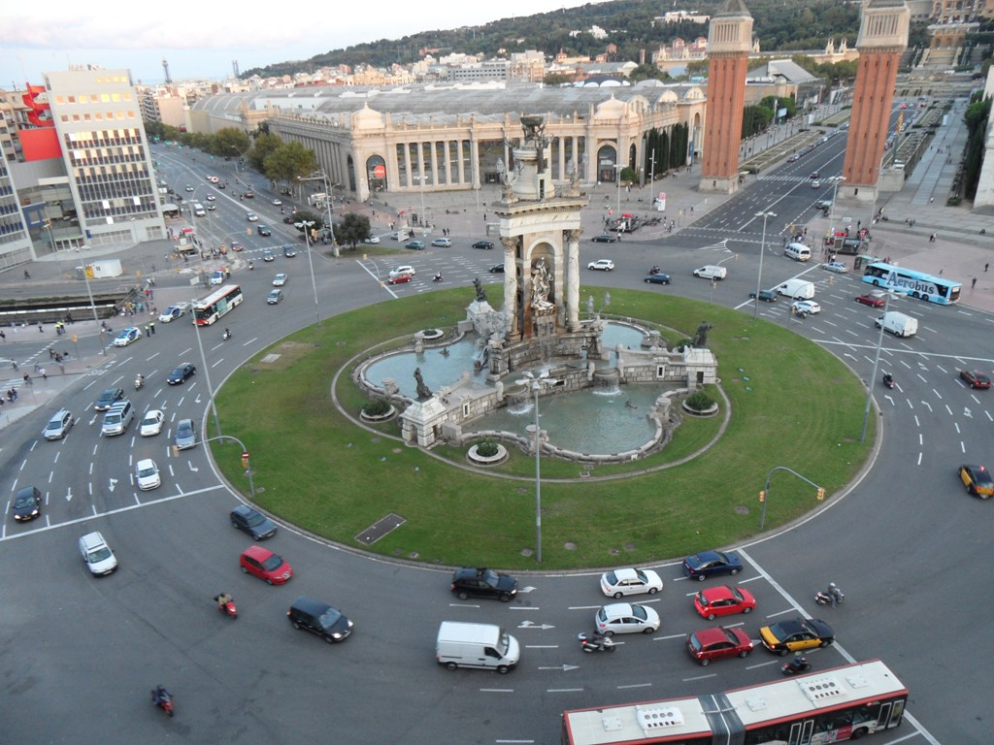

Slide 19
