Slide 1
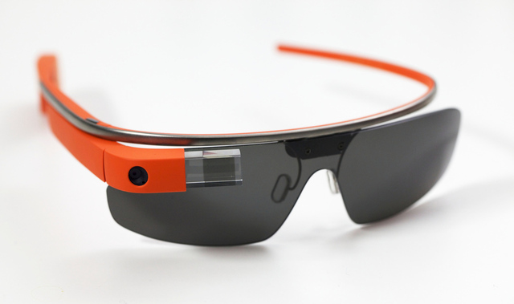
UX design for Google Glass
Alena Kovárová
PeWe Seminar 6.5.2014

Slide 2
Input
Microphone
voice commands
Touchpad on the frame
only for right handed
Camera
take photos 5MP
record video in 720p
Notes:
when the camera is recording, a light is displayed to alert others when the glasses are recording

Slide 3
Sensors
3 axis gyroscope,
3 axis accelerometer
3 axis magnetometer (compass)
Ambient light sensing
Proximity sensor

Slide 4
Output
Optical head-mounted display
Audio transducer
(Earphone)

Slide 5
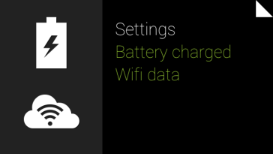
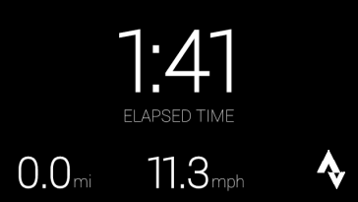
Timeline
Future/Present Now Past
Home

Slide 6
UI Elements
Static card - Displays text, HTML, images, and video. Static cards can invoke live cards or immersions.
Live card - Displays cards that are important at the current moment, usually rendered at a high frequency.
Immersion - Displays Android activities that take over the timeline experience.

Slide 7
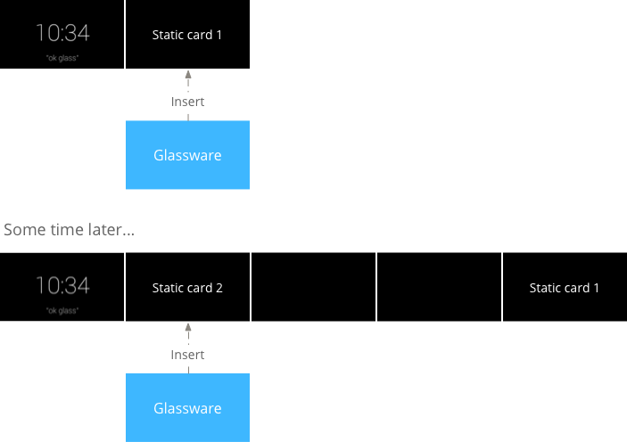
Static Cards
Periodic events

Slide 8
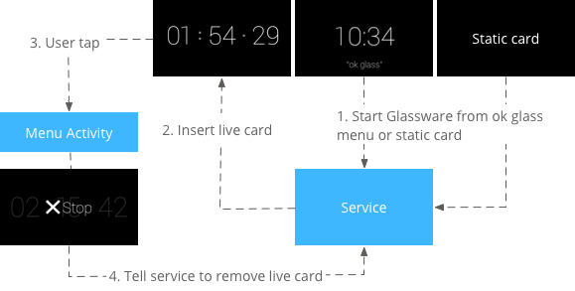
Live Cards
ongoing tasks / real-time updates to the UI
Stopwatch
Navigation
Music player

Slide 9
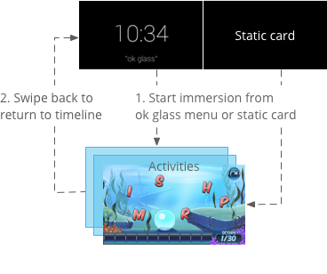
Immersions
display outside of the timeline

Slide 10
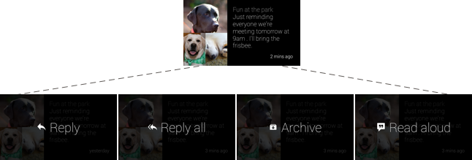
Menu Items

Slide 11
Invocation Methods
“ok glass” touch or voice menu
Contextual voice or touch menu on a timeline card

Slide 12
Let’s see it live

