Slide 1
Group Experiments in UX Class
Jozef Tvarožek

Slide 2
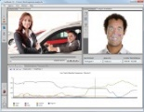
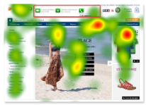
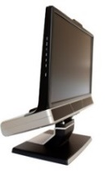
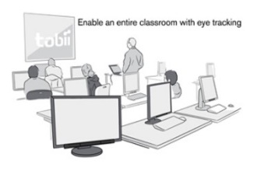
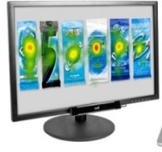
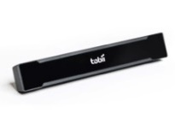
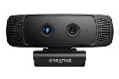
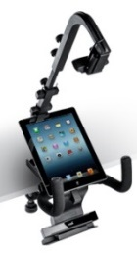
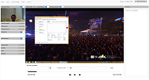
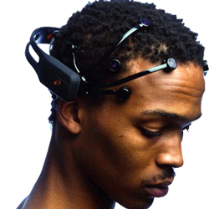
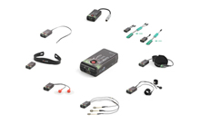
User eXperience and Interaction Research Center @ FIIT STU
UX Lab
UX Class
20x
emotion detection
Tobii studio
300 Hz
gaze tracking
60 Hz gaze tracking
3D depth camera
TV
3D depth camera
Emotion detection
EEG
ECG, GSR, FSR, °C
Smartphones, tablets
UX Research infrastructure software

Slide 3
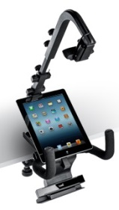
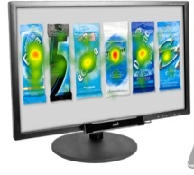
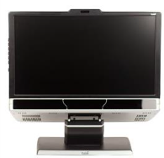
UXI@FIIT = three laboratories
60 Hz mobiles, TV, PC
Control
room
300 Hz PC, EEG, ...
20x 60 Hz gaze tracking PC

Slide 4
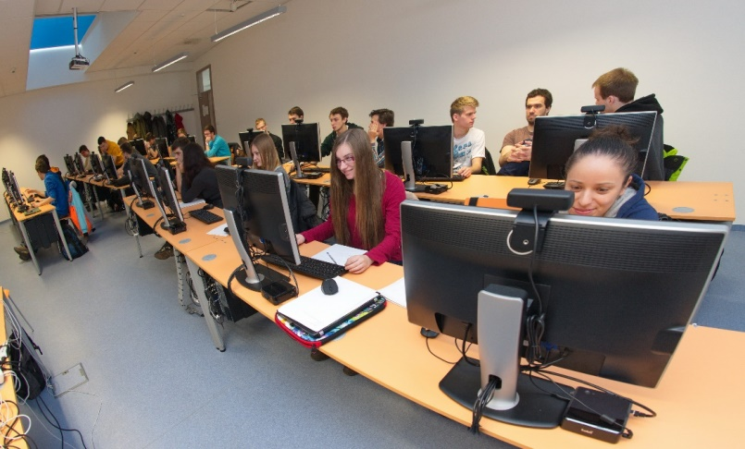
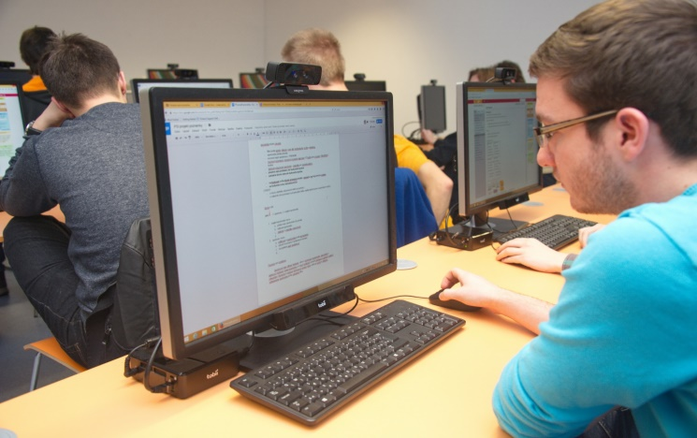
UX Class – research in groups
Mass data collection
Same conditions for every participant
Saving staff time
Domains
Business environment (information systems)
Filling surveys
Learning
Entertainment/Multimedia
60Hz
eyetracker
3D depth camera

Slide 5
Our UX Research infrastructure software – Overview
Software infrastructure for:
Data collection from UX Class
Lifecycle management of research projects
Processing of research data
Annotations
Cleaning
Export
Archivation

Slide 6
Our UX Research infrastructure – Replay and annotations
Eye gaze
Mouse cursor

Slide 7
Group Experiments in UX Class
Step by Step Walktrough

Slide 8
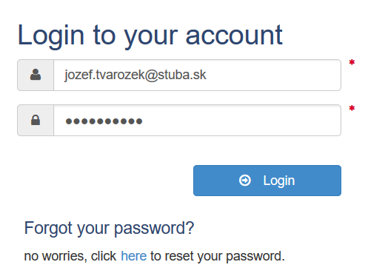
Step 1: Login
http://uxlab.fiit.stuba.sk/UxLabWebAppTest/

Slide 9
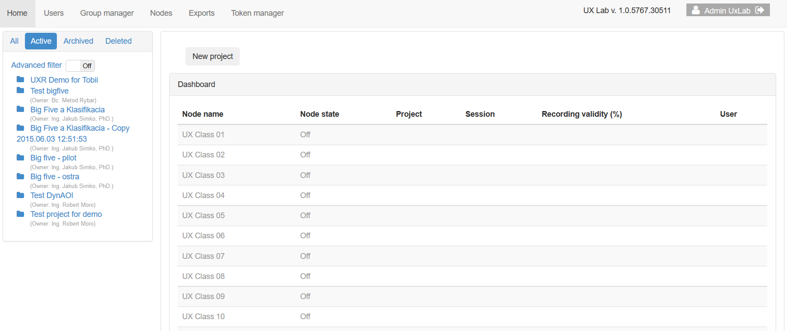
Step 2: Home screen

Slide 10
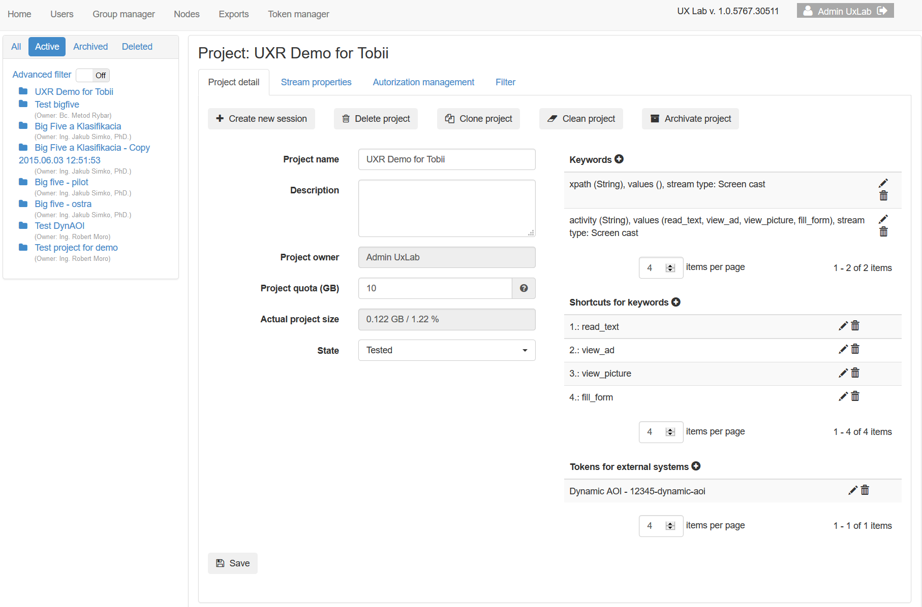
Step 3: Fill in project details

Slide 11
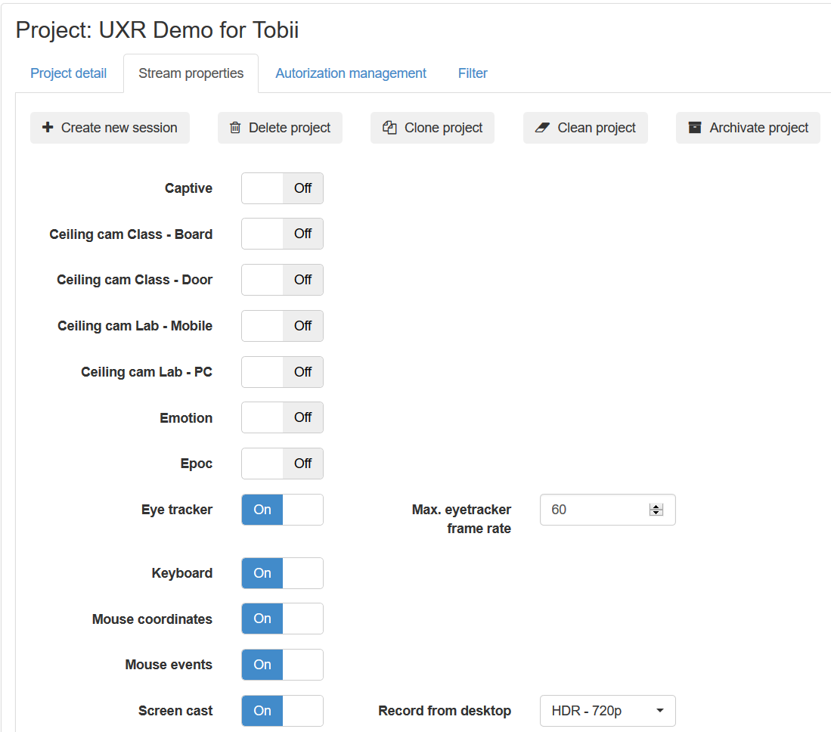
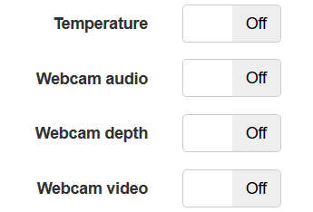
Step 4: Setup data streams

Slide 12
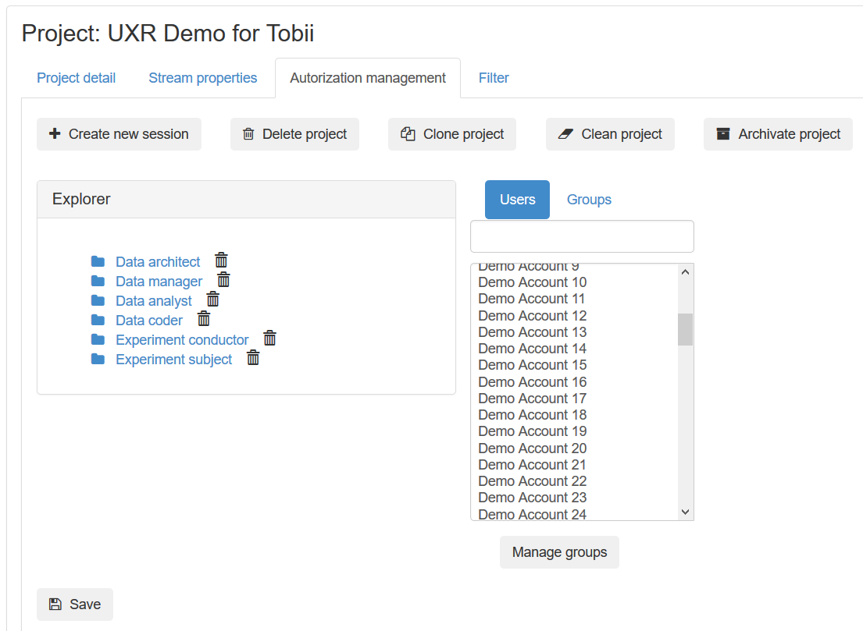
Step 5: Setup users & subjects

Slide 13
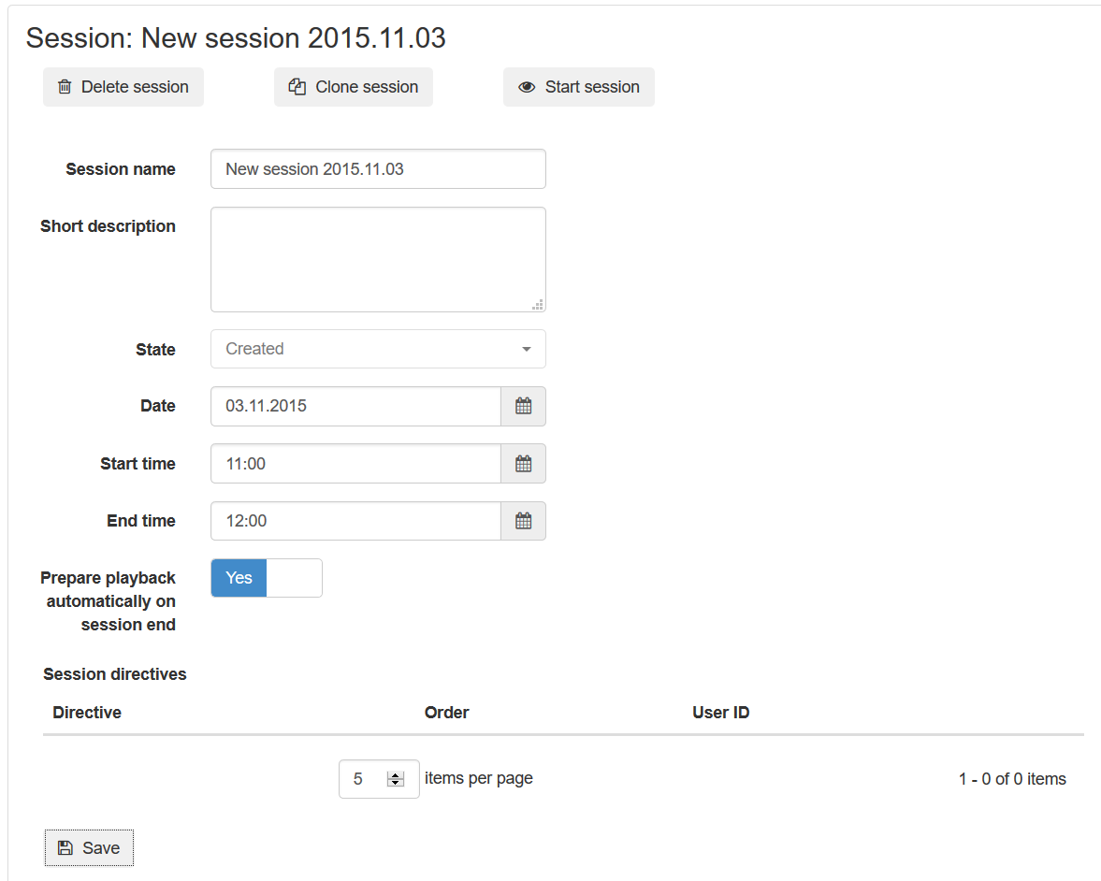
Step 6: Schedule data collection session

Slide 14
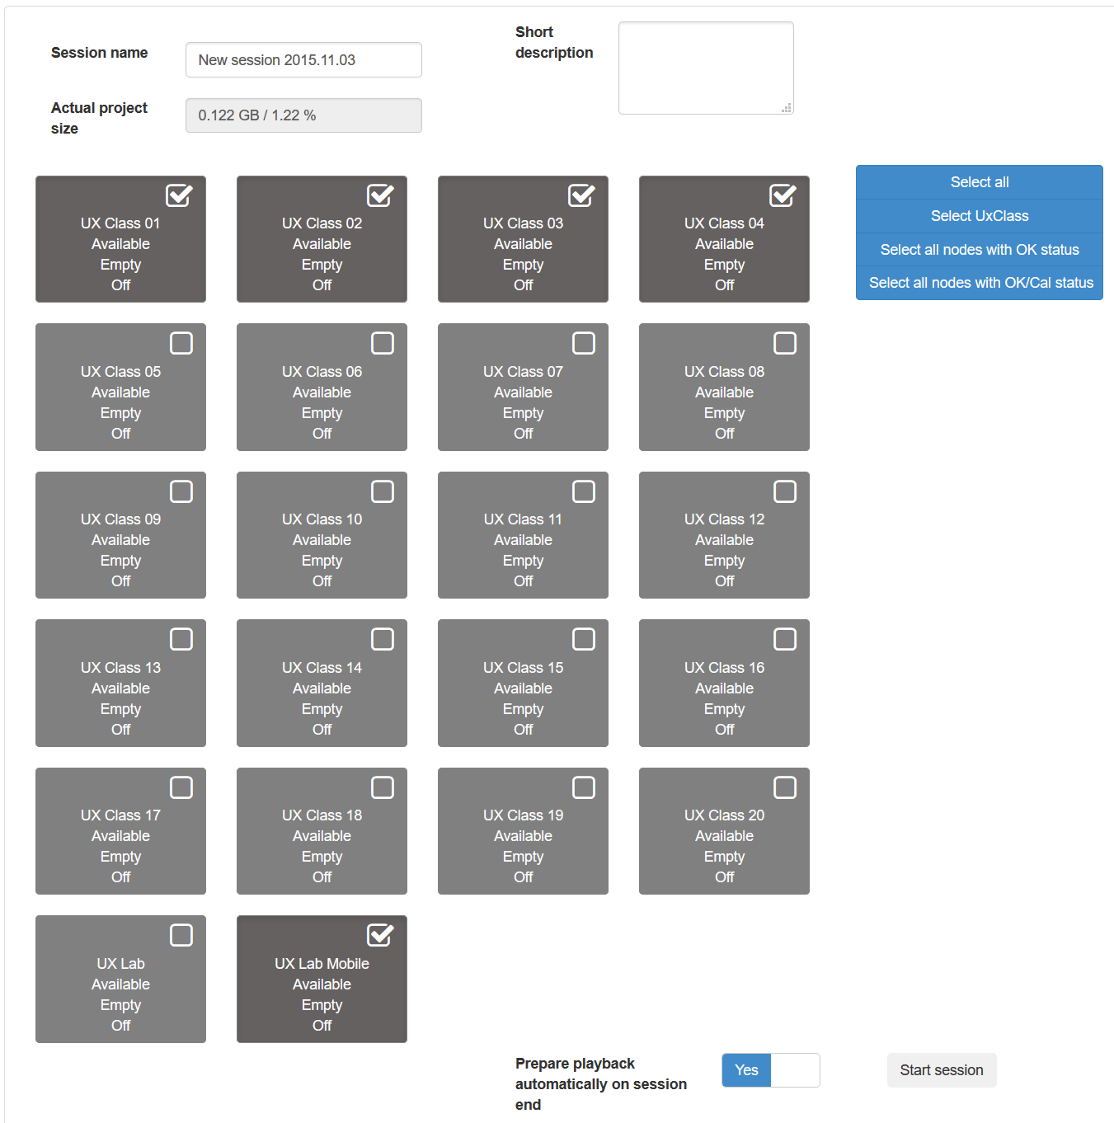
Step 7: Start session

Slide 15
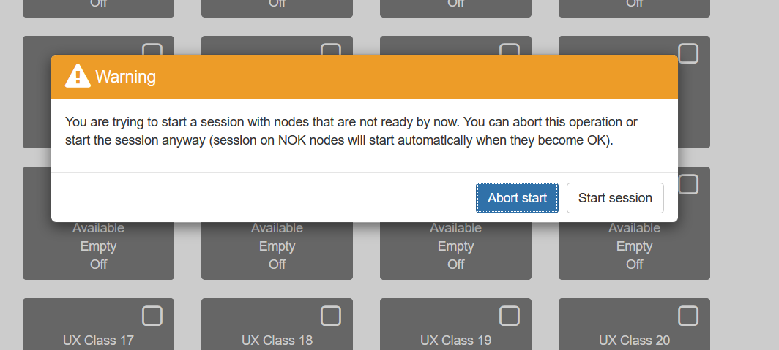
Step 7: Start session (warning!)

Slide 16
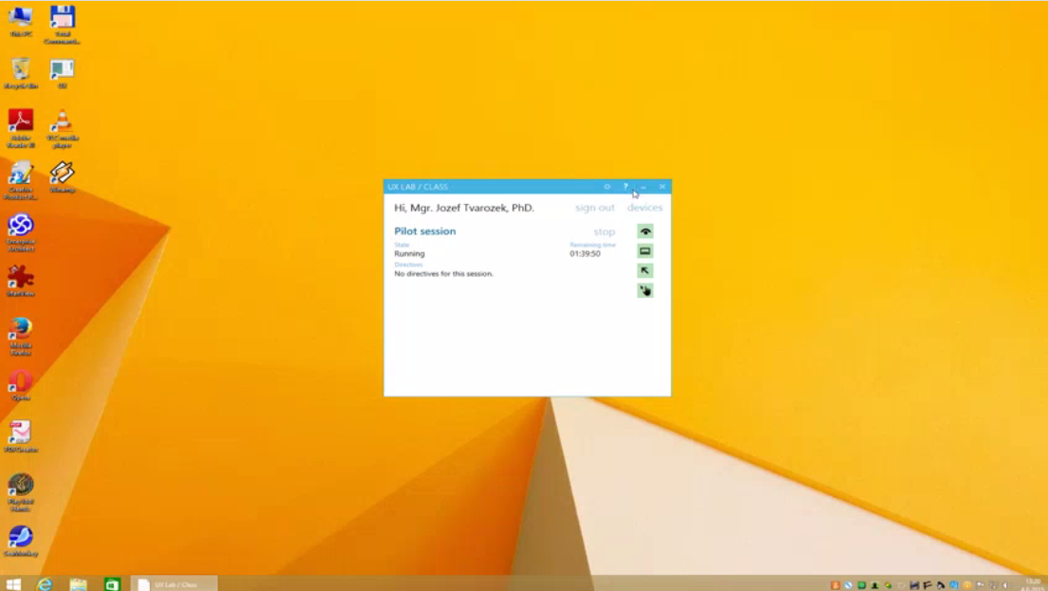
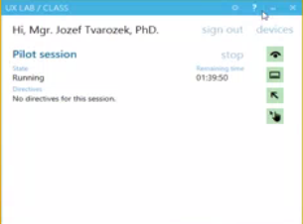
Step 8: Login and record in UX Class

Slide 17
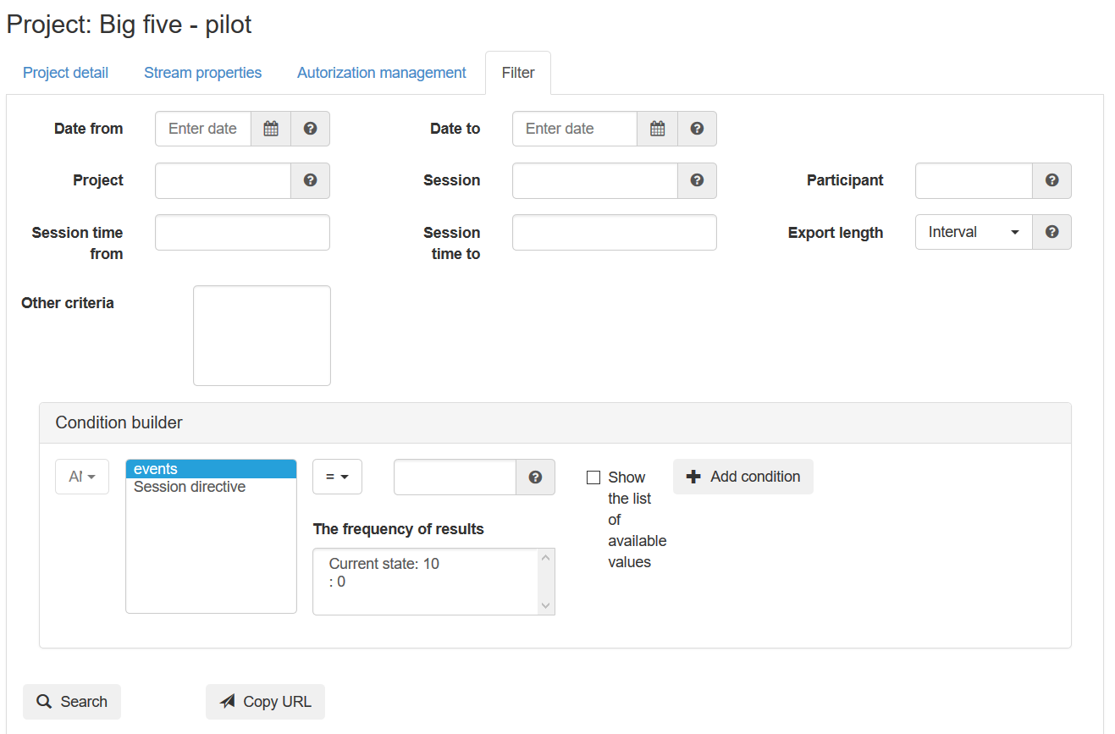
Step 9: Search recorded data

Slide 18
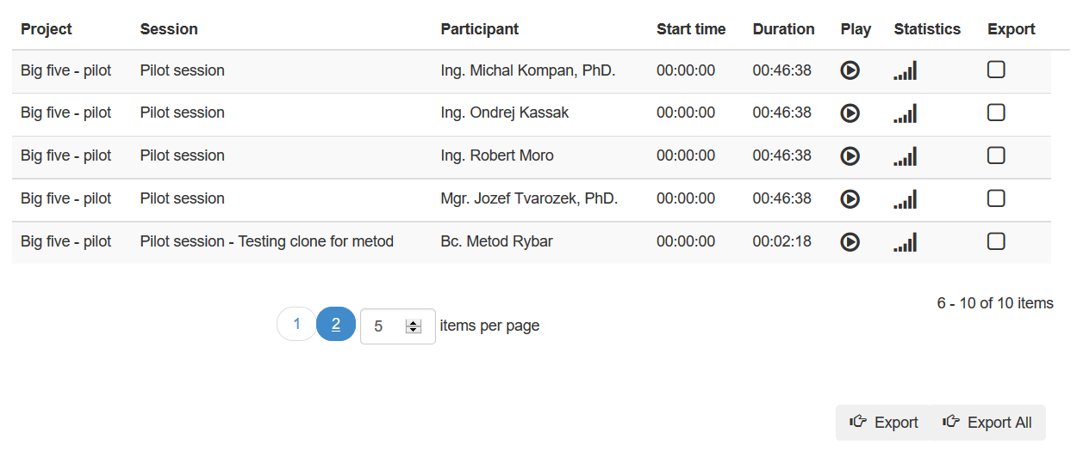
Step 9: Search recorded data

Slide 19
Step 10: View recorded data

Slide 20
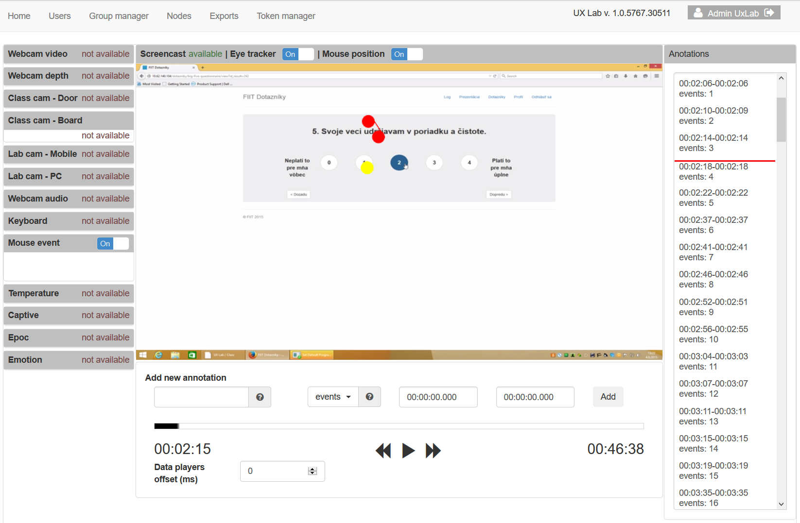
Step 11: Annotate recorded data

Slide 21
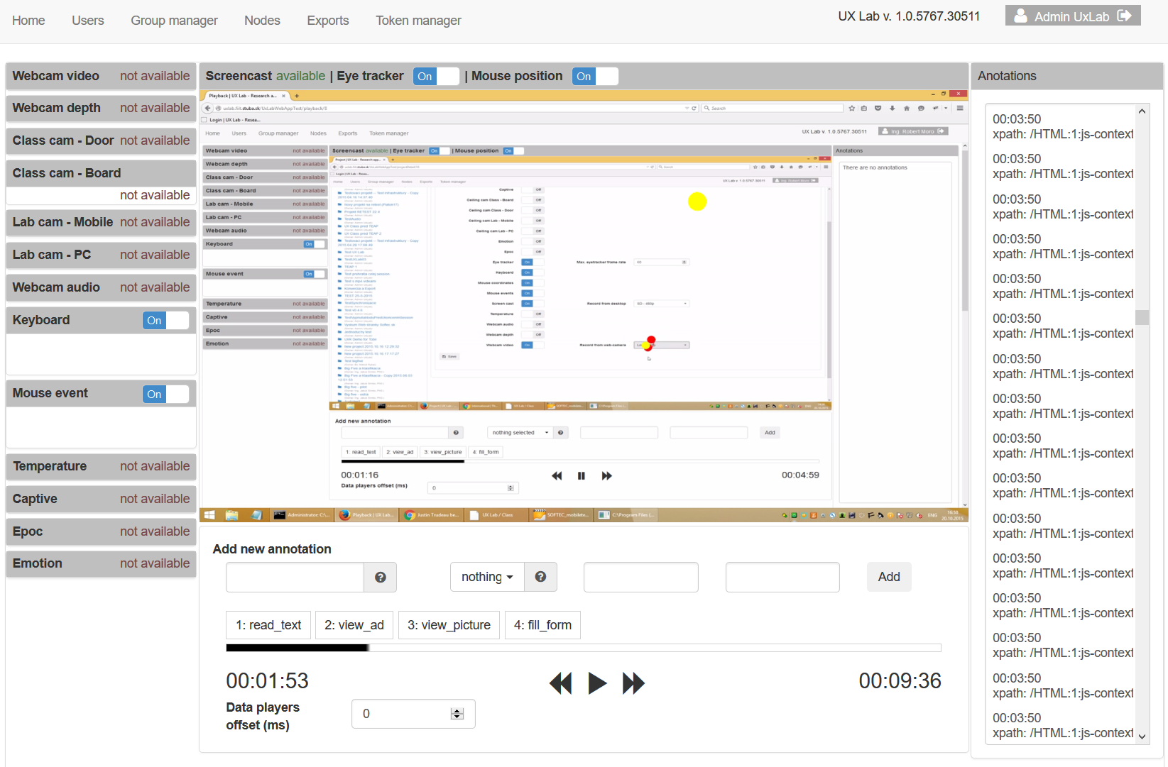
Step 11: Annotate recorded data

Slide 22
Step 11: External tokens, dynamic AOIs

Slide 23
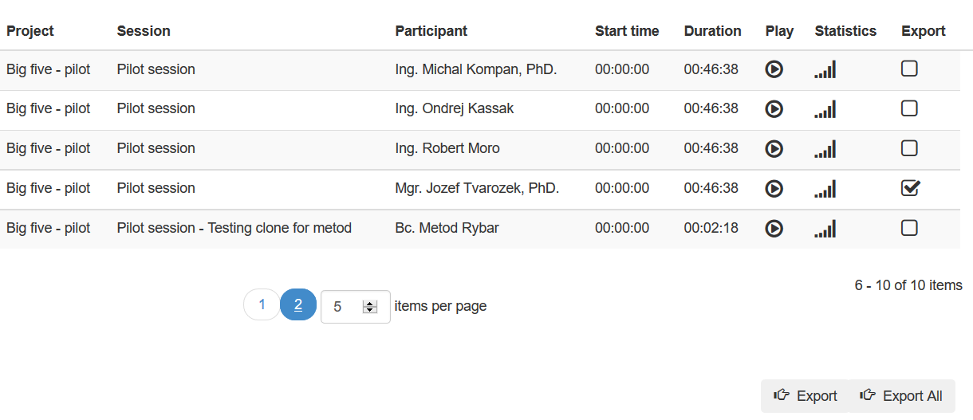
Step 12: Export recorded data

Slide 24
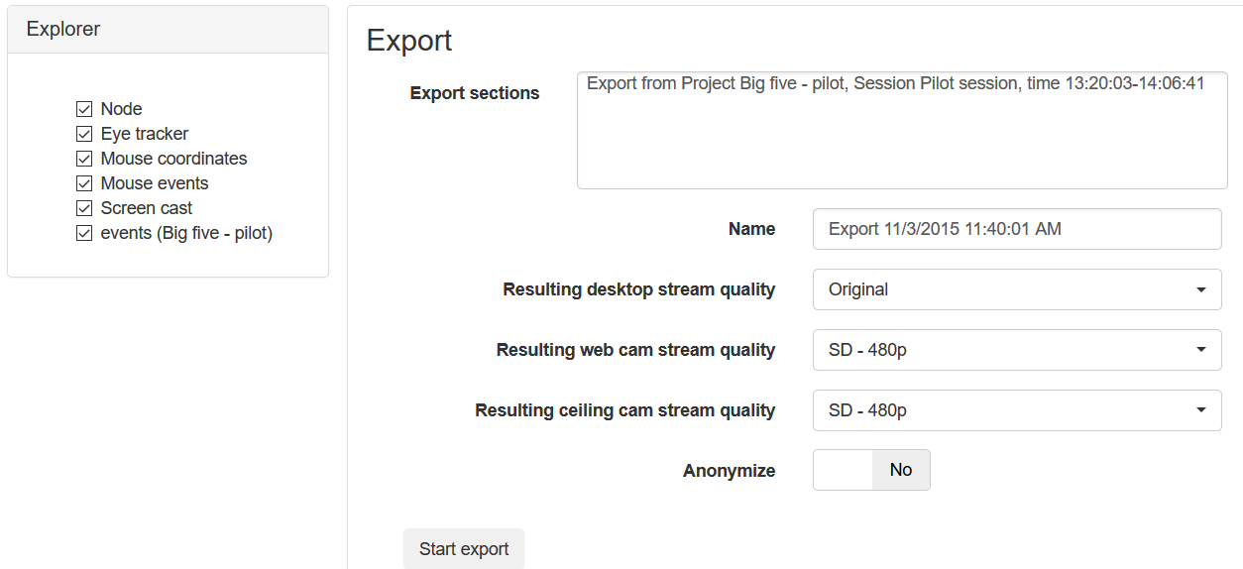
Step 12: Export recorded data

Slide 25
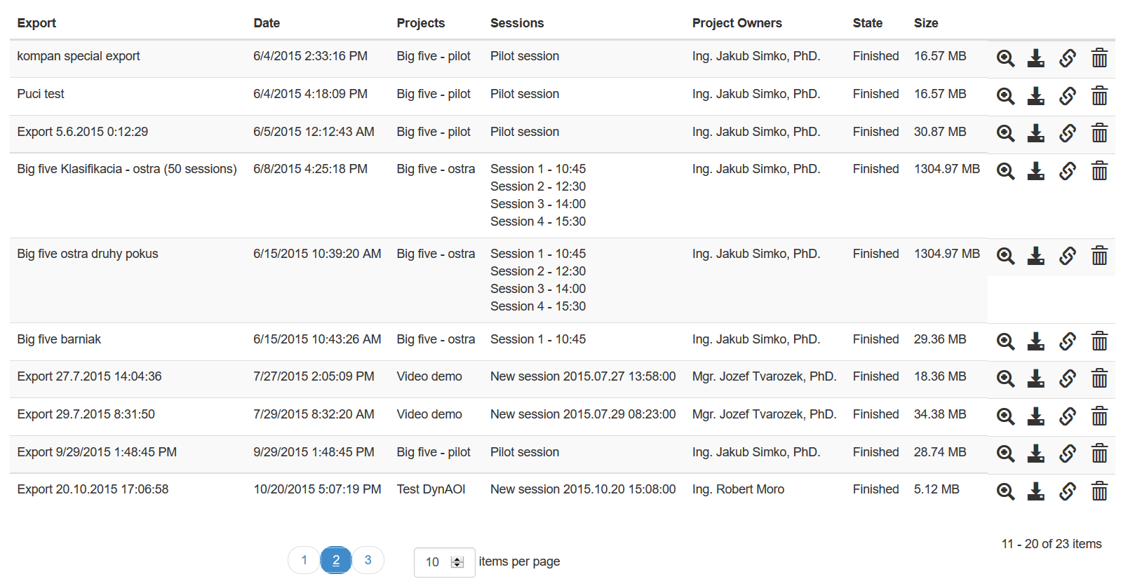
Step 12: Export recorded data

Slide 26
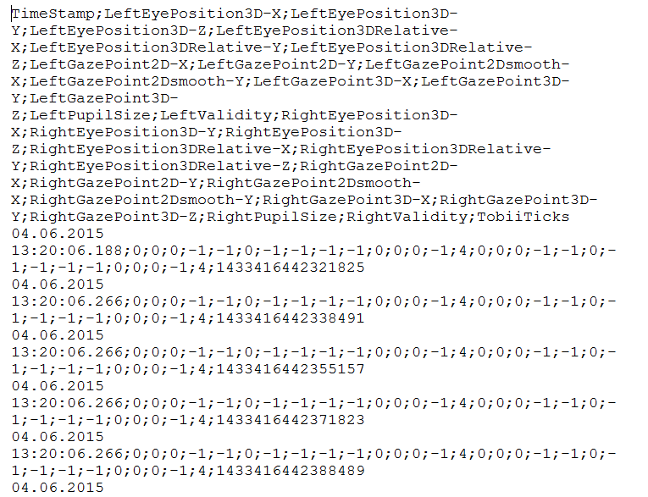
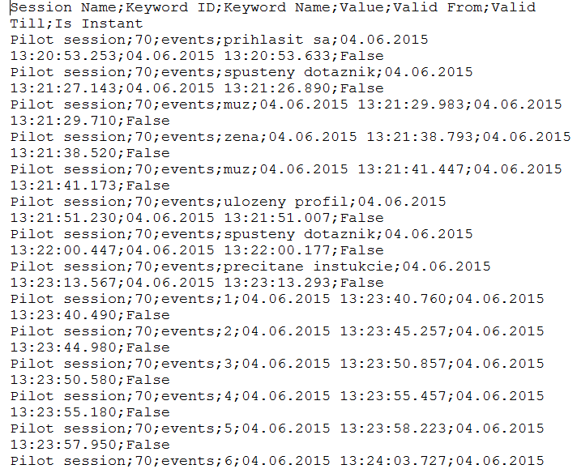
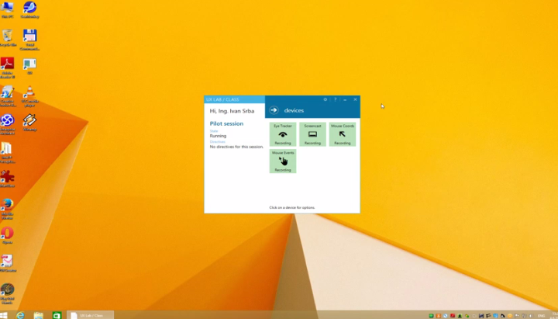
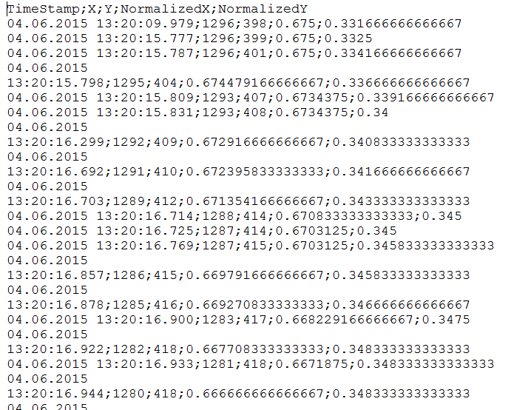
Final Step: Enjoy your data!

Slide 27
Visit us at ux.fiit.stuba.sk

