Slide 1
An introduction to NoSQL Databases
Karol Rástočný, Eduard Kuric

Slide 2
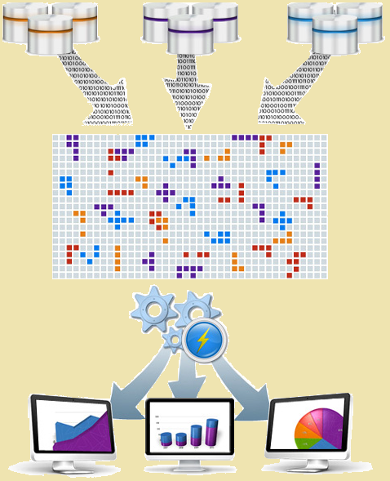
Motivation
Not stable data
No fixed tables
Big data
Horizontal scalability
Distributed computing/querying
Concurrent access
Consistency

Slide 3
What is NoSQL?
NoSQL = No + SQL
More-accurately:
Not Only SQL
NoRel – No relational

Slide 4
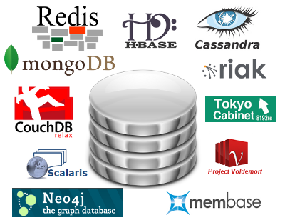
NoSQL Databases - Classification
Sorted Ordered Column-Oriented Stores
Key/Value Stores
Document Databases
Graph Databases

Slide 5
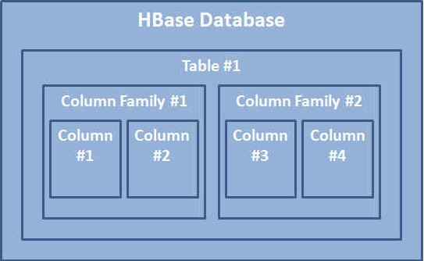
Column-Oriented Stores
Contrast with row-oriented RDBMS
Data unit
Set of key(column)/value pairs
Sorted by row-key (primary key)
Nulls are not stored
Columns are organized in column-families
Name: FirstName, LastName,
Location: Address, State, GPS

Slide 6
Column-Oriented Stores
Bigtable
Google
HBase
Facebook, Yahoo!, Mahalo
Hypertable
Zvents, Baidu, Redif
Cloudata

Slide 7
Key/Value Stores
Idea
HashMap – fast O(1) access
Data unit: Key/Value pair
Key – string
Value
Basic types: int, string, …
Collections of basic types: set, list, …

Slide 8
Key/Value Stores
Membase
Zynga, NHN
Redis
Craigslist, Seznam, ALEF
Dynamo
Amzon
Cassandra
Facebok, Twitter, Digg
Voldemort
LinkedIn

Slide 9
Document Databases
Data unite:
Document = Object
Stored as a whole (not fragmented)
JSON (BSON) notation
Allows indexes on attributed

Slide 10
Document Databases
CouchDB
Apple, BBC, Cern, PeWeProxy
MongoDB
Github, ForSquare, Shutterfly, Sourceforge

Slide 11
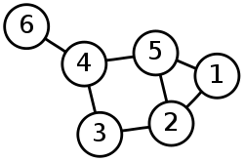
Graph Databases
Data unite:
Node with relations to incident nodes
Representation
Set of triples – object, predicate, subject
Set of pointers to incident nodes

Slide 12
Graph Databases
AllegroGraph
TwitLogic, Pfizer
FlockDB
Twitter
Neo4j
Box.net

Slide 13
Use cases
Access to attributes, computation over attributes
Sorted ordered column-oriented stores
Temporal store, frequent add/remove operations
Key/Value stores
Operations over whole objects
Document databases
Relations store, deduction
Graph databases

Slide 14
Main Properties
Data modeling
Querying
Scalability
Consistency

Slide 15
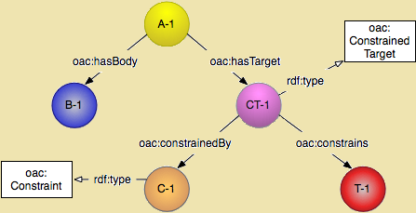
Data Modeling
No standardized data model
Sorted ordered column-oriented stores
Structure in class-families level
Key/Value stores
Data structures of collections
Document databases
Rudimentary “class” diagrams
Graph databases
Graph schema definitions

Slide 16
Querying
MapReduce
Distributed computing and “views” generation
Custom languages
Mostly based on JavaScript
SQL-like languages
Apache Hive, HQL, CQL, SPARQL, …
Language bindings
Apache Thrift, REST API, Java API, custom Drivers, …

Slide 17
Scalability
Multi-master replication
Data partitioning (shards)
Fraud tolerance
Limits
Maximal number of rows, columns, column-families, documents, nodes, replicas, shards, …
Maximal size of index, data unit, …

Slide 18
Consistency
Strong Consistency
One master for write, multiple slaves for read
Eventual Consistency
Multiple write masters
Updates are propagated in low load phases
Consistency level
Transaction, row, column, document, …

Slide 19
Resources
Tiwari, S.: Professional NoSQL
Comparison of NoSQL databases (http://kkovacs.eu/cassandra-vs-mongodb-vs-couchdb-vs-redis)
Web sites of databases

Slide 20
Upcoming Presentations
Cassandra – Eduard Kuric
CouchDB – PeWeProxy team
Graph Databases – Michal Holub
MongoDB – Karol Rástočný
Redis – Alef team
and a lot more (board is opened for everyone ☺)

