Slide 1
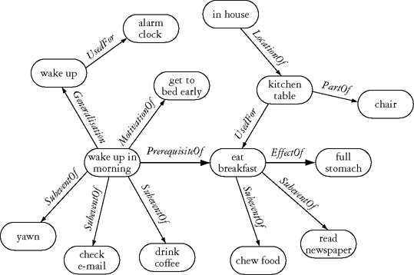
ConceptNet – Common Sense Facts

Slide 2
ConceptNet – How to access it
http://csc.media.mit.edu/conceptnet
REST API (or Python library)
No SPARQL needed
Only simple calls (no reasoning)
Returns JSON, XML or YAML
google for other language ports
Ontology for starters

