Slide 1
Tools for Graph Vizualization
Karol Rástočný

Slide 2
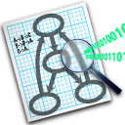
Graphviz
http://www.graphviz.org
Open Source
Vizualizácia 2D grafov (hierarchické, vrstevné, uniformné, radiálne, kruhové rozloženie)
Výstup: interactive graph browser, bmp, eps, gif, jpg, pdf, svg, png, ico, tiff, ps, ...
C, .Net, Tcl/Tk, Java, Guile, Perl, Phyton, Ruby, Django, Go, COM, R, HTML

Slide 3
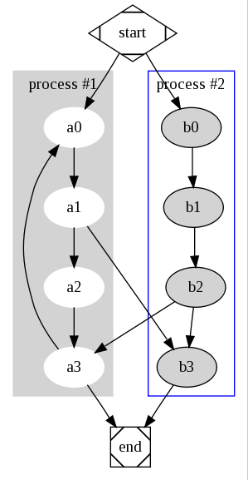
digraph G {
subgraph cluster_0 {
style=filled;
color=lightgrey;
node [style=filled,color=white];
a0 -> a1 -> a2 -> a3;
label = "process #1";
}
subgraph cluster_1 {
node [style=filled];
b0 -> b1 -> b2 -> b3;
label = "process #2";
color=blue
}
start [shape=Mdiamond];
end [shape=Msquare];
start -> a0;
start -> b0;
a1 -> b3;
b2 -> a3;
a3 -> a0;
a3 -> end;
b3 -> end;
}

Slide 4
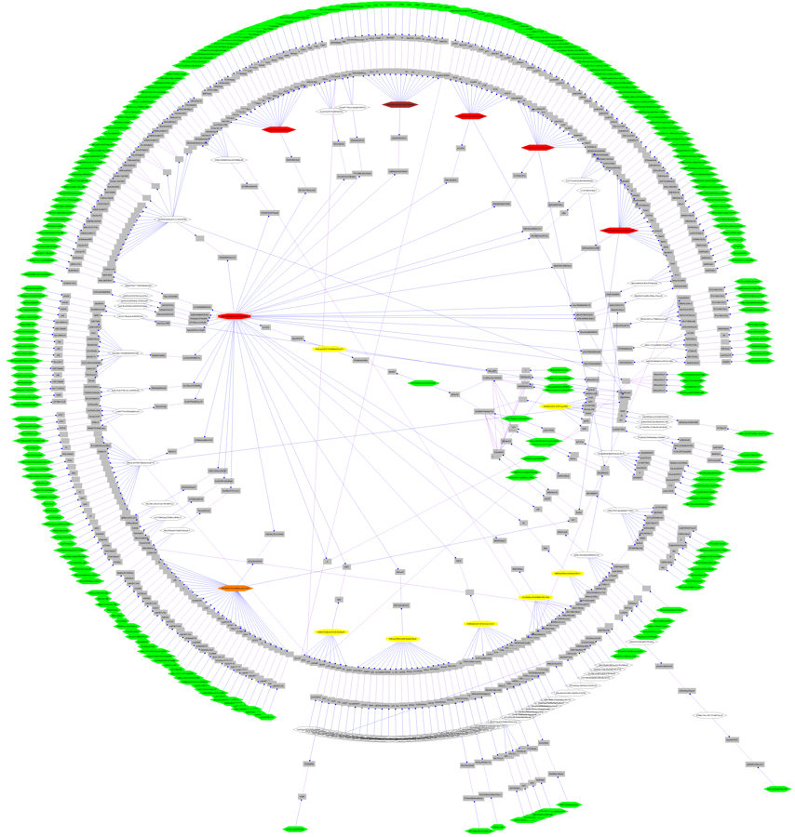

Slide 5
prefuse
http://prefuse.org/
Sada nástrojov na vytváranie interaktívnych vizualizácií grafov
Java (OpenSource)
Beta 21.10.2007 (posledný commit 16.8.)
Prefuse flare
Vizualizácie pre ActionScript, Flash
Alpha 24.1.2009 (posledný commit 2.8.2012)

Slide 6
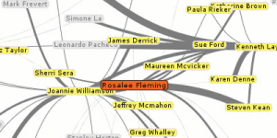
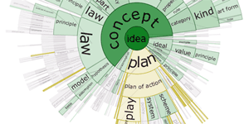
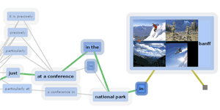
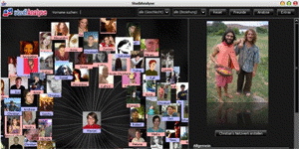
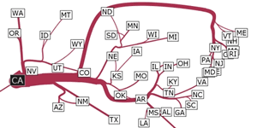
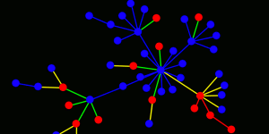
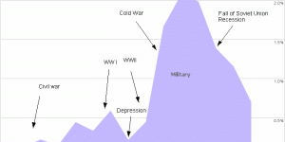
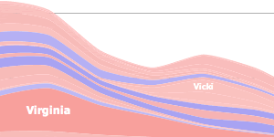
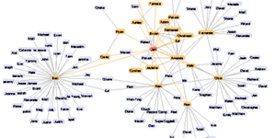

Slide 7
UBIGRAPH
http://ubietylab.net/ubigraph/
Vizualizácia dynamických 3D grafov
Distribuovaná editácia grafu
Python, Ruby, PHP, Java, C, C++, C#, ...
Release alpha-0.2.4 (June 2008)
Mac OS X, Linux
Demo: http://ubietylab.net.s3.amazonaws.com/DemoReel.mov

Slide 8
JS/HTML5
Dracula Graph Library
http://www.graphdracula.net/
arbor.js
http://arborjs.org/
js-graph.it
http://js-graph-it.sourceforge.net/index.html
jsPlumb
http://jsplumb.tumblr.com/

