Slide 1
ACM Recommender Systems 2012
Dublin 9-13 September
Kompan,Kramár,Zeleník,Bieliková

Slide 2
O čom?
Pracovné dielne:
Recommender Systems and the Social Web (RSWeb)
Human Decision Making in Recommender Systems
Context-Aware Recommender Systems (CARS)
Recommendation Utility Evaluation (RUE)
RecSys Data Challenge
Interfaces for Recommender Systems (Interfaces)
Personalizing the Local Mobile Experience

Slide 3
Online Controlled Experimetns
Ronny Kohavi Microsoft
Listening to the customers, not to the HiPPO
Amazon recommender
If you’re going to experiment, try more variants, especially if they’re easy to implement

Slide 4
Online Controlled Experimetns
At Amazon, half of the experiments failed to show improvement
QualPro tested 150,000 ideas over 22 years (75%)
Based on experiments with ExP at Microsoft
1/3 of ideas were positive ideas and statistically significant
1/3 of ideas were flat: no statistically significant difference
1/3 of ideas were negative and statistically significant

Slide 5
Kde
recsys.acm.org
Ulozisko
ACM DL

Slide 6
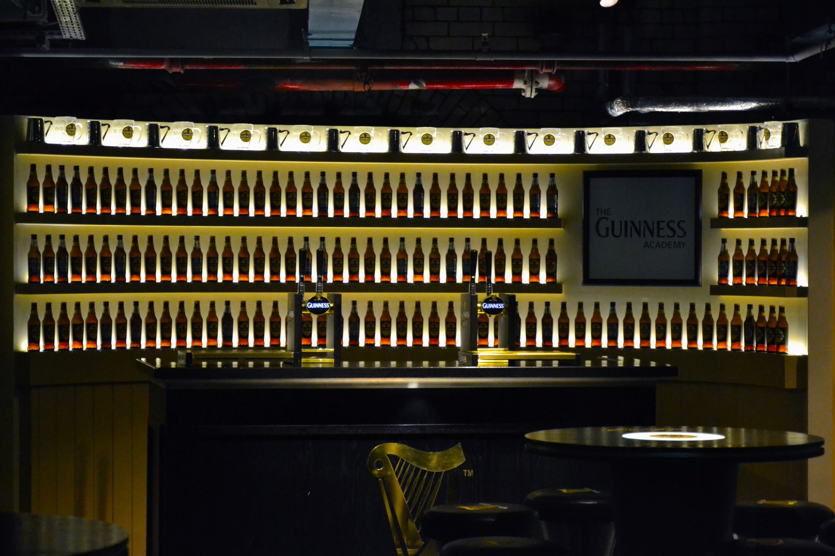

Slide 7
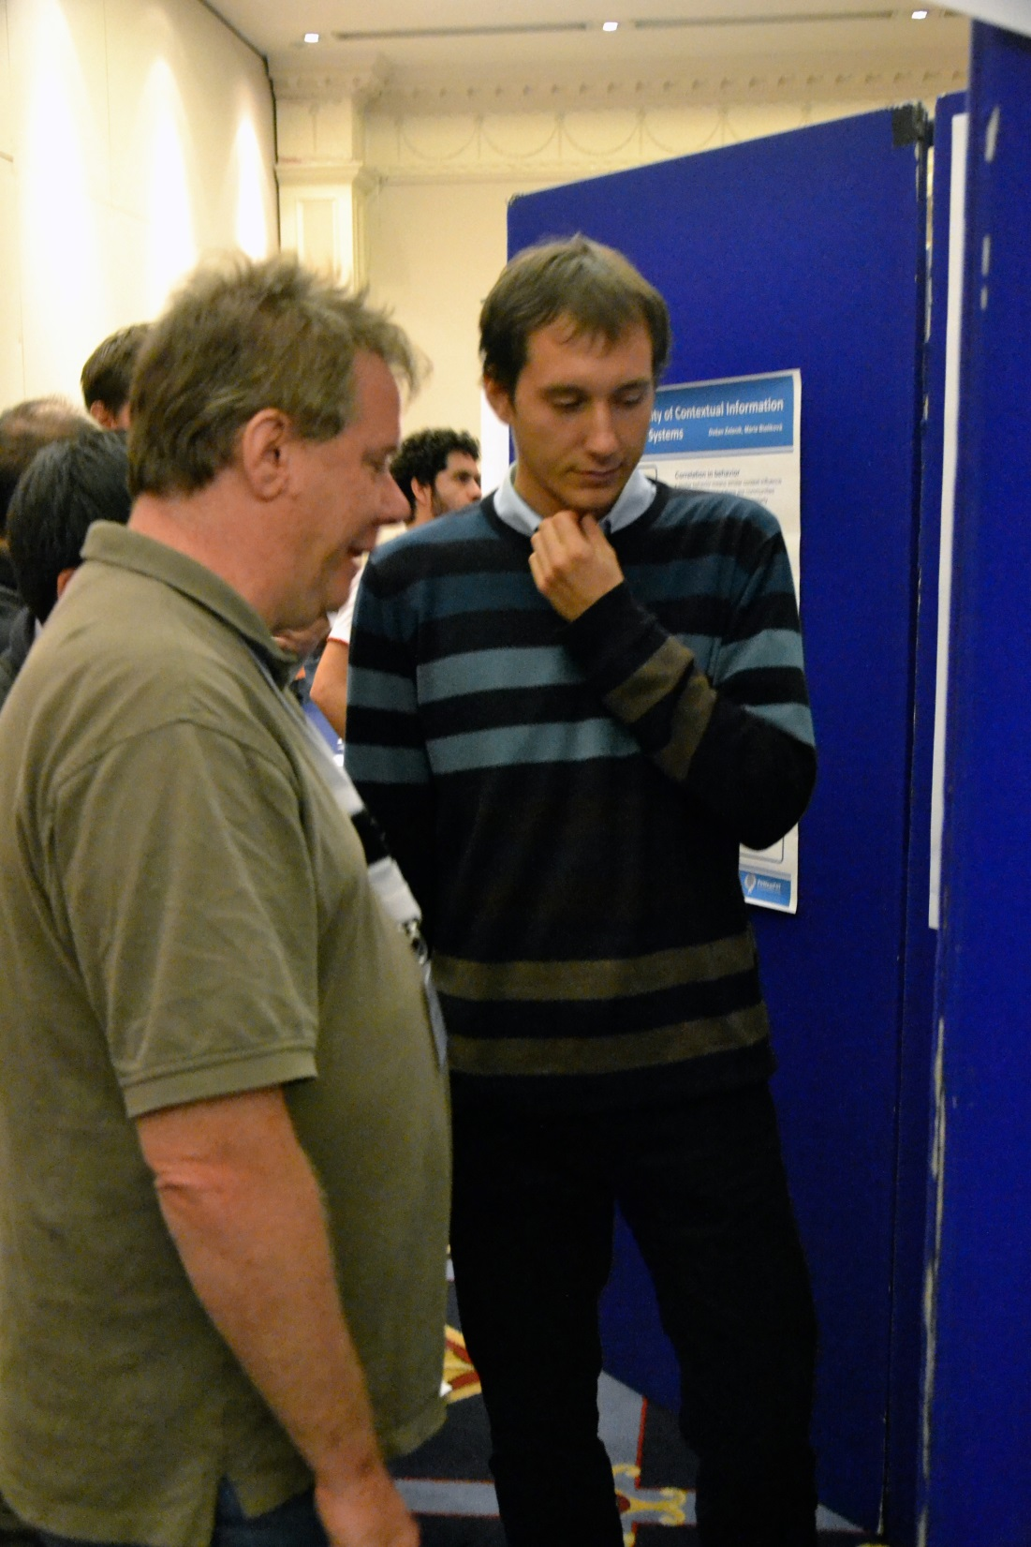
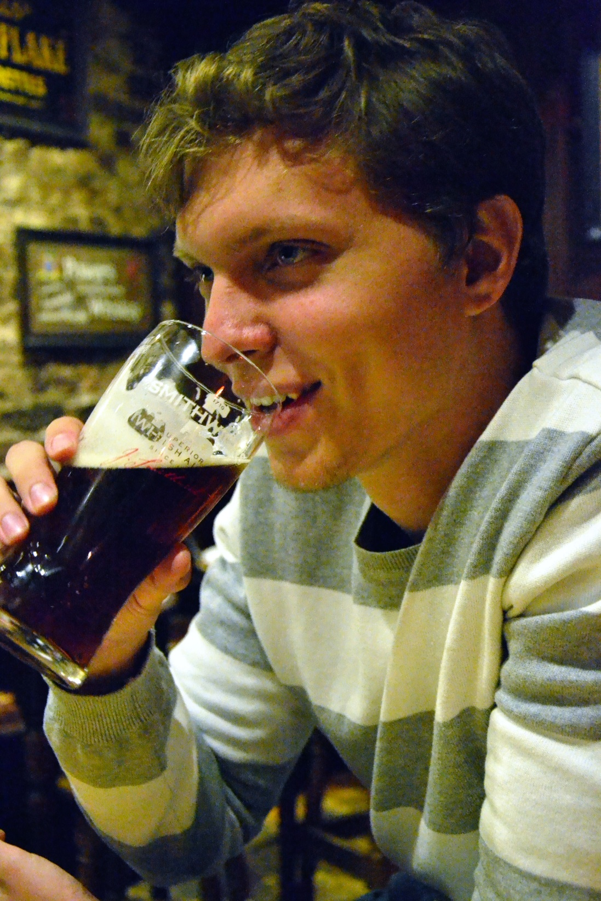

Slide 8
