Slide 1
RECO
Personalizované odporúčanie
ako webová služba
Notes:
Good morning. My name is Jakub Sevcech I am from slovak university of technology and I will tell you about a framework for experimentation with recommender systems we have created.

Slide 2
Problém
Zahltenie používateľov
Narastajúci počet slov, obrázkov, reklám, odkazov (2x od 2003)
„Kvalita“ meraná množstvom
Odporúčanie:
Doménovo závislé
Nutnosť opakovanej implementácie
Proces „objavovania“ parametrov
Využiteľnosť len v rámci jedného systému
Notes:
Common way to solve current information overload is provide recommendations. Whedher it is digital library, electronic shop or education system. The probelm when we want to integrate recommendation into our system is, that we have to closely study domain of recommenders, find out what type of recommendation is best for our domain and implement it. Find the best recommendation type is not problem for experts in the domain of recommender systems, but bor commot programmer, or manager it is simply too difficult. The main problem we are focusing on is recommender evaluation and comarison. Not only from the view of system that want to find best recommedation approach for its domain, but mainly from point of view of researcher, that want to evaluate his new recommendation algorithm and he want to camapre it with another common approaches.

Slide 3
RECO
Rámec pre personalizované odporúčanie umožňujúci vysokú mieru rozšíriteľnosti
Sada nástrojov pre automatizáciu a zjednodušenie experimentovania
Abstrakcia od infraštruktúry
Jednoduchá integrácia do webových sídel
Podpora AB testovania
Notes:
Created framework allows to compose recommender systems from predefined modules and configure them. Create own implementations of modules and use them in configurations. Simply integrate created recommendations into system that will provide them to their consumers. There is possibility to evaluate individual configurations, monitor changing metrics results in time during online expriments, when we change settings. The created system even allows us to compare mulstiple configurations in online experiments.

Slide 4
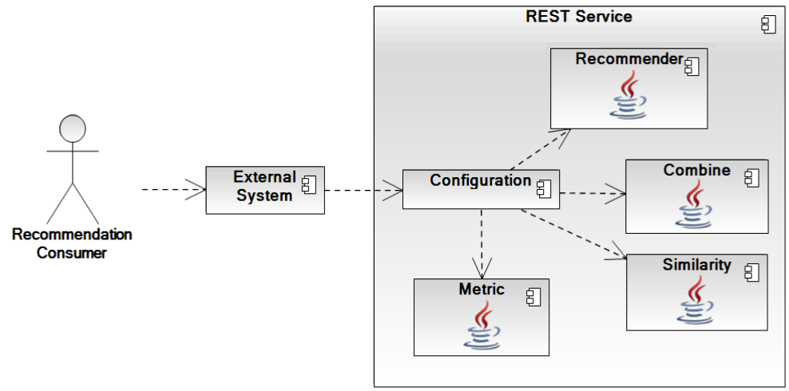
Architektúra
Notes:
The architecture of created system is diplayed on this picture. Every module represents an algorithm implemented in java language. They are composed and configured using one or multiple configurations. These configurations are used in a web service to create recommendations. Recommendations are provided through REST intervace. An external system can use this interface to retrieve recommendations and provide the to its final consumers.

Slide 5
Použitie
Registrácia
Zloženie odporúčača z existujúcich modulov
Import dát
Integrácia
Vytvoriť a zapojiť vlastný modul
Vyhodnocovať pomocou spätnej väzby
Porovnávať cez AB-testing
Notes:
The basic usage scenario for system, that want to integrate recommendation is as follows. First registration is necessary, where unique api key is generated. Then we can dirrectly create configuration from existing modules. We import data and use provided rest api or jquery plugin to integrate recommendations into our system.
Then we want to evaluate our own algorithm so we create implementation of our algorithm in java language and we upload it to the server. We use this implementation in another configuration.
Now we can use this new recommender system that is using our algorithm to provide recommendations for consumers and to evaluate its behavior.
Then we want to compare our new configuration to the first one, that we created from existing modules or whatever different configuration. We conect these two or multiple configurations using AB-testing module.
This module will randomly devide users in groups and for each group it will provide recommendations from different configuration.
For every configuration, you can send back custom types of feddback. For example that user visited document, scrolled in document, purchased item and so on.
Using feedback retrieved from users metric modules will evaluate behavior of all configurations. There are multiple modules for metric computation already implemented and you can create your own if you want to.

Slide 6
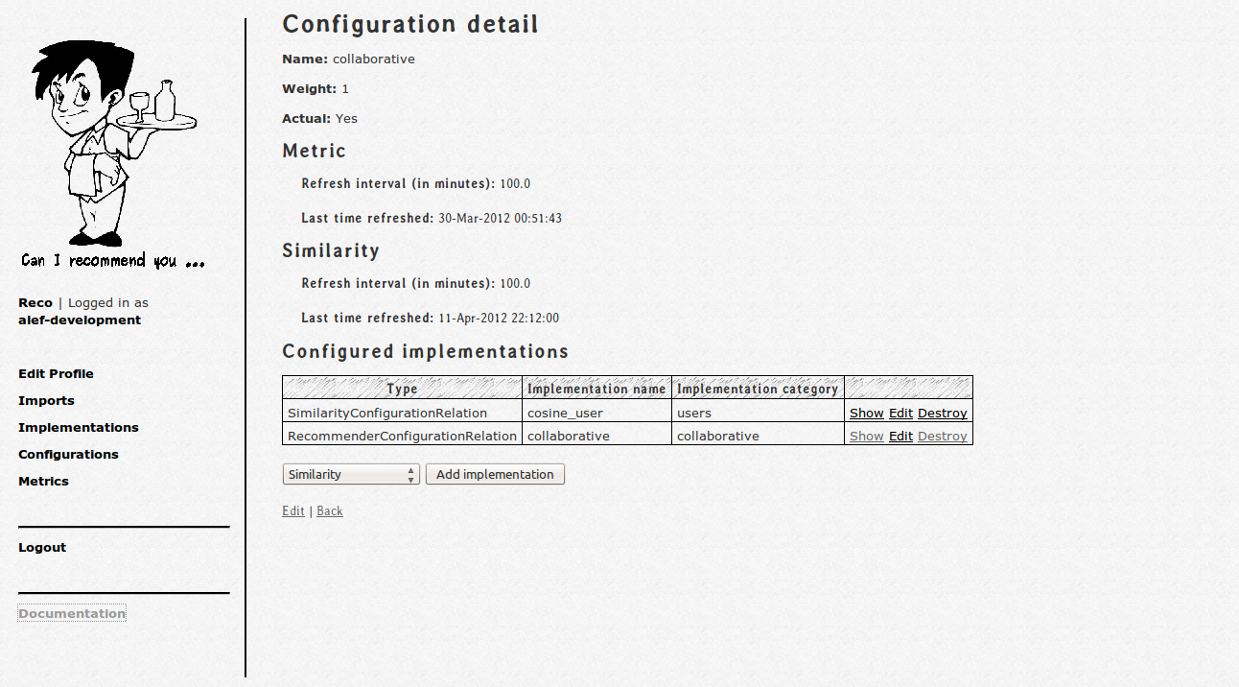
Interface
Notes:
On this screen you can see an example of interface used to create one configuration. On this screen is only the most basic configuration, where only modul for similarity computation an module for recommendation are inserted. Using composition of modules and their configuration, the process of composition of recommender system is very short and when we are using only predefined modules we can create recommender system in minutes.

Slide 7
Ako na to?
Vymysli a implementuj odporúčač
  Zabudované funkcie
  Dátová vrstva
Vytvor .jar súbor
Nahraj ho cez webové rozhranie
Odporúčačaj
Notes:
The process of creataing your own modules is composed of four steps. Implementation of your algorithm in java language. In this step you can use builtin functions such as clustering and you can use data layer to access stored data about users, documents, users actions and so on.
When you have implemented your algorithm, you package it into single file and upload it using web interface and use in configuration.

Slide 8
Integrácia
REST web-service
curl "http://team12-11.ucebne.fiit.stuba.sk/app/api/
recommend.format?apikey=your_apikey&config=configuration_name&user=user_identification"
jQuery plugin
<script type="text/javascript">
jQuery(document).ready(function(){
jQuery("#reco").reco({
apikey: 'your_apikey',
user: 'user_identifiction',
config: 'configuration_name'
});
});
</script>
Notes:
There you can see example of request to rest api and example how to insert recommendations using provided jquery plugin.
As for the rest interface, to retrieve recommendations there is necessery only to call this url with api key, user and configuration specified in parameters. The result is list of recommended documents in the format specified in called url.
When using jquery plugin to insert recommendations into web page, you have to include one javascript file into your page and use a few lines of javascript to specify where you want to isert annotations. Using jquery selector you specify the element, where you want to insert annotations and as parameters you provide user identification, api key and configuration identification. This is all you have to do to integrate recommendations into your web page.

Slide 9
Kontakty
http://team12-11.ucebne.fiit.stuba.sk
kompan@fiit.stuba.sk, sevo_jakub@yahoo.fr

