Slide 1
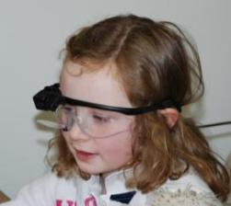
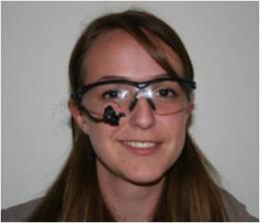
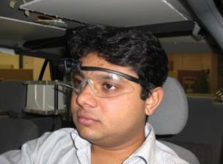
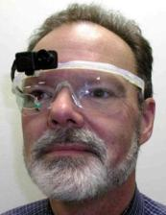
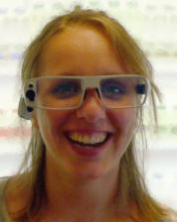
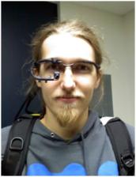
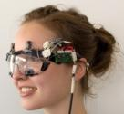
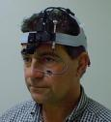
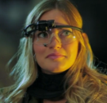
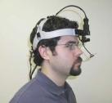
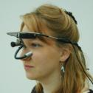



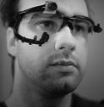
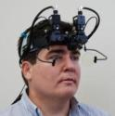
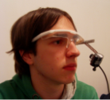



















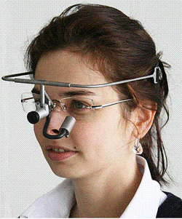






Gaze-Tracked Crowdsourcing
Jakub Šimko, Mária Bieliková
jakub.simko@stuba.sk, maria.bielikova@stuba.sk

Slide 2
We believe that eye-tracking has a future place in crowdsourcing scenarios.

Slide 3
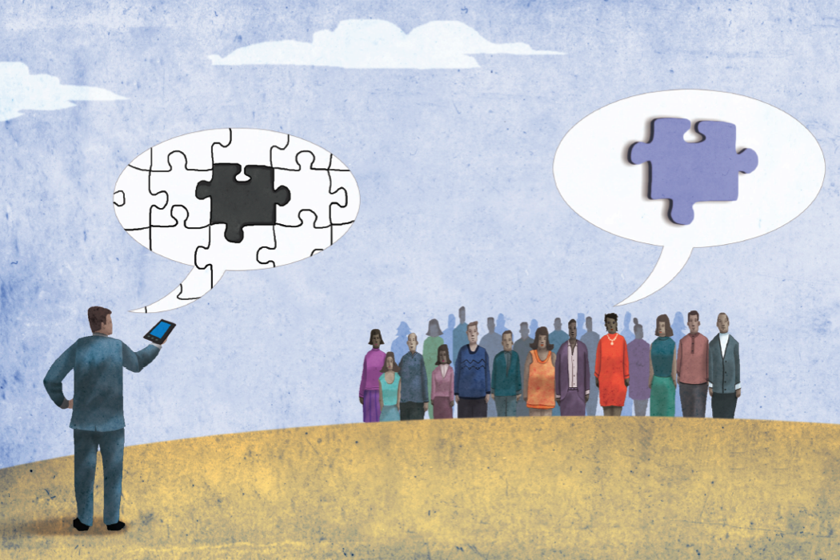
Crowdsourcing means using of a mass of people to solve of a vast task hard for computers

Slide 4


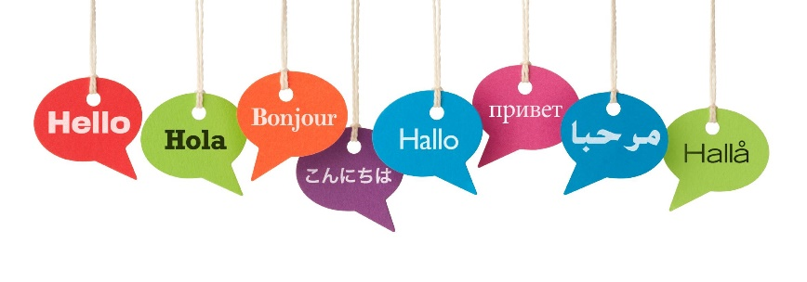

Crowdsourcing is used for variety of tasks
Sunlight
Houses
Acquisition of multimedia metadata
Data verification
Translation
Website testing
…
Street
Bricks

Slide 5
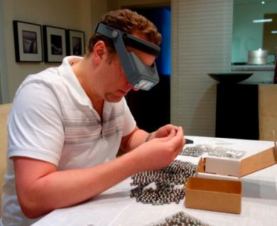
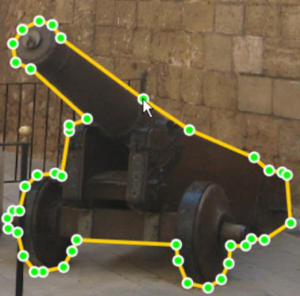
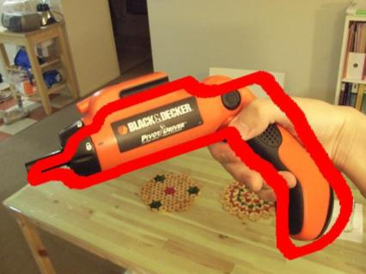

However, crowdsourcing has quality and effectiveness issues
Large number of tasks
Tasks are tedious
Mistakes and impreciseness
(need for redundancy)
Black box problem: The worker observation options are limited.
When do workers concentrate?
What problems they encounter?
What do they consider?
Lack of implicit feedback

Slide 6
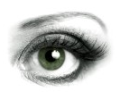
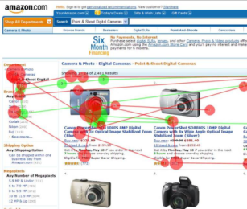
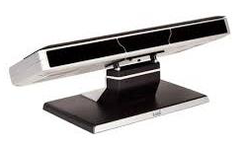
Eye-tracking - a tool for user behavior tracking

Slide 7
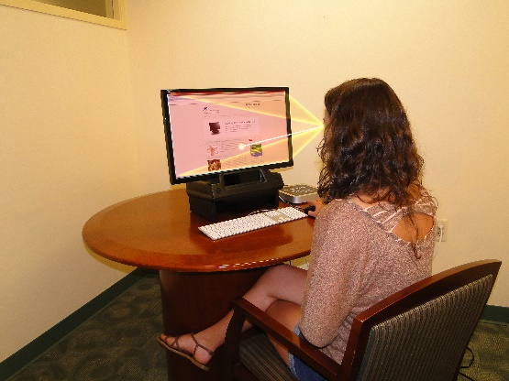
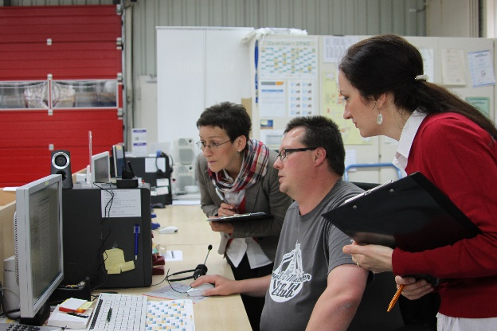
Eye-tracking is traditionally used for UX studies
Manual and qualitative analysis

Slide 8
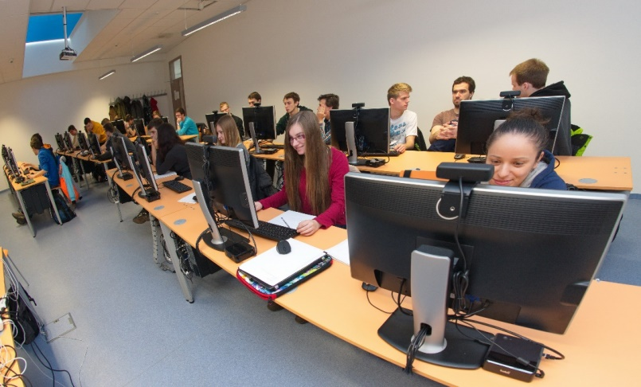

A quantitative potential with eye-trakcing
Much data
20 eye-trackers in one room
(UXI Labs @ Slovak University of Technology)
Requires automated analysis
(research in progress)

Slide 9

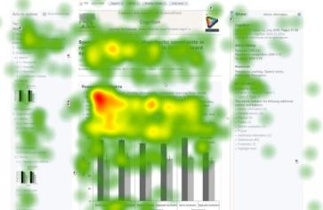


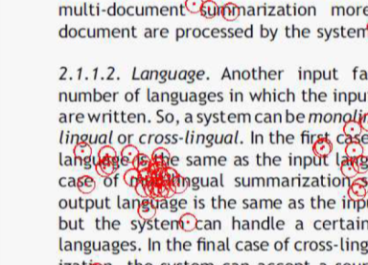

Eye-tracking can pose as ideal implicit feedback source for crowdsourcing
It becomes gradually cheaper
It discloses user focus and problems.
Eye movements manifest user’s mental state* – usable for certainty measures
Was already used in some human computation tasks (e.g. text summarization**)
* Martinez-Gomez (2012) Quantitative Analysis and Inference on Gaze Data Using Natural Language Processing Techniques
**Xu et al. (2009) User-Oriented Document Summarization through Vision-Based Eye-Tracking

Slide 10
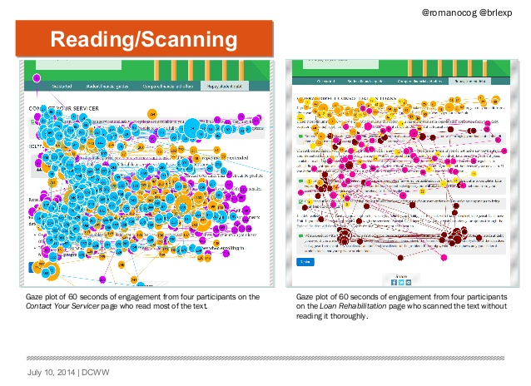
Eye-tracking in crowdsourcing can remove some of the black box problem

Slide 11
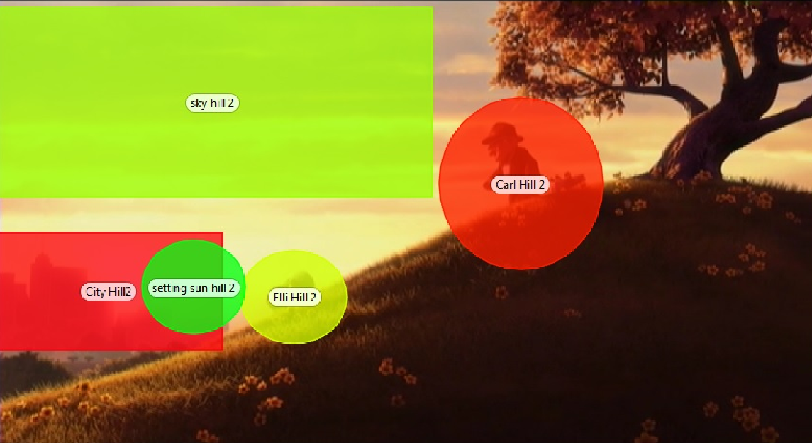
Eye-tracking in crowdsourcing can also gain extra information (e.g. image tagging)
Sky
Carl
City
Sunset
Elli

Slide 12
Study #1:
In word sense disambiguation task, the eye-tracking can identify context determining words

Slide 13
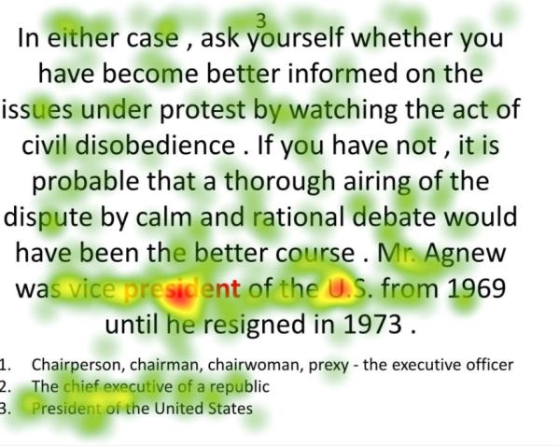
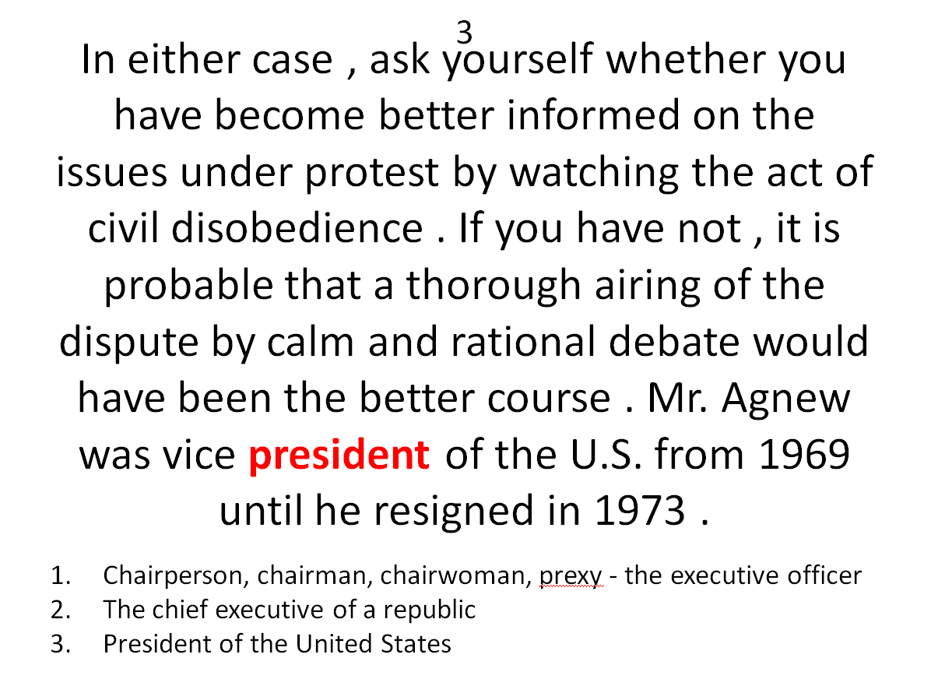
Study #1:
In word sense disambiguation task, the eye-tracking can identify context determining words
A traditional crowd task
(training dataset preparation)
The expectation: important words should trigger behavior changes

Slide 14
Study #1:
We invited people to perform this task under eye-tracking and manually analyzed their behavior
Conclusion: The gaze points to important words and to useful behavioral traits.
5 participants, 10 tasks
In 54% cases the decision was made based on distinguishing word
In 36% cases, the whole text was read (several times when the participant was unsure)

Slide 15
Study #2 (currently underway):
Categorization of documentary movies based on their descriptions
Worker’s task:
View the description of a documentary movie
Pick a primary category for the movie from the list
[Optionally] Pick a secondary category
Hypothesis:
We can discover additional classification information, if we eye-track the workers during the task

Slide 16
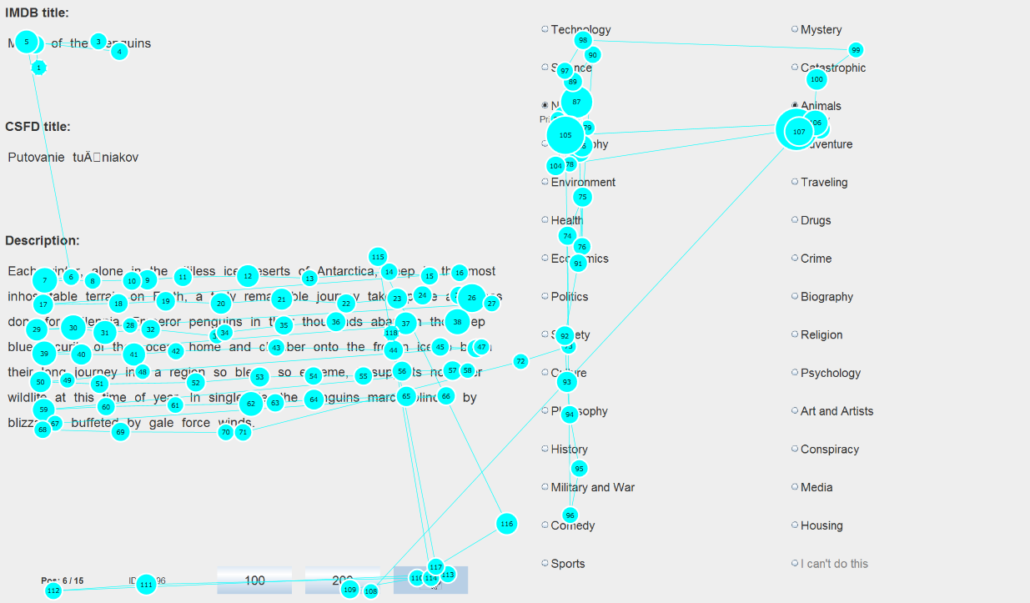
Study #2:
Task user interface with example gaze plot.

Slide 17
Study #2:
Recorded data from preliminary experiment
14 participants
25187 fixations
4681 fixations on categories
9637 fixations on description words

Slide 18
The gaze reveals, what other options the workers considered
Study #2:
Observations
Title:
Picked categories:
Viewed categories:
“Saving rhino phila"
[["animals", 100], ["crime", 50]]
[["traveling", 1150.0], ["geography", 1017.0], ["biography", 500.0], ["health", 400.0], ["animals", 367.0],

Slide 19
Betting mechanism was used to assess the certainty of worker answers (further analysis needed)

Slide 20
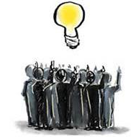
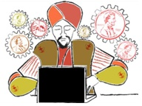
We have observed the potential of additional information gains, when using eye-tracking in crowdsourcing
+
Potential benefits
Open questions
More information gain
Faster task solving
More information on worker confidence
How to systematically modify crowd tasks to eye-tracked ones?
How to classify the approaches?
How to build the infrastructure?

