Slide 1
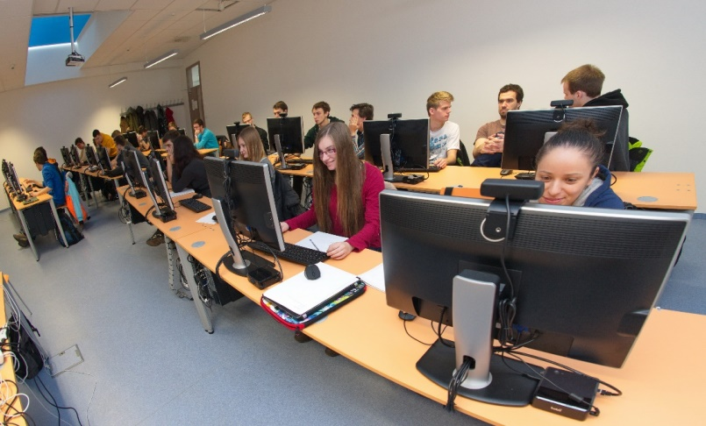
UX Group: Eye-tracking with quantity
Mária Bieliková

Slide 2
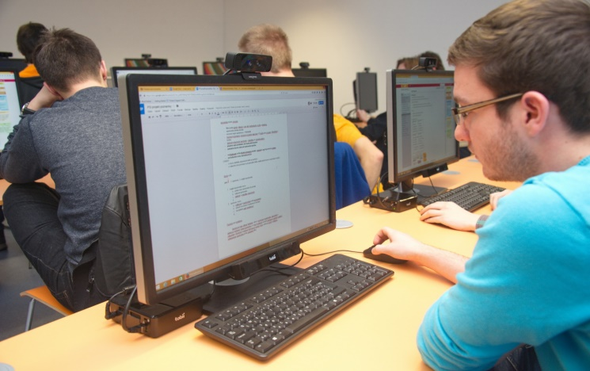
20 eye-trackers in one room (UXI Labs @ Slovak University of Technology)
20x Tobii X2-60 eye trackers
Screen recording
Face recording
+
Infrastructure for transferring all the data to the central server
3D depth camera
60Hz
eyetracker

Slide 3
Mass data collection is excellent for summative studies
Same conditions for every participant
Saving staff time

Slide 4
Group studies need infrastructure software

Slide 5
Our UX Group Research Software
Data collection from all UX nodes
Lifecycle management of user studies projects
Processing of gathered data
Annotations
Cleaning
Export
Archivation

Slide 6
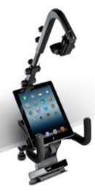
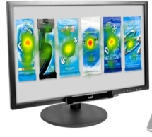
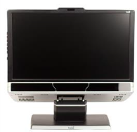
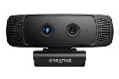
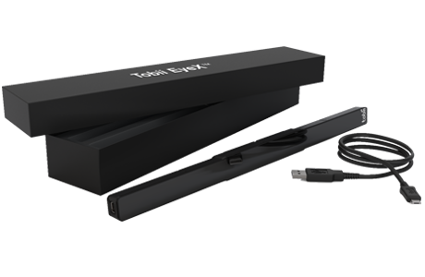
UXI@FIIT = three laboratories
60 Hz mobiles, TV, PC
Control
room
300 Hz PC, EEG, ...
20x 60 Hz gaze tracking PC
10x EyeX Accuracy: Tobii EyeX ≈ Tobii X2-30
Precision: Tobii EyeX < Tobii X2-30

Slide 7
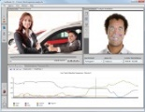
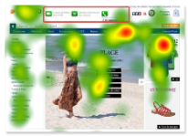
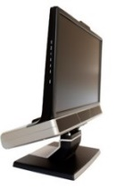
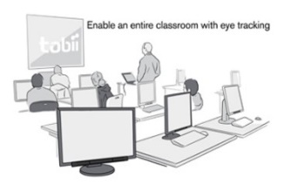
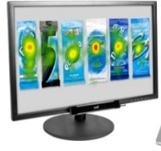
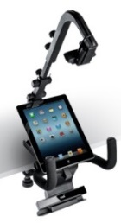
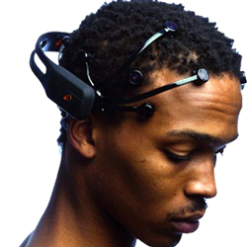
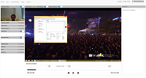
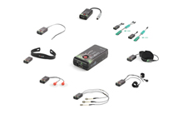
User eXperience and Interaction (UXI) Research Center @ FIIT STU
UX Lab
UX Group
20x
emotion detection
Tobii studio
300 Hz
gaze tracking
3D depth camera
60 Hz gaze tracking
TV
3D depth camera
Emotion detection
EEG
ECG, GSR, FSR, °C
Smartphones, tablets
UX Research infrastructure software

Slide 8
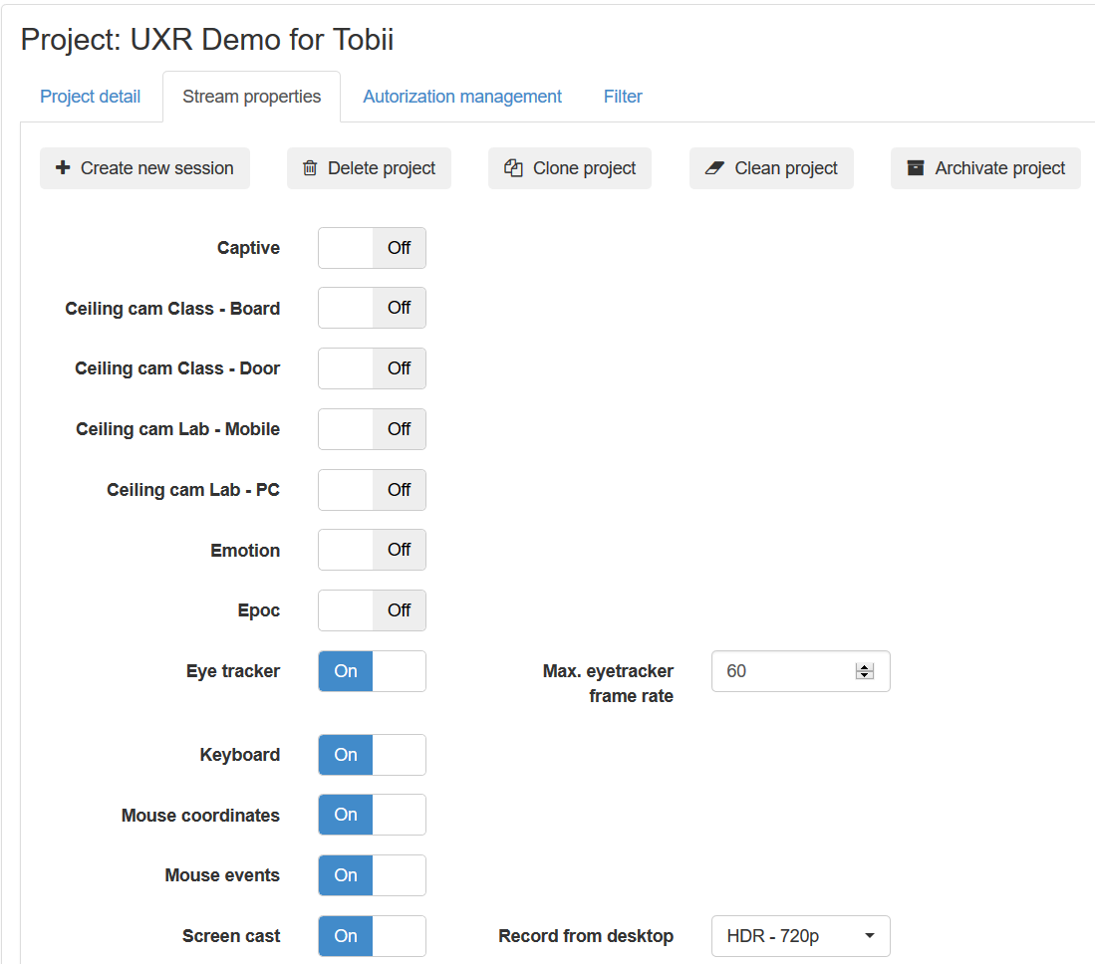
Setup Data Streams

Slide 9
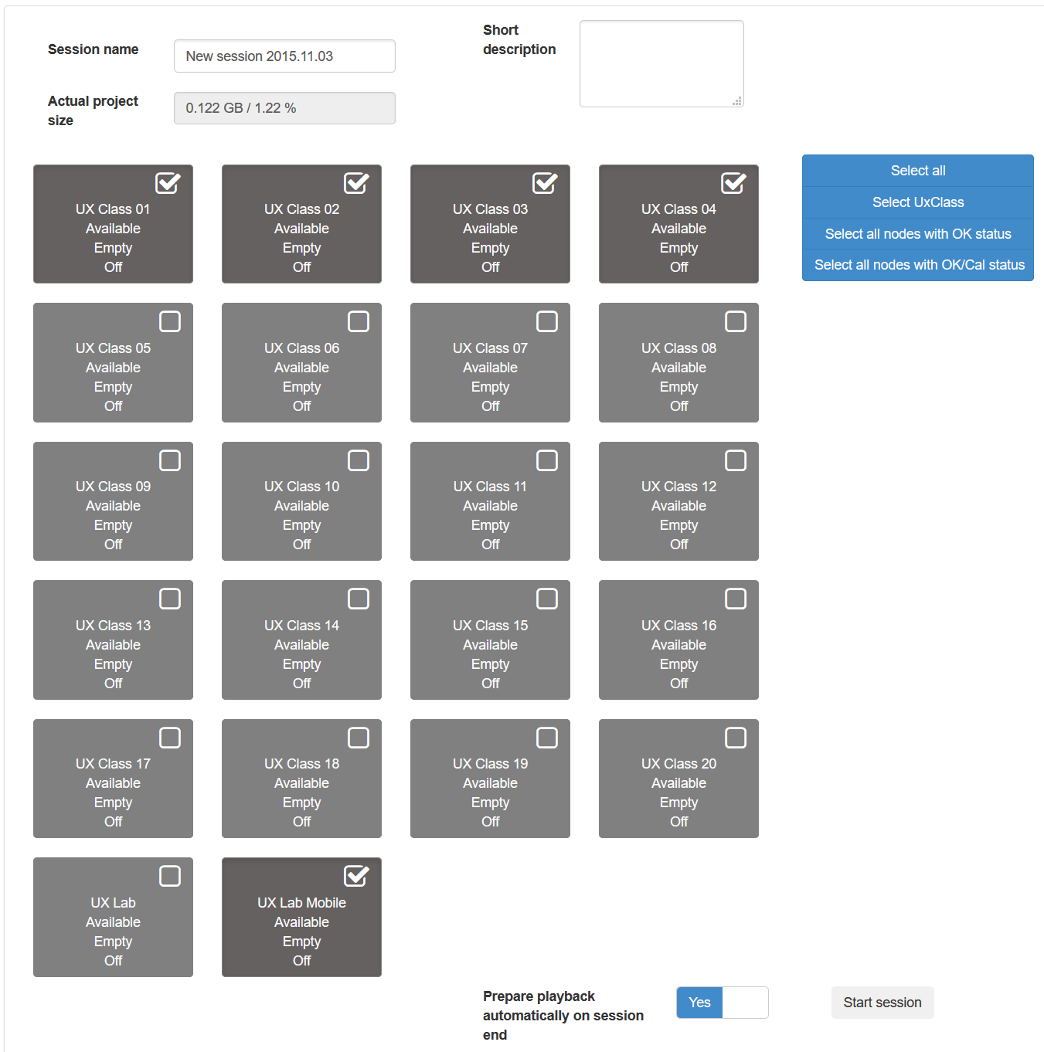
Start Session

Slide 10
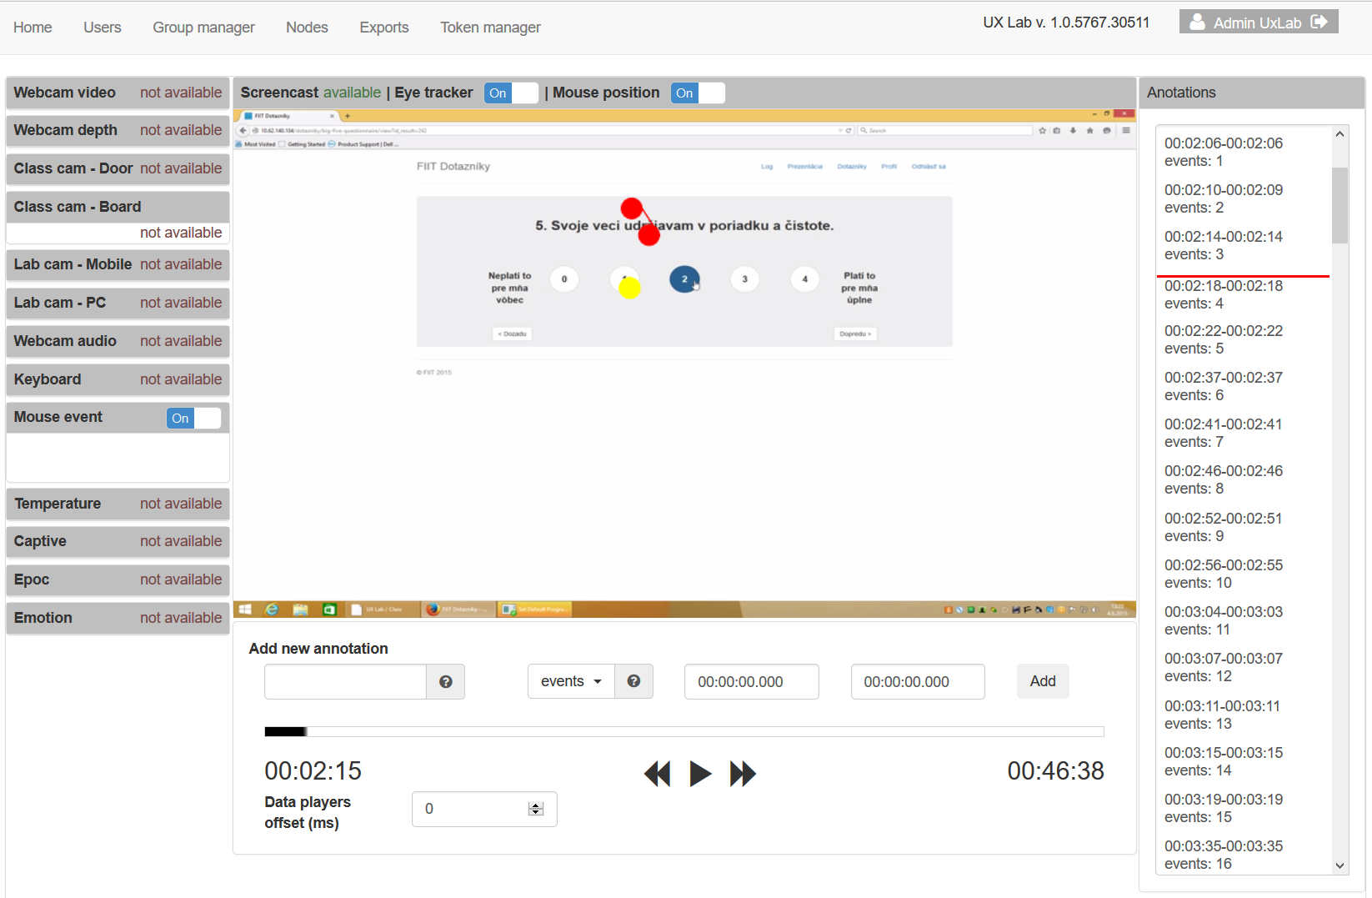
Annotate recorded data

Slide 11
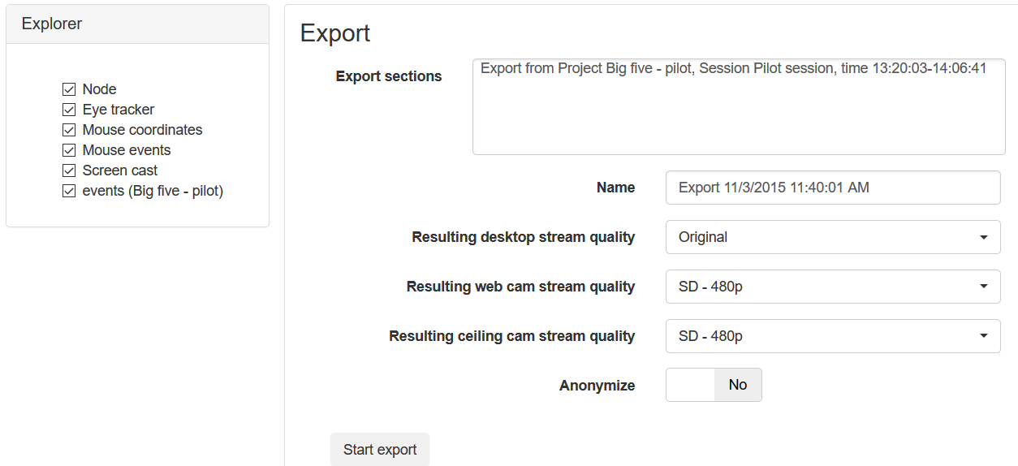
Export recorded data

Slide 12
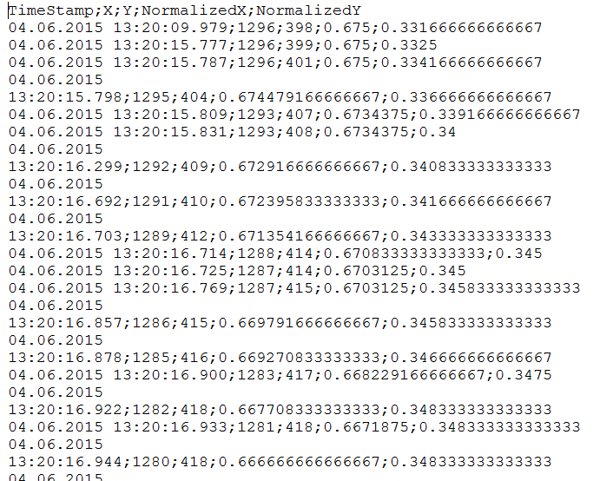
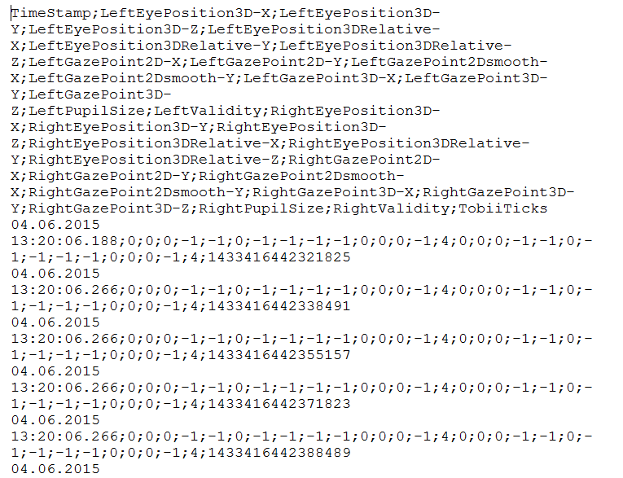
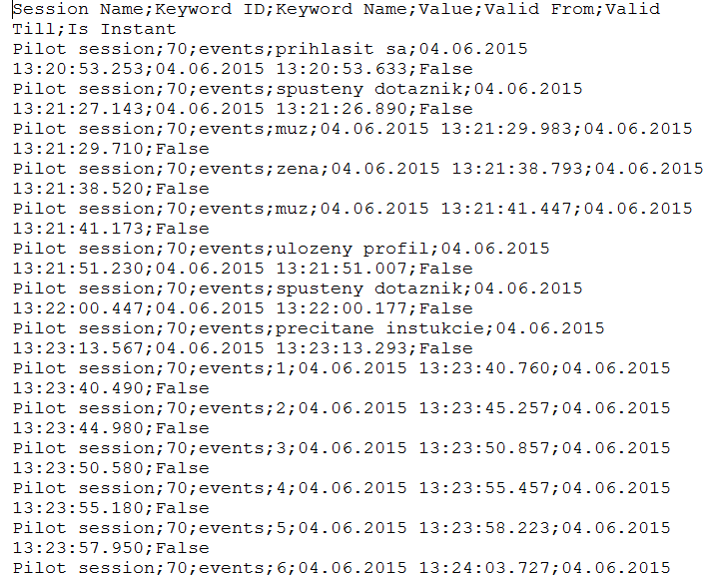
Enjoy your data!

Slide 13
UX Group Lab – first experiences

Slide 14
Twin-experiment (two experiments taken with the same group of 50 participants, ~2,5GB of raw csv data)
Experiment #1:
Crowdsourcing study demonstrating the use of eye-tracking for human computation scenario.
Participants had to categorize of documentary movies based on their descriptions.
Experiment #2:
Questionnaire deception detection using eye-tracking
Participants had to fill out the big five personality trait questionnaire.
Notes:
Up to 20 users at the same time
Eyetracker data for each user
50 people during one day
~2,5GB of raw csv data
Need for data preprocessing

Slide 15
Experiment #1: Crowdsourcing movie categorizations
Participant’s task:
View the description of a documentary movie
Pick a primary category for the movie from the list
[Optionally] Pick a secondary category
Hypothesis:
We can discover additional classification information, if we eye-track the workers during the task

Slide 16
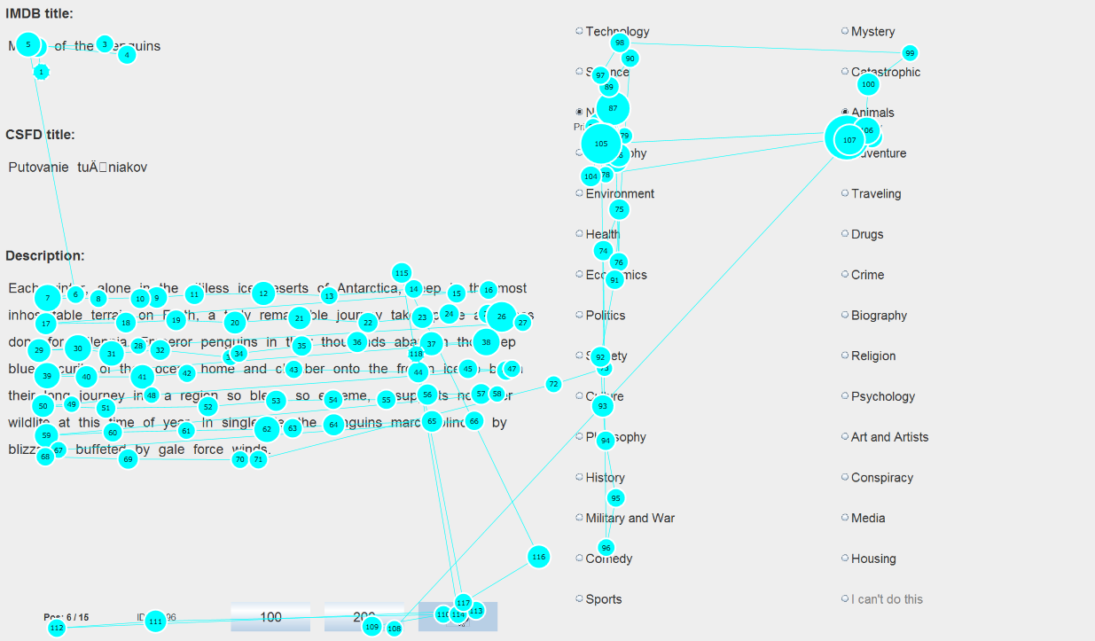
Experiment #1: Task user interface with example gaze plot.

Slide 17
The gaze reveals, what other options the workers considered
Experiment #1: Observations
Title:
Picked categories:
Viewed categories:
“Saving rhino phila"
[["animals", 100], ["crime", 50]]
[["traveling", 1150.0], ["geography", 1017.0], ["biography", 500.0], ["health", 400.0], ["animals", 367.0],

Slide 18
Experiment #2: Questionnaire deception detection
Participant’s task:
Fill out the big five personality trait questionnaire that matches
your personality (respond honestly)
an ideal worker for job position (faking good instruction)
Hypothesis:
We can detect deception by analysis of gaze data
Van Hooft, E.A.J. & Born, M.P. (2012). Intentional response distortion on personality tests: Using eye-tracking to understand response processes when faking. Journal of Applied Psychology, 97(2), 301–316. doi:10.1037/a0025711
Notes:
H1. Používateľ pri správaní, ktoré spôsobuje skresľovanie informácií, zameria svoj pohľad najskôr na extrémne (krajné) odpovede
H2. Klamanie je v danom návrhu experimentu kognitívne menej náročné a teda odpovedanie trvá kratšiu dobu

Slide 19
Experiment #2: Big five personality trait question example

Slide 20
We were looking for fixation order, response times, pupil dilation, first fixation…
Experiment #2: Observations
Deception cases were characteristic by:
First fixations at extreme response options
p = 3.538e-14 < 0.001
Longer reaction times
p = 0.039 < 0.05
Pupil dilation variance before and after answering a question
p = 0.022 < 0.05
Notes:
Z výsledkov môžeme vidieť, že niektoré z metrík sa ukazujú ako štatisticky významné.
Pri prvej fixácii na odpoveď sme sledovali či používateľ po prečítaní otázky zameral svoj pohľad najskôr na krajné odpovede alebo na stredné odpovede. Pri zavádzaní bol pohľad častejšie zameraný na krajné odpovede ako na stredné
Reakčným časom sme merali čas od zobrazenia otázky do jej zodpovedania. Štatisticky pri zavádzaní používateľom trvalo zodpovedanie otázky dlhšie.
Pri priemer zreničky sme sledovali rozdiel medzi primerom zreničky v čase -1200ms a v čase +800ms po zodpovedaní otázky, a štatisticky bol tento rozdiel väčší pri pravdivých odpovediach

Slide 21
Methodological lessons learnt

Slide 22
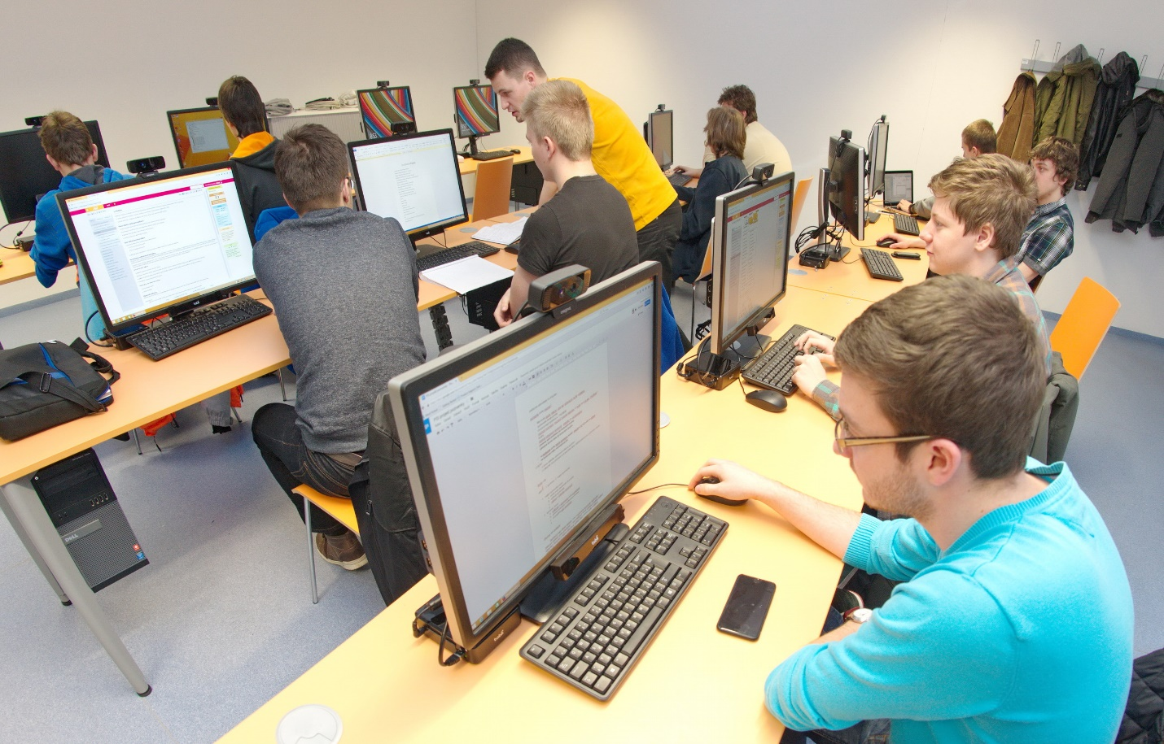
Have some assistants
There were 3 of us: one experiment conductor and two assistants. It was enough for 20 people, but barely.

Slide 23
Do a pilot study with multiple participants, don’t just do it with individuals
If the study has to be parallel recording, do the pilot likewise
Pilot allowed us to properly update instructions
No browser window resizing, no zooming
Make the scenario as simple as possible. The more steps there are, the more mistakes the participants make.
Instructions are crucial
Don’t just use paper instructions, use slides and presentation as well

Slide 24
Group calibration is best done two-step
First, do a presentation (slide) demonstration.
Do not allow participants to do anything during the explanation.
Make them watch you, or they will screw up.
Second, let everyone follow the remembered instruction from the first step.
Watch the calibration status on the dashboard
Attend everyone that raises any problems
3 experiment conductors were enough to handle calibration problems
Notes:
ukazka

Slide 25
Never let participants to do anything during the time you speak to them.
Stress to them the necessity of discipline.
Paper instructions won’t always save you. Participants do not read them properly. Better communicate important things also verbally.

Slide 26
More group studies in preparation

Slide 27
Visual search ability for target findability evaluation
Target:

Slide 31
Join us at FB http://www.facebook.com/groups/UXIsk/

