Slide 1
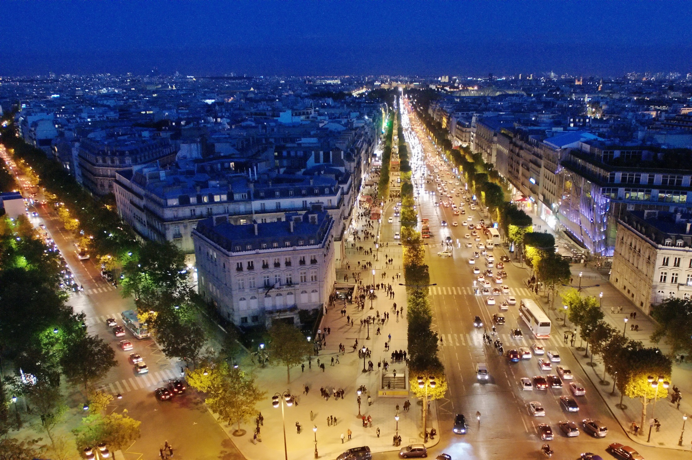
Web Science 2013
Paris, France
May 1-5

Slide 2
Web Science
emergent science of the people, organizations, applications, and of policies
that shape and are shaped by the Web,
the largest informational artifact constructed by humans in history.
Social Sciences vs. Computational Sciences
human behaviour and social interactions vs. data analysis and transformation

Slide 3
Program
Workshops
Keynotes
Papers
Pech Kucha session (20x20)
Posters
and more

Slide 4
SIGACCESS, HiPEAC, SIGDA GLSVLSI,
SIGWEB HyperText
SIGWEB Web Science
Notes:
SIGDA – SIG Design Automation

Slide 5
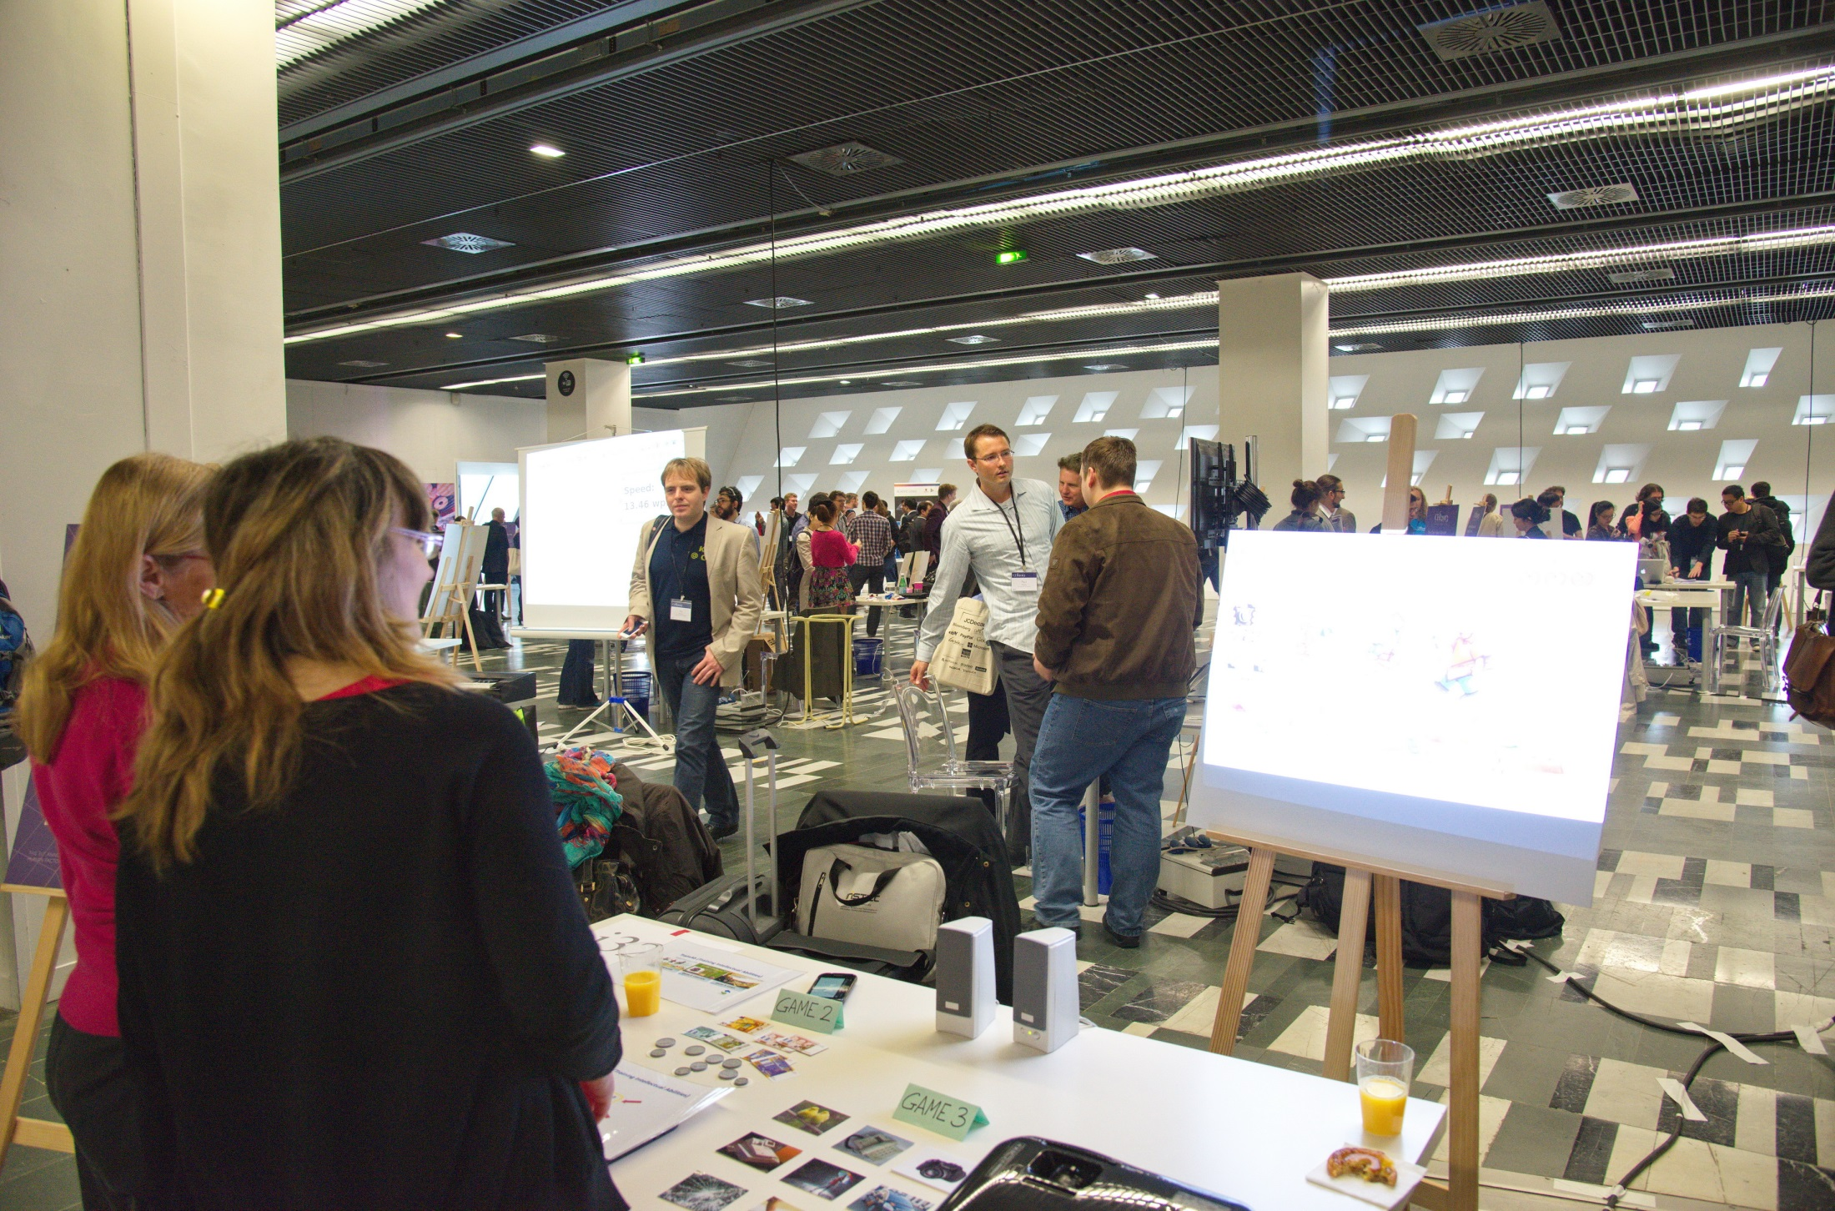
SIG CHI 2013

Slide 6
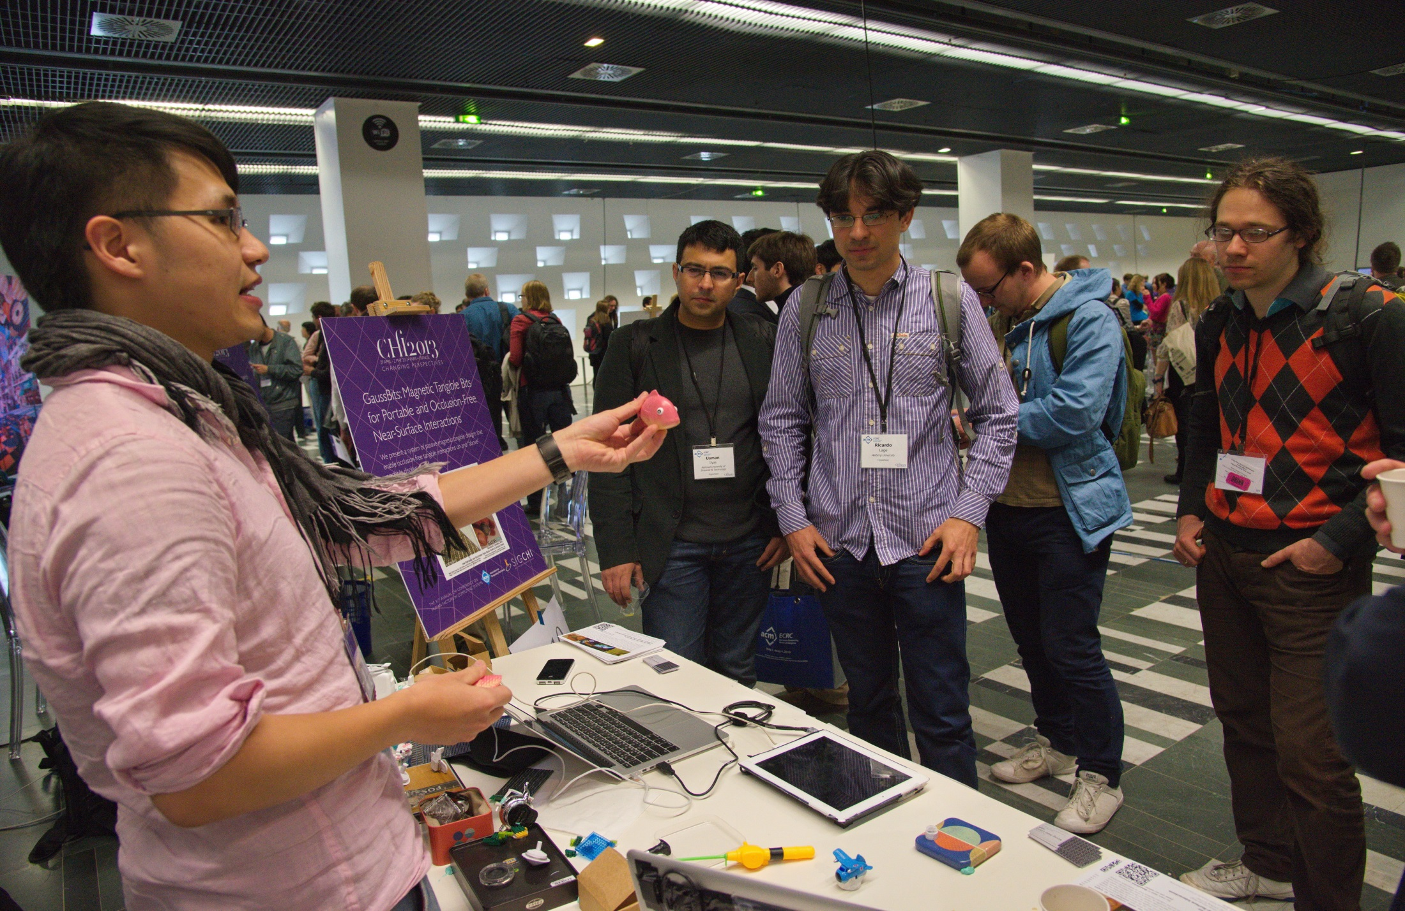
SIG CHI 2013

Slide 7
Building Web Observatories
Observation life cycle
emerging trends
peak interest
long tail
Undesrtanding
collecting, describing
analyzing, modelling, predicting, repeating
The Southampton Web Observatory
http://wow.west.webobservatory.org/ - registry of web science datasets
Rather than sharing the data, share the code for observing

Slide 8
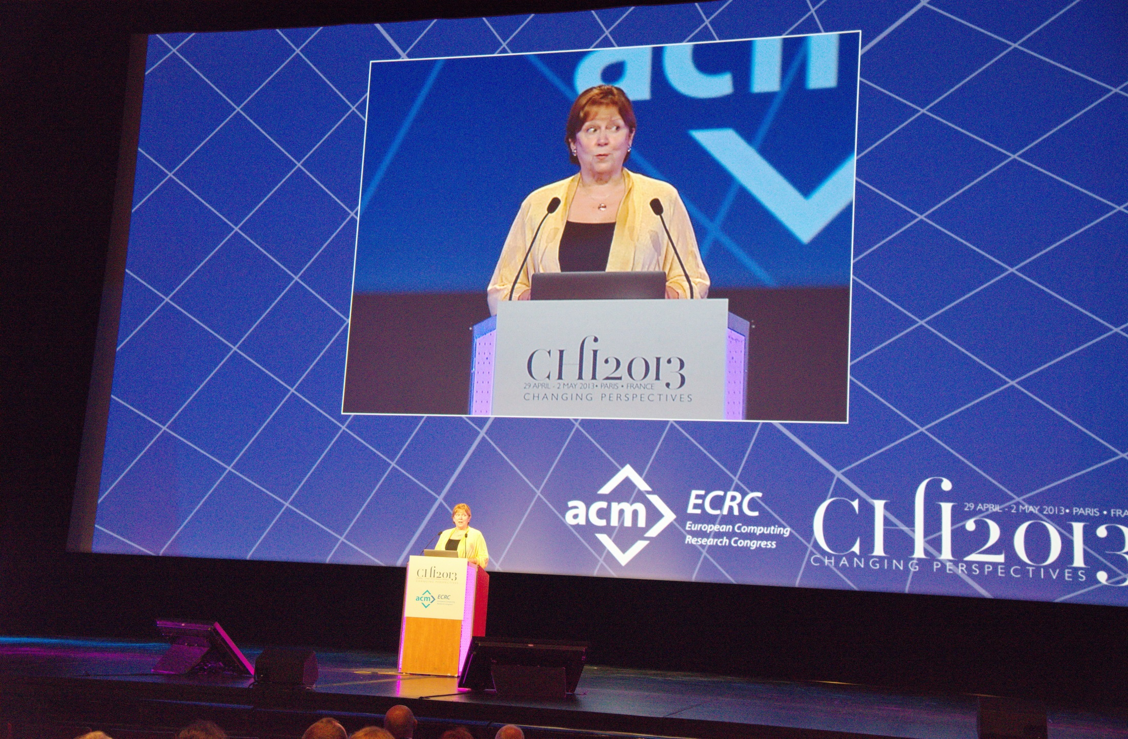

Slide 9
Social Media for Crowdsourcing and Human Computation
Crowd Quality - 1,000 participants on Amazon Mechanical Turk flip a coin and report “h” (heads) or “t” (tails)
65% heads
28% tails
M.Bernstein, 2012
Notes:
Michael Bernstein: Crowd Powered Systems
`If we want to embed this fundamentally human element in our interactive systems, we need to address a couple of challenges. The first is quality. I asked one thousand people online to flip a coin and type “h” if they got heads and “t” if they got tails. In this room, I’m sure we’d get 50-50, but it turns out that on the Internet there’s a 2-to-1 bias towards heads in what people will report. It’s not that the internet is a biased coin, it’s that people are satisficing and exhibit inherent biases.
Hopefully you’ve noticed already that this doesn’t actually add up to 100%. That’s because…
Fully 7% of the respondents didn’t type “h” OR “t”. They went out of vocabulary, sometimes trying to be helpful by writing out the word, sometimes misspelling it: head, heads, tail, t for tails, and the enigmatic “f”.
These are the kinds of unexpected quality results you’ll get when you reach out to crowds, and we’ll need to build our systems to expect or take advantage of them.

Slide 10
Soylent - projects.csail.mit.edu/soylent/
Word processor that recruits crowds to aid complex writing tasks
M. Bernstein et al. Soylent: A Word Processor with a Crowd Inside. UIST 2010.
M.Bernstein, 2012
Notes:
Uses TurKit

Slide 11
30% Rule
~30% of the results in open-ended tasks will be unsatisfactory
M.Bernstein, 2012

Slide 12
Solution: Find-Fix-Verify
Find-Fix-Verify is a design pattern for programming with crowds in open-ended tasks.
Find a problem
Fix the problem
Verify the quality of each fix
Soylent, a prototype...
Soylent, a prototype...
Soylent, a prototype...
Soylent, a prototype...

Slide 13
Find
“Identify at least one area that can be shortened without changing the meaning of the paragraph.”
Independent agreement to identify patches
Fix
“Edit the highlighted section to shorten its length without changing the meaning of the paragraph.”
Soylent, a prototype...
Randomize order of suggestions
Verify
“Choose at least one rewrite that has style errors, and at least one rewrite that changes the meaning of the sentence.”
M.Bernstein, 2012

Slide 14
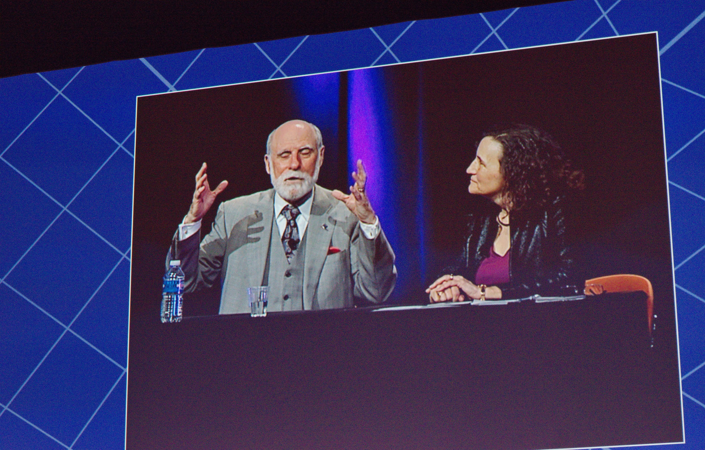

Slide 15
Some interesting presentations
Lora Aroyo, Chris Welty: Harnessing disagreement in crowdsourcing a relation extraction gold standard
annotator disagreement is not noise, but signal; it is not a problem to be overcome, rather it is a source of information that can be used by machine understanding systems
Peter Kraker et al.: Head Start: Improving Academic Literature Search with Overview Visualizations based on Readership Statistics - http://labs.mendeley.com/headstart/
library co-occurrences as a measure of subject similarity
readership statistics provide a good coverage of top publications there is reasonable correlation with the impact factor

Slide 16
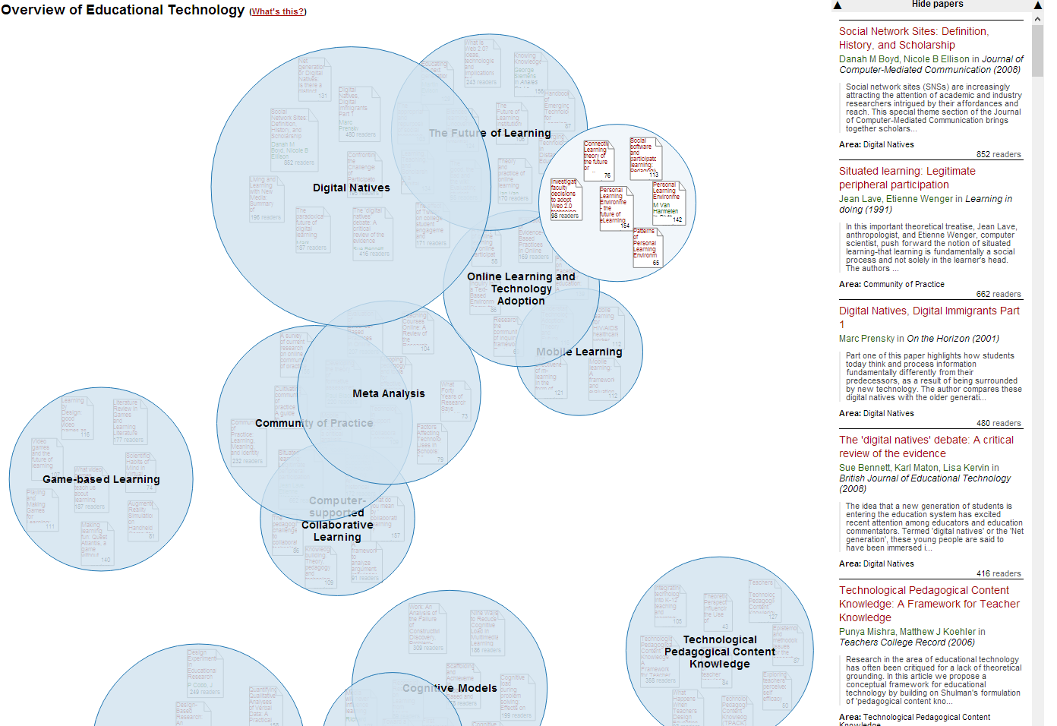

Slide 17
Some interesting presentations (2)
Denny Vrandenic: Wikidata project - www.wikidata.org
free knowledge base that can be read and edited by humans and machines alike
Wikimedia project
zatial skromné, 13 mil. položiek
Robert Sanderson et al.: Designing the W3C Open Annotation Data Model
http://www.openannotation.org/spec/core/

Slide 18
ECRC Panel: Future of Computer Science
Tony Hoare, Robin Milner: Grand Challenges for Research, The Computer Journal Vol. 48 No. 1
ISTAG report (2012) - Software Technologies The Missing Key Enabling Technology
Key Software Technologies
Parallel computing, cloud computing, high performance computing
Building Data Value
Social Computing
Internet base applications and real time services
Embedded systems
Human-centered computing and multimedia

Slide 19
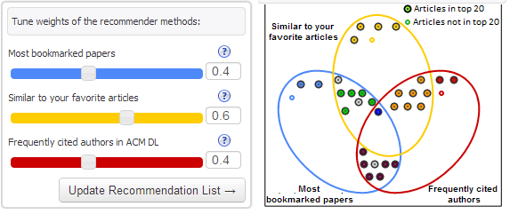
Conference navigator Visual recommender

Slide 20
