Slide 1
Application of Machine Learning for Sequential Data
Peter Uherek

Slide 2
Problem
Data from online editions of daily newspapers or weekly magazines.
Logs of users access to articles
Stream of user activity
Unlabeled data
How to predict popularity of articles in a particular time?

Slide 3
“I've worked all my life in Machine Learning, and I've never seen one algorithm knock over benchmarks like Deep Learning” Andrew Ng

Slide 4
Feature Learning
Set of techniques that learn a transformation of raw data input to a representation that can be effectively exploited in machine learning tasks.
Attempt to automatically learn good features or representation.
Deep Learning
The modern reincarnation of Artificial Neural Network from the 1980s and 90s.
Deep Learning means using a neural network with several layers of nodes between input and output.

Slide 5
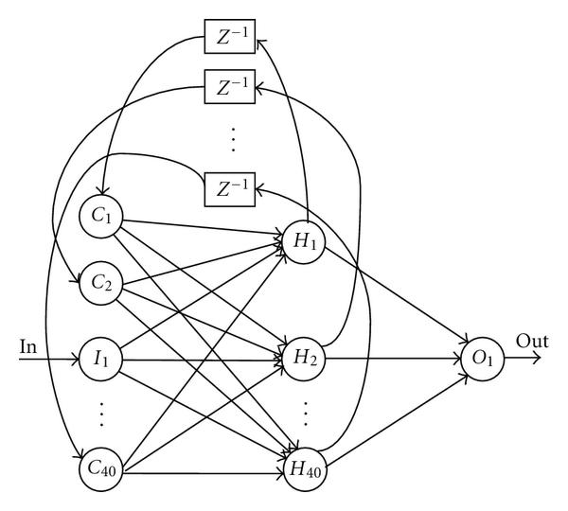
Vision
Predictive model
New representation
Raw Data

Slide 6
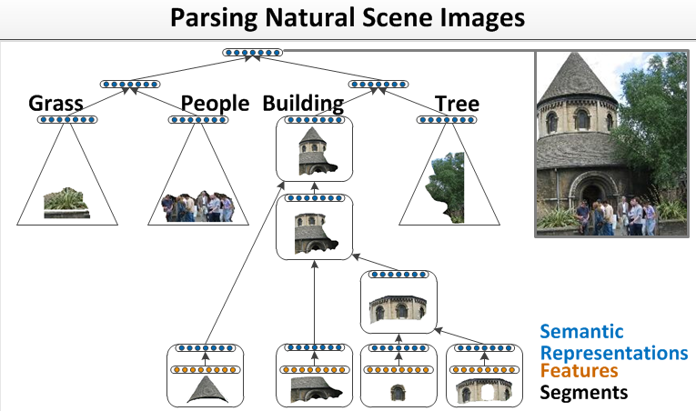
Recursive neural networks
Recursive networks are recurrent networks and the difference between them is not well defined.
Instead of considering tokens sequentially, recursive models combine neighbors based on the recursive structure of the parse trees, starting from the leaves and proceeding recursively in a bottom-up fashion until the root of tree is reached.
RNNs have first been introduced to learn distributed representations of structure, such as logical terms.

Slide 7
Architecture concept
ArticleID
Section
Gender
Age
Day
Hour
Minutes
Article info
User Info
Access info

Slide 8
Architecture concept
ArticleID
Section
Gender
Age
Day
Hour
Minutes
ArticleID
Section
Gender
Age
Day
Hour
Minutes
Article info
User Info
Access info
Article info
User Info
Access info

