Slide 1
Classsourcing: Crowd-Based Validation of Question-Answer Learning Objects
Jakub Šimko, Marián Šimko, Mária Bieliková, Jakub Ševcech, Roman Burger
12.9.2013
jsimko@fiit.stuba.sk
ICCCI ’13

Slide 2
This talk
How can we use crowd of students to reinforce the learning process?
What are the upsides and downsides of using student crowd?
And what are the tricky parts?
Case of a specific method: interactive exercise featuring text answer correctness validation
Notes:
Toto chcem aby odznelo na zaciatku. Chcem hlavne nastolit temu studentskeho crowdu a poukazat na plusy, minusy a uskalia jeho vyuzitia. To vsetko demonstrujuc na nasom otazkovaci.

Slide 3
Using students as a crowd
Cheap (free)
Students can be motivated
The process must benefit them
Secondarily reinforced by teacher’s points
Heterogeneity (in skill, in attitude)
Tricky behavior

Slide 4
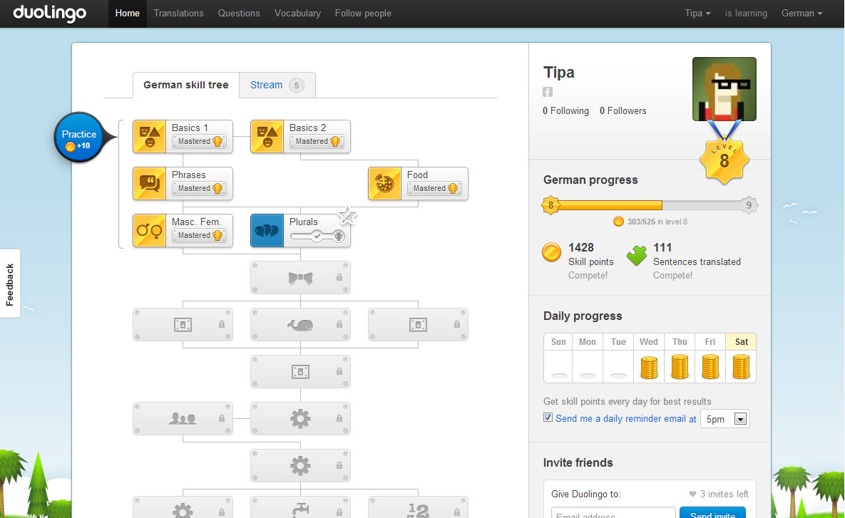
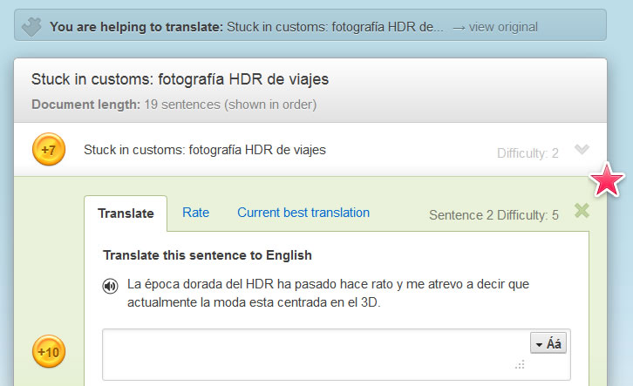
Example 1: Duolingo
Learning language by translating real web
Translations and ratings also support the learning itself

Slide 5
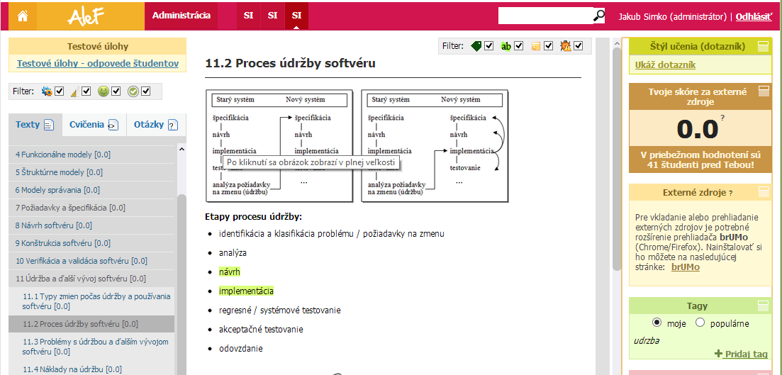
Example 2: ALEF
Adaptive LEarning Framework
Students crowdsourced for highlights, tags, external resources

Slide 6
Our method: motivation
Students like online interactive exercises
Some as a preferred form of learning
Most as self-testing tool (used prior to exams)
… but these are limited
They require manually-created content
Automated evaluation is limited for certain answer types
OK with (multi)choice questions, number results, …
BAD with free text answers, visuals, processes, …
… limited to certain domains of learning content

Slide 7
Method goal
Bring-in interactive online exercise, that
Provides instant feedback to student
Goes beyond knowledge type limits
Is less dependent on manual content creation

Slide 8
Method idea
Instead of answering a question with free text,
student evaluates an existing answer…
The question-answer combination is our
learning object.

Slide 9
… like this:
Notes:
Tu chcem v podstate opisat cely bezny use case (a teda nasledovne slidy budu davat zmysel)

Slide 10
This form of exercise
Uses answers of student origin
Difficult and tricky to be evaluated, thus challenging
Enables to re-use existing answers
Plenty of past exam questions and answers
Plenty of additional exercises done by students
Feedback may be provided
By existing teacher evaluations
By aggregated evaluations of other students (average)

Slide 11
Deployment
Integrated into ALEF learning framework
2 weeks, 200 questions (each 20 answers)
142 students
10 000 collected evaluations
Greedy task assignment
We wanted 16 evaluations for each question-answer (in the end, 465 reached this).
Counter-requirement: one student can’t be assigned with the same question for some time.

Slide 12
Some students are more motivated than others: expect a long tail
Notes:
Tu chcem poukazat na odlisnu motivaciu a mieru usilia clenov crowdu, s ktorou sa velmi neda hybat a treba na to preto pri navrhu akejkolvek ulohy pre studentsky crowd mysliet.
Nejde pritom len o cas straveny riesenim uloh ale aj pristup k ich rieseniu atd.

Slide 13
Crowd evaluation: is the answer correct or wrong?
Our first thought: (having a set of individual evaluations – values between 0 and 1):
Compute average
Split the interval in half
Discretize accordingly
… didn’t work well
“trustful student effect”

Slide 14
Example of a trustful student
True ratio of correct and wrong answers in the data set was 2:1

Slide 15
Example question and answer
Question:
“What is the key benefit of software modeling?”
Seemingly correct answer:
“We use it for communication with customers and developers, to plan, design and outline goals”
Correct answer:
“Creation of a model cost us a fraction of the whole thing”

Slide 16
Interpretation of the crowd
Wrong answer
Correct answer
Correctness computation
Average
Threshold
Uncertainty interval around threshold
0
1
0
1

Slide 17
Evaluation: crowd correctness
We trained threshold (t) and uncertainty interval (ε)
Resulting in precision and “unknown cases” ratios
t | ε = 0.0 | ε = 0.05 | ε = 0.10
0.55 | 79.60 (0.0) | 83.52 (12.44) | 86.88 (20.40)
0.60 | 82.59 (0.0) | 86.44 (11.94) | 88.97 (27.86)
0.65 | 84.58 (0.0) | 87.06 (15.42) | 91.55 (29.35)
0.70 | 80.10 (0.0) | 88.55 (17.41) | 88.89 (37.31)
0.75 | 79.10 (0.0) | 79.62 (21.89) | 86.92 (46.77)

Slide 18
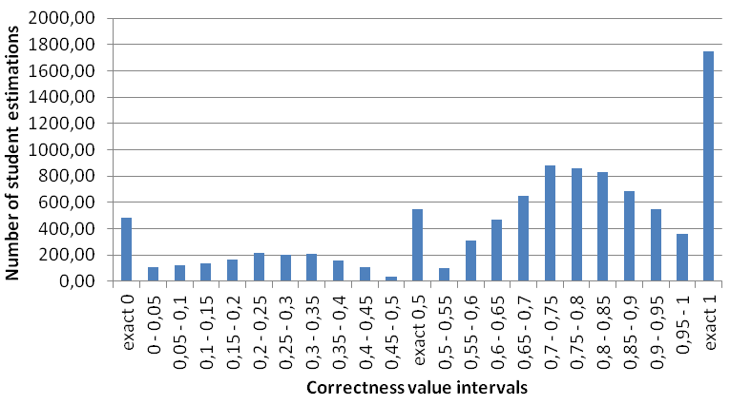
Aggregate distribution of student evaluations to correctness intervals
Notes:
Tu este poukazem na casto extremne odpovede a tiez na moznost spamu (ktory vidno na stlpci uprostred).

Slide 19
Conclusion
Students can work as a cheap crowd, but
They need to feel benefits of their work
They abuse/spam the system, if this benefits them
Be more careful with their results (“trustful student”)
Expect long-tailed student activity distribution
Interactive exercise with immediate feedback, bootstrapped from the crowd
Future work:
Moving towards learning support CQA
Expertise detection (spam detection)

