Slide 1
Harnessing manpower for creating semantics
(doctoral dissertation)
Institute of Informatics and Software Engineering,
Faculty of Informatics and Information Technologies,
Slovak University of Technology in Bratislava
Jakub Šimko
jsimko@fiit.stuba.sk
Supervised by: prof. Mária Bieliková
July 4th, 2013

Slide 2
Thesis overview

Slide 3
Thesis Goals
Create new, GWAP-based approaches to semantics creation, particularly for specific domains
Bring in generally applicable improvements to GWAP design, focusing on selected problems

Slide 4
Semantics acquisition
Semantics needed everywhere
Resource metadata acquisition
  Resource types: texts, multimedia, websites
Domain modelling
  Concept identification, Relationships identification, labelling, Interconnecting of datasets

Slide 5
Semantics acquisition
Automated
Output quantity
Quick
Inexpensive
(once created)
Scalable
[3,4]
Crowdsourcing
Human based
Scalable
No specific problems
We still need to pay
[5,6]
Expensive
Essential for certain
tasks [1,2]
Expert
Output quality

Slide 6
Games with a purpose
Cheap (once they are created)
Difficult to create
Often used for semantics acquisition tasks
[6,7]

Slide 7

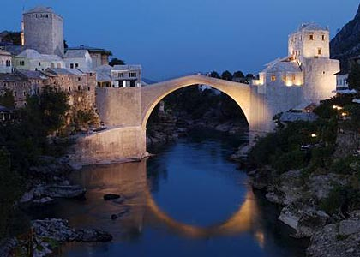

ESP Game: image metadata acquisition
What is in the image?
Player 1:
Player 2:
water
sky
bridge
Mostar
night
river
bridge
Bosnia
The players must blindly match
Banned words: blue, towers
[7]

Slide 8
Our taxonomy of GWAPs

Slide 9
Our GWAP design dimensions

Slide 10
Existing GWAPs in our design space

Slide 11
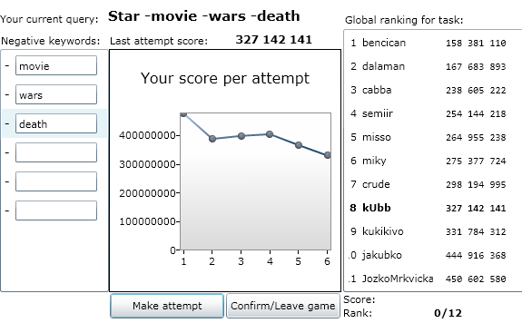
Little Search Game (negative search game)
Search query: „Star –movie –war –death“
Result number decrease = points
Logs processed to term network

Slide 12
LSG evaluation: term network soudness
Recorded data
300 players
27200 queries
3200 suggested rels.
400 nodes, 560 edges
Method
A posteriori
Group of judges
H: term-term relationship is sound
Results
91% correctness

Slide 13
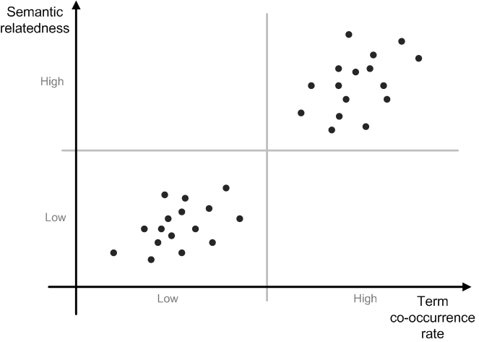
Hidden term relationships

Slide 14
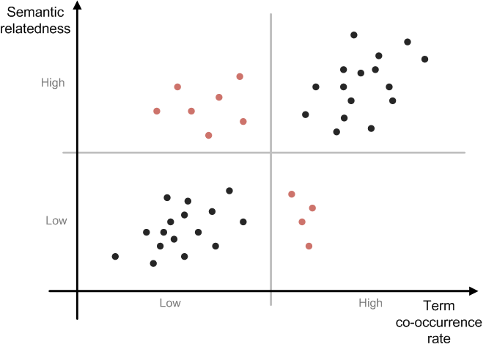
Hidden term relationships – reality

Slide 15
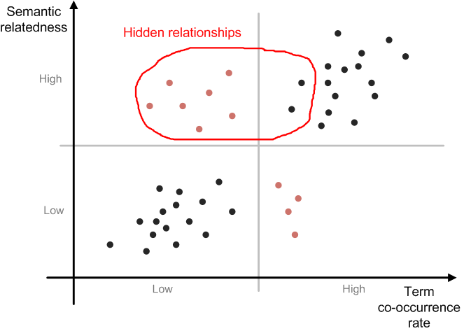
Hidden term relationships – reality

Slide 16
LSG evaluation: hidden relationships
Data
400 nodes, 560 edges
Most used word lists: 800, 5000, 50000
Web search index (Bing)
Method
Co-occurrence of terms in LSG rels.
Co-occurrence of random term pairs
Noise level indentification
Results
Medium sized corpus
  Noise level: 0.35
  Hidden relationship ratio: 40%

Slide 17
PexAce: image annotation game

Slide 18
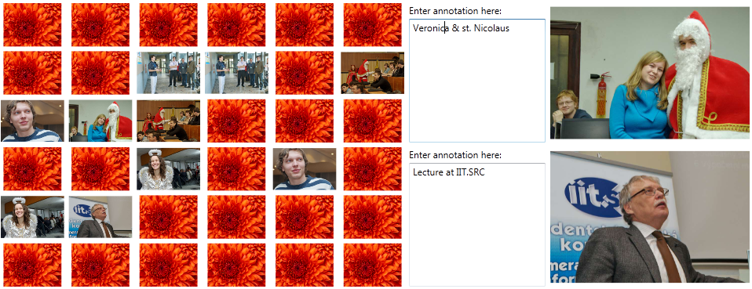
PexAce: image annotation
Annotations
Currently disclosed pair

Slide 19
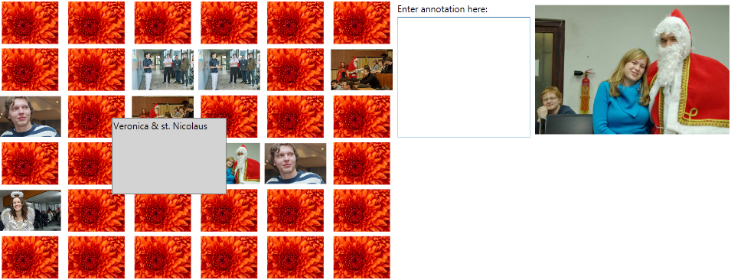
PexAce: image annotation
Annotation “tooltip”

Slide 20
General domain: Deployment
Corel 5K dataset: photos + tags + our tags
107 players, 814 games, 2 792 images
22 176 annotations, 5 723 tags
Golden standard comparison
  Precision 73% and Recall 26%
Aposteriori evaluation
  3 independent judges
  94% of tags was correct

Slide 21
Personal images
What if we change the image corpus to personal albums?
  Players like that more
  They provide specific annotations (metadata)
Potential problem? Validation
  We can hardly apply cross-player validation of tags

Slide 22
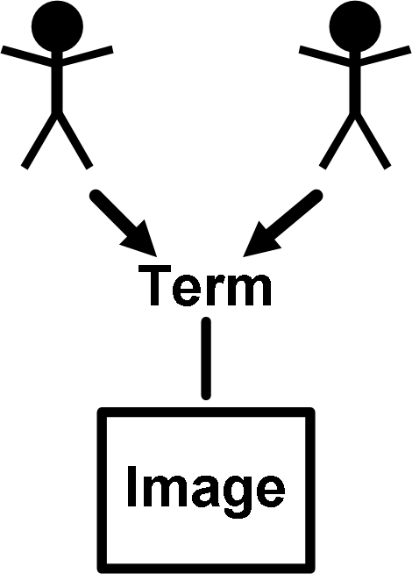


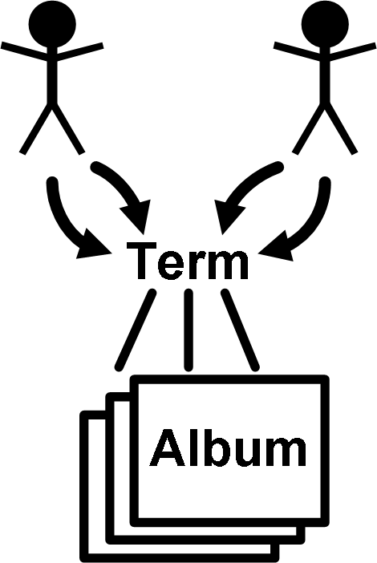
„Benevolent“ artifact validation model
Annotations decomposed to votes:
P - players, T- terms, I - Images
Original mutual player supervision
Less strict heuristics

Slide 23
Personal images: Experiments
Two social groups in each:
  2 players, 1 judge
  A set of 48 images in albums
    Portraits, Groups, Situational and Non-person (other)
  One group was aware of the purpose, the other was not
Each player played 3 games
Each image was featured twice for a single player
Measured properties of tags
  Correctness
  Specificity
  Understandability
  Type of tag (person, event, place, other)

Slide 24
Personal images: Experiments
 | Aware (253 tags) |  |  | Unaware (108 tags)
 | Corr. | Spec. | Und. | Corr. | Spec. | Und.
Portraits | 0.98 | 0.61 | 0.71 | 0.77 | 0.53 | 0.87
Groups | 0.97 | 0.57 | 0.74 | 0.76 | 0.45 | 1.00
Situations | 0.92 | 0.41 | 0.77 | 0.93 | 0.19 | 1.00
Other | 0.98 | 0.18 | 0.82 | 0.88 | 0.15 | 1.00
Average | 0.96 | 0.44 | 0.76 | 0.84 | 0.33 | 0.97
Other (11%)
Persons (56%)
Places (14%)
Events (21%)

Slide 25
Artifact validation and cold start problem
„How can a result of a human intelligence task be automatically evaluated?“
GWAPs use:
  Mutual player supervision
  Approximative or exact automated evaluation (case dependent)
Threat to multiplayer validation schemes:
‘’The requirement is to have multiple players online at the same time, sometimes with a requirement that they cannot communicate.”
Keep the games single-player

Slide 26
Helper artifacts: a new artifact validation principle
Helper artifacts:
  Decouple scoring from task solving, instead motivate players to solve tasks to help themselves in the progress of the game
  E.g. in PexAce, a player may win the game well enough even without the annotations

Slide 27
GWAP player competences
Quantify player skills – player model
(e.g. player’s expertise for each sub-domain)
Apply model in
  Solution filtering
  (e.g. vote weighting)
  Task assignment
  (e.g. match task subdomain to expertise areas)
Speed up the process or/and retrieve higher quality results

Slide 28
PexAce dataset:
Usefulness (delivery of correct artifacts)
Consensus ratio (agreement with other players)
Correlation: 0.496

Slide 29
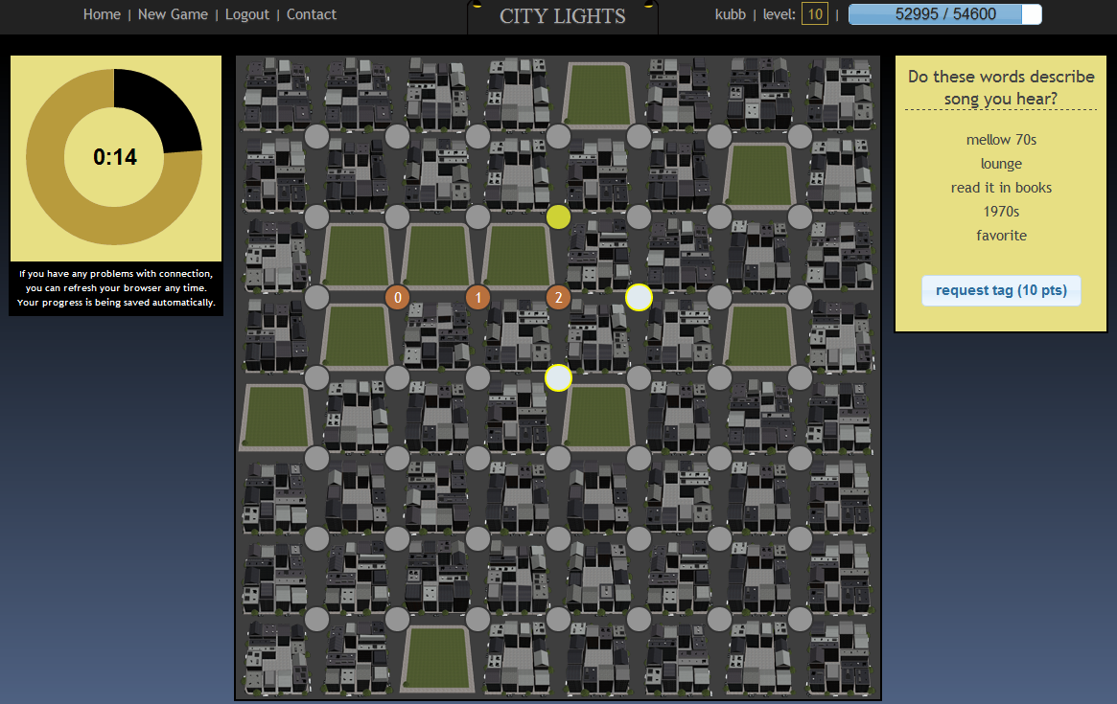
CityLights: music tag validation
Validation question:
“Which of these tag groups characterizes the music track you hear?”
Rockabilly, USA, 60ties
Seasonal, rich oldies, xmas
February 08 love, oldies, 60 musik
Tag support value:
+ increases
+ player selects the group
decreases
- p. doesn’t select the group
- player rules out the tag
Wrong and correct tags bubble out
Possitive and negative thresholds

Slide 30
CityLights: experiments
LastFM datasets
875 games, 4933 questions, 1492 tags
Feedback actions per tag:
  17.75 implicit
  5.29 explicit
Optimized parameter configuration
  68% correctness, 51% confidence
  no false negatives

Slide 31
Competence through confidence
Betting mechanism within a GWAP
Through bet height, the player expresses his confidence
CityLights case: bet height aligns with impact on support value
Good for new players, about which no confidence model is yet known

Slide 32
Harnessing manpower for creating semantics

Slide 33
References
J. A. Gulla and V. Sugumaran. Aninteractive ontology learning workbench for non-experts. In Proceedings of the 2nd international workshop on Ontologies and information systems for the semantic web, ONISW ’08, pages 9–16, New York, NY, USA, 2008. ACM.
K. Maleewong, C. Anutariya, and V. Wuwongse. A semantic argumentation approach to collaborative ontology engineering. In Proceedings of the 11th International Conference on Information Integration and Web-based Applications & Services, iiWAS ’09, pages 56–63, New York, NY, USA, 2009. ACM.
L. Mcdowell and M. Cafarella. Ontology-driven, unsupervised instance population. Web Semantics: Science, Services and Agents on the World Wide Web, 6(3):218–236, Sept. 2008.
M. Jačala and J. Tvarožek. Named entity disambiguation based on explicit semantics. In Proc. of the 38th int. conf. on Current Trends in Theory and Practice of Computer Science, SOFSEM’12, pages 456–466, Berlin, Heidelberg, 2012. Springer-Verlag.
M. Sabou, K. Bontcheva, and A. Scharl. Crowdsourcing research opportunities: lessons from natural language processing. In Proceedings of the 12th International Conference on Knowledge Management andKnowledge Technologies, i-KNOW ’12, pages 17:1–17:8, New York, NY, USA, 2012. ACM.
A. J. Quinn and B. B. Bederson. Human computation: a survey and taxonomy of a growing field. In Proceedings of the SIGCHI Conference on Human Factors in Computing Systems, CHI ’11, pages 1403–1412, New York, NY, USA, 2011. ACM.
L. von Ahn and L. Dabbish. Designing games with a purpose. Commun. ACM, 51(8):58–67, 2008.

Slide 34
Selected publications
Šimko, Jakub - Tvarožek, Michal - Bieliková, Mária: Semantics Discovery via Human Computation Games. In: International Journal on Semantic Web and Information Systems. - ISSN 1552-6283. - Vol. 7, No. 3 (2011), s. 23-45
Šimko, J., Tvarožek, M., Bieliková, M. Human Computation: Single-player Annotation Game for Image Metadata. International Journal on Human-Computer Studies. [accepted].
Dulačka, Peter - Šimko, Jakub - Bieliková, Mária: Validation of Music Metadata via Game with a Purpose. In: I-Semantics 2012 Proceedings of the 8th International Conference on Semantic Systems 5th - 7th of September 2012Graz, Austria. - New York : ACM, 2012. - ISBN 978-1-4503-1112-0. - S. 177-180
Šimko, Jakub - Bieliková, Mária: Games with a Purpose: User Generated Valid Metadata for Personal Archives. In: SMAP 2011 : Proceedings of Sixth International Workshop on Semantic Media Adaptation and Personalization SMAP 2011, 1-2 December 2011 Vigo, Pontevedra, Spain. - Los Alamitos : IEEE Computer Society, 2011. - ISBN 978-0-7695-4524-0. - S. 45-50
Šimko, Jakub - Tvarožek, Michal - Bieliková, Mária: Little Search Game: Term Network Acquisition via a Human Computation Game. In: HT 2011 : Proceedings of the 22nd ACM Conference on Hypertext and Hypermedia June 6-9, 2011 Eindhoven, The Netherlands. - New York : ACM, 2011. - ISBN 978-1-4503-0256-2. - S. 57-61
Šimko, Jakub - Bieliková, Mária: Personal Image Tagging: a Game-based Approach. In: I-Semantics 2012 Proceedings of the 8th International Conference on Semantic Systems 5th - 7th of September 2012Graz, Austria. - New York : ACM, 2012. - ISBN 978-1-4503-1112-0. - S. 88-93

Slide 35
LSG evaluation: relationship types
Data
400 nodes, 560 edges
ConceptNet lightweight dataset
Method
Identify relationship types
  A posteriori (2 judges)
  Reference dataset
Results
Not all LSG relationships were present in ConceptNet
Dominant rel. types:
  Unlabelled ,hasProperty, hasA, atLocation

Slide 36
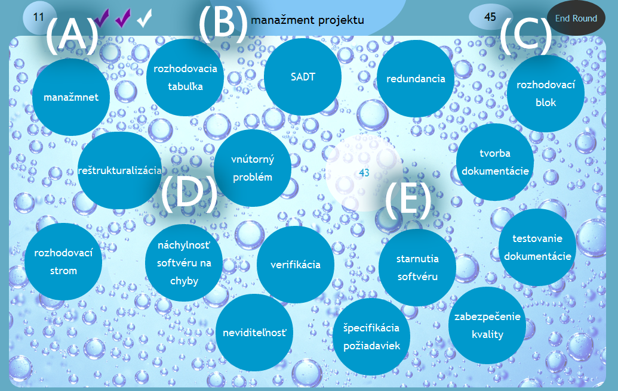
TermBlaster: towards specific domain
Specific domain
No text typing
Experiments:
38 players
732 rounds
6 task terms, 15 relationships each
71 % correct, 21% „hidden relationships“

