Slide 1
Precision and more
mk

Slide 2
Group recommendation for eduactional system
Engage users to discuss and to help each other within the system
Incerase students collaboration
Improve process of learning
Personalize materials in order to users’ learning styles

Slide 3
Learning styles
Perception – sensory vs intuitive
Input – visual vs auditory
Processing – active vs reflective
Understanding – sequential vs global

Slide 4
Single user recommendation

Slide 5
Single user recommendation

Slide 6
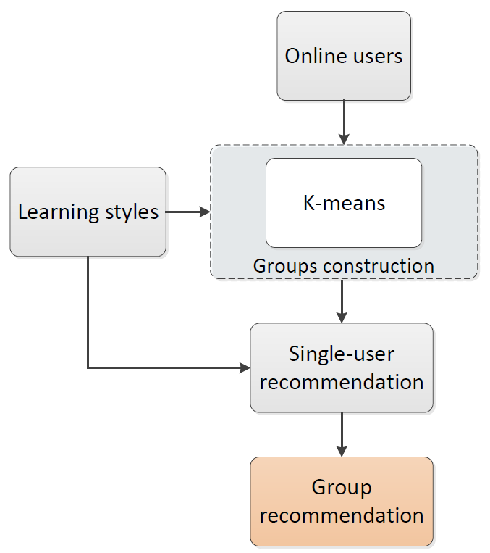
Group recommendation

Slide 7
Evaluation
What? How?

Slide 8
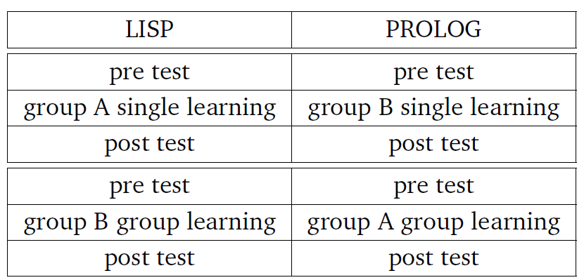
Evaluation
Influence of learning styles for the single user recommendation
Influence of group recommendation for knowleadge increase
Pre/post test
Single learning
Group learning
New user scenario

Slide 9
1. Single learning
6x normal recommendation, 6x edhanced by learning styles
78 percent of clicks for recommendation with learning styles

Slide 10
2. Group learning

Slide 11
What next?
Ranking measures
Normalized Distance-based Performance Measure
Normalized Cumulative Discounted Gain
Coverage
Item space
Users space
Confidence
System trust in its recommendations

Slide 12
What next? 2
Trust
User trust in the recommender system
Novelty
Serendipity
How the results are surprising
Diversity
Opposite to similarity

Slide 13
What next? 3
Utility
E.g. revenue
Risk
E.g. stock
Robustness
Fake information
Privacy

Slide 14
What next? 4
Adaptivity
E.g. news – short vs. longterm
Scalability
Milions of items

Slide 15
Evaluating Recommendation Systems. Guy Shani and Asela Gunawardana, Microsoft

