Slide 1
Spracovanie prirodzeného jazyka
Robo Móro, Márius Šajgalík
PeWe, 11.11.2014

Slide 2
I made her duck.

Slide 3
I made her duck.
Uvaril (upiekol) som jej kačku.
Uvaril som kačku, ktorá jej patrí.
Spravil som jej kačku (napr. ako origami).
Primäl som ju zohnúť sa.
Premenil som ju na kačku.

Slide 4
Ako sa v tom vyznať?
made -> make
Lematizácia (stemming)
Word sense disambiguation
make ?= uvariť, spraviť, prinútiť, ...
Part-of-speech tagging
duck ako sloveso alebo podstatné meno?
A kto dokelu je her?
Coreference (anaphora) resolution

Slide 5
Buffalo buffalo Buffalo buffalo buffalo buffalo Buffalo buffalo.

Slide 6
Ďalšie NLP úlohy
Segmentácia textu
na tokeny
na vety (sentence boundary disambiguation)
na témy
Automatická sumarizácia textu
Analýza sentimentu
Strojový preklad textu
(Syntaktické) parsovanie viet
Analýza diskurzu, odpovedanie na otázky
Rozpoznávanie a segmentácia reči
Speech-to-text, text-to-speech

Slide 7
Dostupné nástroje
Stanford NLP
Apache OpenNLP
Natural Language Toolkit (NLTK)
Gensim
WordNet

Slide 8
Stanford CoreNLP
Segmentácia textu na vety a slová
Určovanie slovných druhov
Rozpoznávanie menných entít
Vytvorenie parsovacieho stromu
Určovanie koreferencií

Slide 9
Príklad
The strongest rain ever recorded in India shut down the financial hub of Mumbai, snapped communication lines, closed airports and forced thousands of people to sleep in their offices or walk home during the night, officials said today.

Slide 10
Určovanie slovných druhov

Slide 11
Určovanie menných entít

Slide 12
Určovanie koreferencií

Slide 13
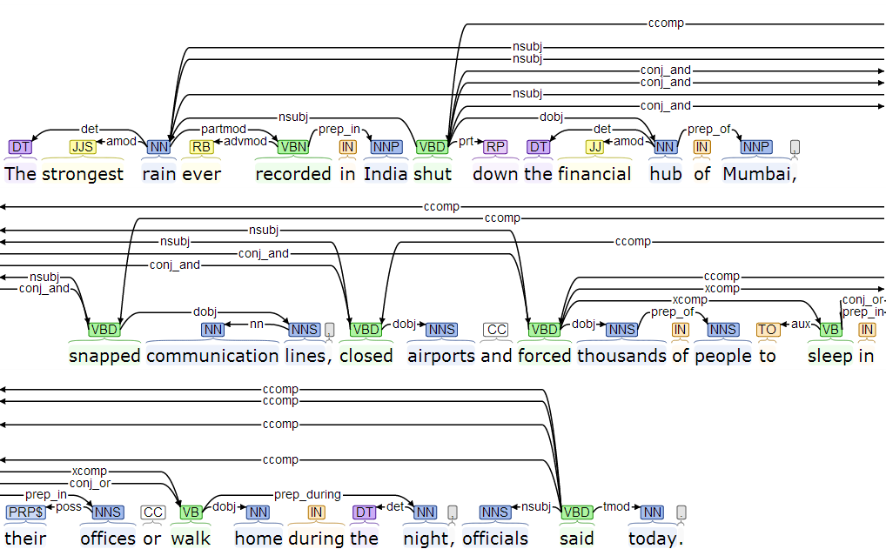
Určovanie závislostí

Slide 14
Parsovací strom
(ROOT
(S
(S
(NP
(NP (DT The) (JJS strongest) (NN rain))
(VP
(ADVP (RB ever))
(VBN recorded)
(PP (IN in)
(NP (NNP India)))))
(VP
(VP (VBD shut)
(PRT (RP down))

Slide 15
Použitie
Properties props = new Properties();
props.put("annotators", "tokenize, ssplit, pos, lemma, ner, parse, dcoref");
StanfordCoreNLP pipeline = new StanfordNLP(props);

Slide 16
Annotation document = new Annotation(text);
pipeline.annotate(document);
List<CoreMap> sentences = document.get(SentencesAnnotation.class);
for (CoreMap sentence : sentences) {
List<CoreLabel> tokens = sentence.get(TokensAnnotation.class);
for (CoreLabel token : tokens) {
String word = token.toString();
String tag = token.get(PartOfSpeechAnnotation.class);
String ne = token.get(NamedEntityTagAnnotation.class);
}
Tree tree = sentence.get(TreeAnnotation.class);
SemanticGraph dependencies = sentence.get(
CollapsedCCProcessedDependenciesAnnotation.class);
}

Slide 17
StanfordCoreNLP
Rozšírenia pre viaceré jazyky
Java, Python, Ruby, Closure, JavaScript (node.js), C# (IKVM)

Slide 18
Podobné nástroje
OpenNLP (tiež Java, v rámci projektu Apache)
NLTK pre Python

Slide 19
NLTK – segmentácia na slová
>>> import nltk
>>> sentence = """At eight o'clock on Thursday morning ... Arthur didn't feel very good."""
>>> tokens = nltk.word_tokenize(sentence)
>>> tokens
['At', 'eight', "o'clock", 'on', 'Thursday', 'morning', 'Arthur', 'did', "n't", 'feel', 'very', 'good', '.']

Slide 20
NLTK – určovanie slovných druhov
>>> tagged = nltk.pos_tag(tokens)
>>> tagged[0:6]
[('At', 'IN'), ('eight', 'CD'), ("o'clock", 'JJ'), ('on', 'IN'), ('Thursday', 'NNP'), ('morning', 'NN')]

Slide 21
NLTK – určovanie menných entít
>>> entities = nltk.chunk.ne_chunk(tagged)
>>> entities
Tree('S', [('At', 'IN'), ('eight', 'CD'), ("o'clock", 'JJ'),
('on', 'IN'), ('Thursday', 'NNP'), ('morning', 'NN'),
Tree('PERSON', [('Arthur', 'NNP')]),
('did', 'VBD'), ("n't", 'RB'), ('feel', 'VB'),
('very', 'RB'), ('good', 'JJ'), ('.', '.')])

Slide 22
NLTK – parsovací strom
>>> from nltk.corpus import treebank
>>> t = treebank.parsed_sents('wsj_0001.mrg')[0]
>>> t.draw()

Slide 23
Gensim
Nástroj na modelovanie tém (Python)
Vie TF-IDF, LSA, pLSA, LDA, HDP, DTM, word2vec
Jednoduché použitie

Slide 24
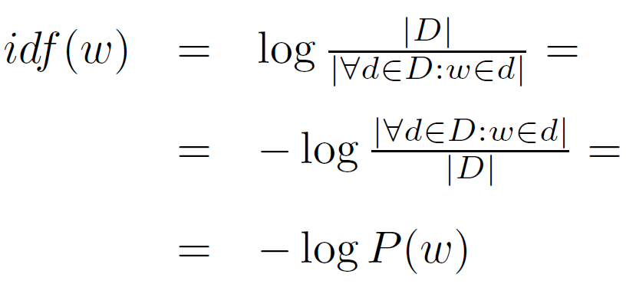
TF-IDF
Term frequency – inverse document frequency
TF – frekvencia slova v aktuálnom dokumente
IDF – záporný logaritmus pravdepodobnosti výskytu slova v dokumente (rovnaká pre všetky dokumenty)

Slide 25
Gensim – LDA
>>> import logging, gensim, bz2
>>> logging.basicConfig(format='%(asctime)s : %(levelname)s : %(message)s', level=logging.INFO)
>>> # load id->word mapping (the dictionary), one of the results of step 2 above
>>> id2word = gensim.corpora. Dictionary.load_from_text('wiki_en_wordids.txt')
>>> mm = gensim.corpora.MmCorpus('wiki_en_tfidf.mm')
>>> # mm = gensim.corpora.MmCorpus (bz2.BZ2File('wiki_en_tfidf.mm.bz2'))
>>> print mm
MmCorpus(3931787 documents, 100000 features, 756379027 non-zero entries)

Slide 26
Gensim – LDA
>>> # extract 100 LDA topics, using 1 pass and updating once every 1 chunk (10,000 documents)
>>> lda = gensim.models.ldamodel.LdaModel(corpus=mm, id2word=id2word, num_topics=100, update_every=1, chunksize=10000, passes=1)
>>> lda.print_topics(20)

Slide 27
topic #0:
0.009*river + 0.008*lake + 0.006*island + 0.005*mountain + 0.004*area + 0.004*park + 0.004*antarctic + 0.004*south + 0.004*mountains + 0.004*dam
topic #1:
0.026*relay + 0.026*athletics + 0.025*metres + 0.023*freestyle + 0.022*hurdles + 0.020*ret + 0.017*divisão + 0.017*athletes + 0.016*bundesliga + 0.014*medals
topic #2:
0.002*were + 0.002*he + 0.002*court + 0.002*his + 0.002*had + 0.002*law + 0.002*government + 0.002*police + 0.002*patrolling + 0.002*their
topic #3:
0.040*courcelles + 0.035*centimeters + 0.023*mattythewhite + 0.021*wine + 0.019*stamps + 0.018*oko + 0.017*perennial + 0.014*stubs + 0.012*ovate + 0.011*greyish
topic #4:
0.039*al + 0.029*sysop + 0.019*iran + 0.015*pakistan + 0.014*ali + 0.013*arab + 0.010*islamic + 0.010*arabic + 0.010*saudi + 0.010*muhammad

Slide 28
Gensim – LDA
There appears to be a lot of noise in your dataset. The first three topics in your list appear to be meta topics, concerning the administration and cleanup of Wikipedia. These show up because you didn't exclude templates such as these, some of which are included in most articles for quality control: http://en.wikipedia.org/wiki/Wikipedia:Template_messages/Cleanup
The fourth and fifth topics clearly shows the influence of bots that import massive databases of cities, countries, etc. and their statistics such as population, capita, etc.
The sixth shows the influence of sports bots, and the seventh of music bots.

Slide 29
WordNet
Lexikálna databáza
Obsahuje synsety
Podstatné mená, slovesá, prídavné mená, príslovky
Prepojenia medzi synsetmi
Antonymá, hypernymá, hyponymá, ich inštancie, holonymá, meronymá

Slide 30
WordNet
dog, domestic dog, Canis familiaris
=> canine, canid
=> carnivore
=> placental, placental mammal, eutherian, ...
=> mammal
=> vertebrate, craniate
=> chordate
=> animal, animate being, beast, brute, creature, ...
=> ...

Slide 31
Vektorová reprezentácia slov
Každé slovo má naučený vektor reálnych čísel, ktoré reprezentujú rôzne jeho vlastnosti
82390 80
</s> 46.219241 -2.252112 -2.518417 -0.288605 ...
THE -0.389057 -1.207682 -1.595120 -0.295630 ...
TO 0.521868 -0.494209 -1.052567 -0.365821 ...
AND 1.468724 -1.010859 -1.505842 -0.218909 ...
...

Slide 32
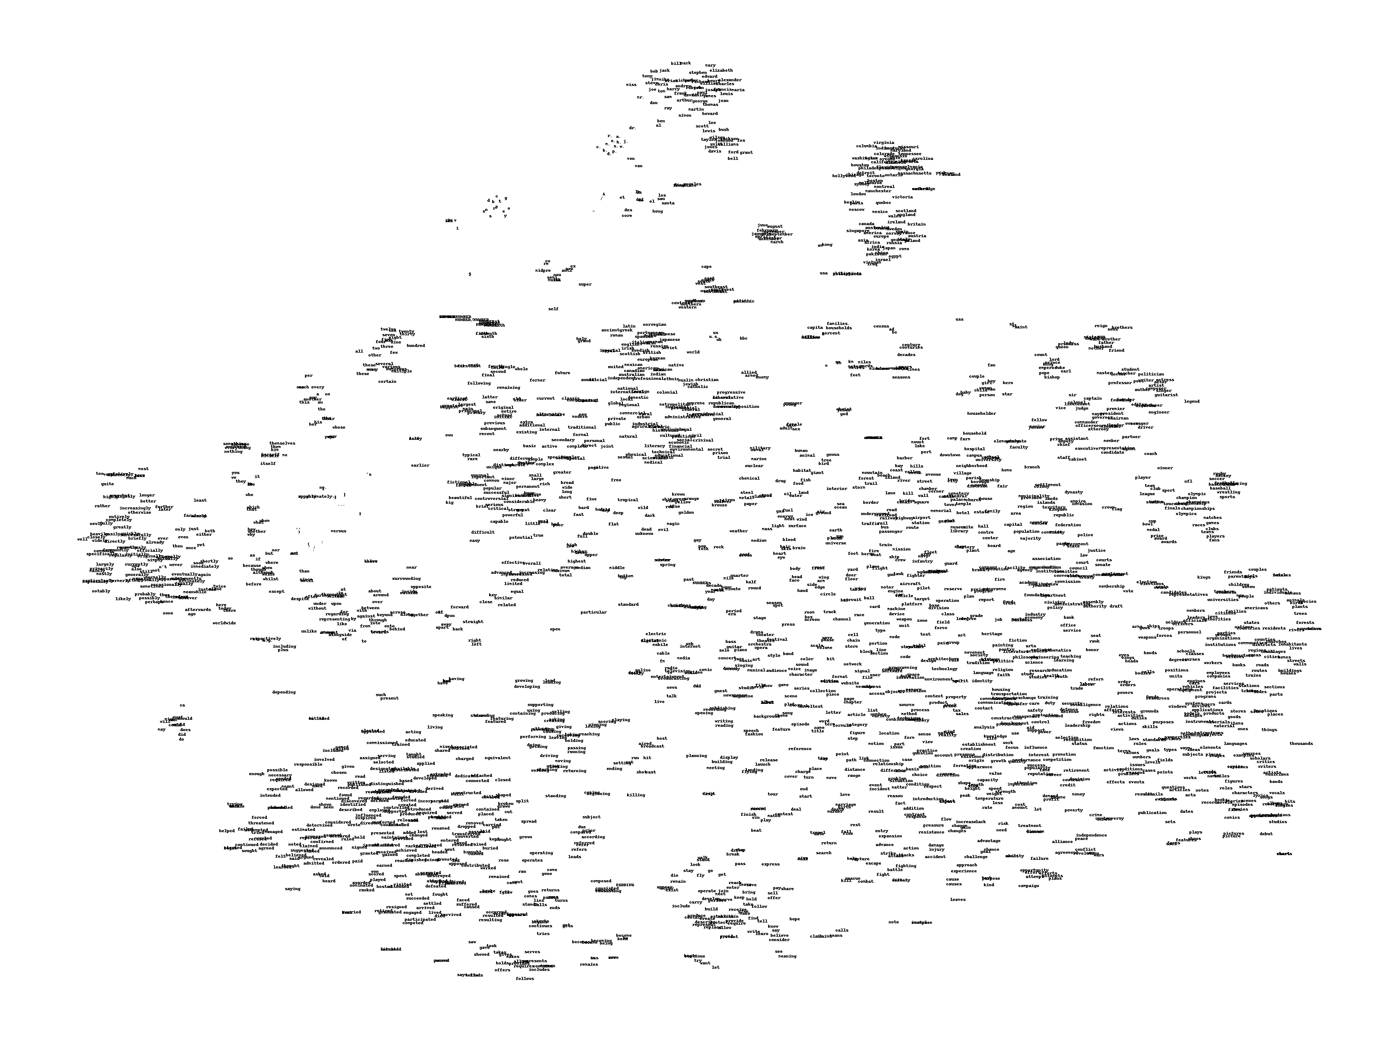
t-SNE

Slide 33
t-SNE

Slide 34
Podobnosť medzi slovami
Kosínusová podobnosť

Slide 35
Vlastnosti vektorov slov
Zachytávajú viaceré lingvistické pravidelnosti
vector('Paris') - vector('France') + vector('Italy')
~= vector('Rome')
vector('king') - vector('man') + vector('woman')
~= vector('queen')

Slide 36
Strojový preklad v Googli
Majúc naučené vektory slov pre viaceré jazyky, preklad znamená nájdenie lineárnej transformácie z jedného vektorového priestoru do druhého

Slide 37
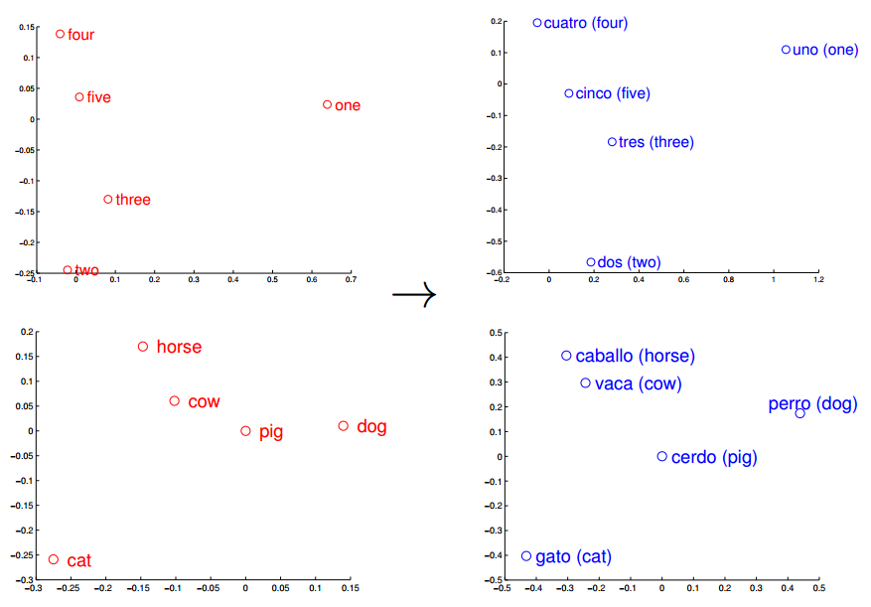

Slide 38
Dostupné nástroje v Ruby
Portnuté Stanford NLP, OpenNLP, Punkt Tokenizer z NLTK
Punkt Segmenter
Segmentácia textu na vety
Učenie bez učiteľa => nezávislý na jazyku
trainer = Punkt::Trainer.new()
# učí sa inkrementálne
trainer.train(trainning_text)
tokenizer = Punkt::SentenceTokenizer.new(trainer.parameters)
result = tokenizer.sentences_from_text(text)

Slide 39
Dostupné nástroje v Ruby
TREAT: The Ruby NLP Toolkit
Jednotné rozhranie pre viacero knižníc (vrátane Stanford NLP, Open NLP, Punkt Segmentera atď.)
Čiastočná podpora ďalších jazykov: nemčina, francúzština, románske jazyky
Extrakcia textu z PDF, HTML, XML, Word, ... + OCR
Segmentácia textu, POS tagging, rozpoznanie jazyka, identifikácie tém (LDA)
Rozhranie nad WordNetom
Serializácia do MongoDB

Slide 40
Dostupné nástroje v Ruby
TREAT: The Ruby NLP Toolkit
Práca s dokumentmi, chunkami, odsekmi (paragrafmi), slovami
Dokumenty z disku, URL alebo z MongoDB
d = document({id: 103757301323})
Kolekcie dokumentov z adresárov
Segmentácia na vety
p = paragraph('A walk in the park. A trip on a boat.').segment

Slide 41
Dostupné nástroje v Ruby
TREAT: The Ruby NLP Toolkit
Reťazenie textových procesorov
sect.do(:chunk, :segment, :tokenize, :parse)
Anotácie textu
w = word('hello')
w.set :topic, "conversation"
puts w.language

Slide 42
Dostupné nástroje v Ruby
TREAT: The Ruby NLP Toolkit
POS tagy ako anotácie
'running'.tag # => "VBG"
'running'.category # => "noun"
'inflection'.tag # => "NN"
'inflection'.category # => "noun"

Slide 43
Dostupné nástroje v Ruby
TREAT: The Ruby NLP Toolkit
Rozhranie nad WordNet-om
'ripe'.synonyms
# => ["mature", "ripe(p)", "good", "right", "advanced"]
'ripe'.antonyms
# => ["green", "unripe", "unripened", "immature"]
'coffee'.hypernyms
# => ["beverage", "drink", [...], "drinkable", "potable"]
'juice'.hyponyms
# => ["lemon_juice", "lime_juice", [...], "digestive_fluid"]

Slide 44
Dostupné nástroje v Ruby
TREAT: The Ruby NLP Toolkit
A ďalšie:
'inflection'.plural # => "inflections"
'inflections'.singular # => "inflection"
'running'.infinitive # => "run"
'run'.present_participle # => "running"
'runs'.plural_verb # => "run"
20.ordinal # => "twentieth"
20.cardinal # => "twenty"

Slide 45
Dostupné nástroje v Ruby
Linguistics
Framework na budovanie jazykových nástrojov v Ruby pre ľubovoľný jazyk
Obsahuje nástroje pre angličtinu
Pluralizácia, prevod čísel na slová, kvantifikáciu, časovanie, ...
"cow".en.quantify( 5 ) # => "several cows"

Slide 46
Dostupné nástroje v Ruby
Linguistics
Integrácia s WordNet-om a LinkParser-om
"he is a big dog".en.sentence.object.to_s
# => "dog"
"he is a big dog".en.sentence.object.en.definition
# => "a member of the genus Canis (probably # descended from the common wolf) that has # been domesticated by man since prehistoric # times; occurs in many breeds"

Slide 47
Dostupné nástroje v Ruby
Chronic
Knižnica na parsovanie dátumov
Chronic.parse('tomorrow')
#=> 2014-11-12 12:00:00 +0100
Chronic.parse('this wednesday 5:00')
#=> 2014-11-12 17:00:00 +0100

Slide 48
Zhrnutie
Množstvo výskumných problémov (bakalárky, diplomovky, dizertačky)
Sú dostupné viaceré nástroje a knižnice
Problém:
Väčšinou len pre angličtinu, príp. iné svetové jazyky
Žiadna (alebo malá) podpora pre slovenčinu

Slide 49
Kam ďalej
Daniel Jurafsky a James H. Martin
Speech and Language Processing
Christopher D. Manning a Hinrich Schütze
Foundations of Statistical Natural Language Processing
NLP@Coursera (archív)
https://www.coursera.org/course/nlp

Slide 50
Zdroje
StanfordCoreNLP - http://nlp.stanford.edu/software/corenlp.shtml
OpenNLP - http://opennlp.apache.org/
NLTK - http://nltk.org/
Gensim - http://radimrehurek.com/gensim/
WordNet - http://wordnet.princeton.edu/
Word2vec - https://code.google.com/p/word2vec/
Vektory slov - http://www.fit.vutbr.cz/~imikolov/rnnlm/
t-SNE - http://homepage.tudelft.nl/19j49/t-SNE.html
Preklad - http://arxiv.org/pdf/1309.4168v1.pdf

Slide 51
Zdroje
Ruby gemy:
https://github.com/louismullie/stanford-core-nlp
https://github.com/louismullie/open-nlp
https://github.com/lfcipriani/punkt-segmenter
https://github.com/louismullie/treat
http://deveiate.org/projects/Linguistics
https://github.com/mojombo/chronic

