Slide 1
RecSys 2010
Holub, Michlik, Zelenik
PeWe
13.10.2010

Slide 2


Slide 3
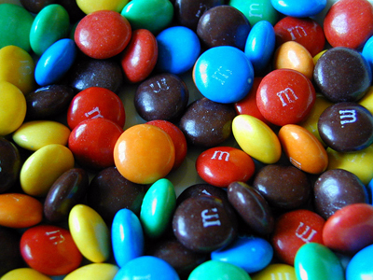
Fail
ACM Recomender Systems 2010

Slide 4
Sessions
Innovative Preference Expressions and Usage Assessments
Contests: Way Forward or Detour?
Beyond Prediction Accuracy
Algorithms
All About Groups
Recommending in Social Networks
Recommending Non-Standard Items
Friends and Lovers

Slide 5
Besides…
7 workshops
Posters, Demos, Symposium
Industry panel, Tutorials

Slide 6
Universities and Companies
Yahoo, Google (YouTube), IBM, SAP, HP, MS
University of Pittsburgh
De Paul University
University of Minnesota

Slide 7
Idols
Ricardo Baeza-Yates
Bamshad Mobasher
Robin Burke
Gediminas Adomavicius (not there)
Francesco Ricci (not there?)
Peter Brusilovsky

Slide 8
Cherry Pick
Query Intention Prediction and Recommendation
Group Recommendations with Rank Aggregation and Collaborative Filtering
Who is Talking about What: Social Map-based Recommendation for Content-Centric Social Websites
Learning in Efficient Tag Recommendation
RECON: A Reciprocal Recommender for Online Dating

Slide 9
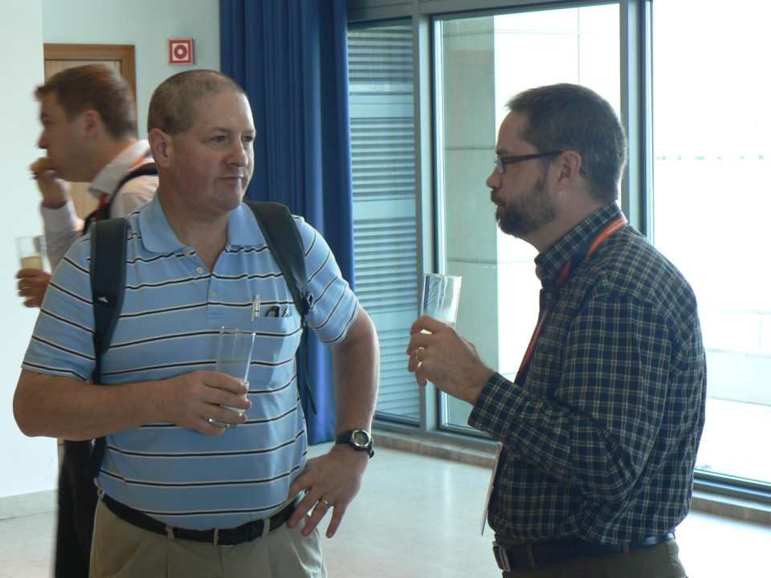

Slide 10
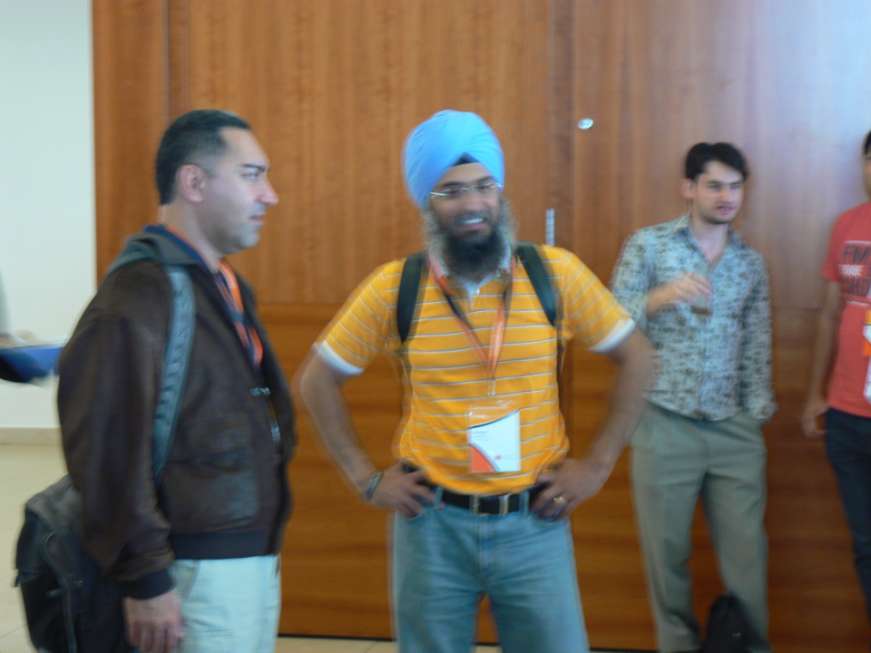

Slide 11
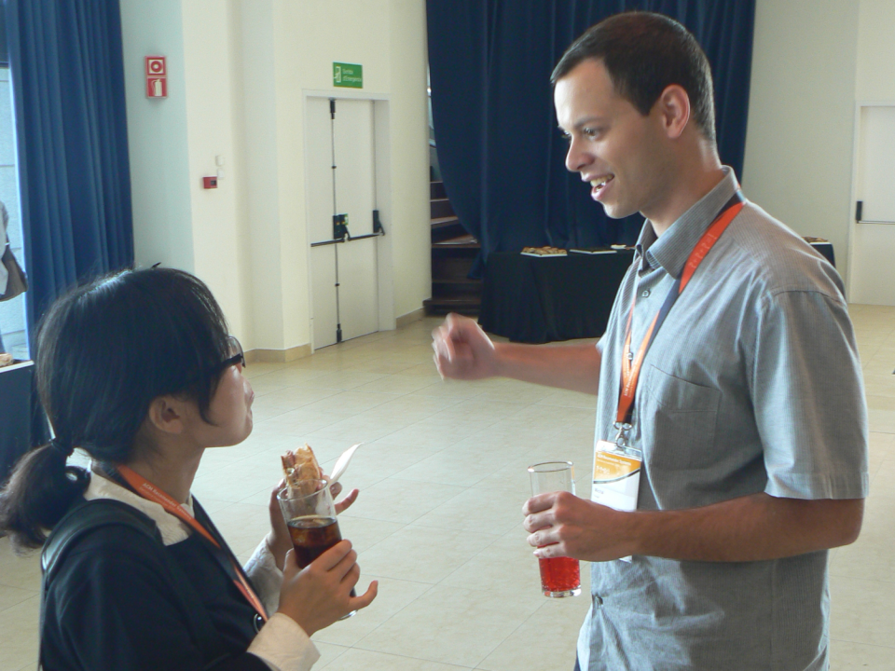

Slide 12
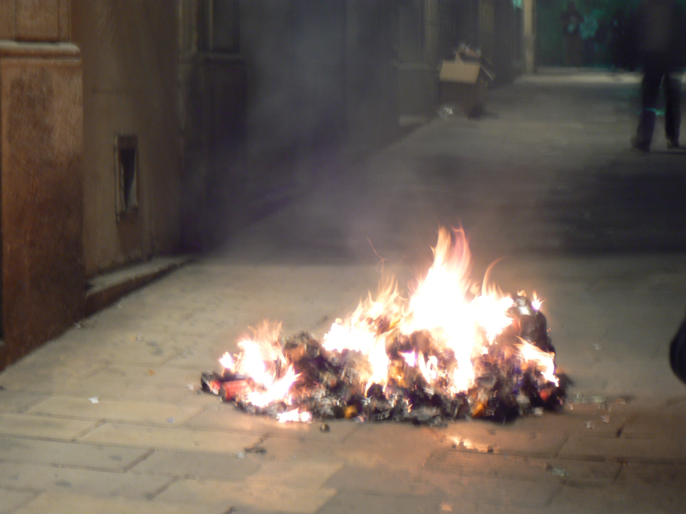

Slide 13
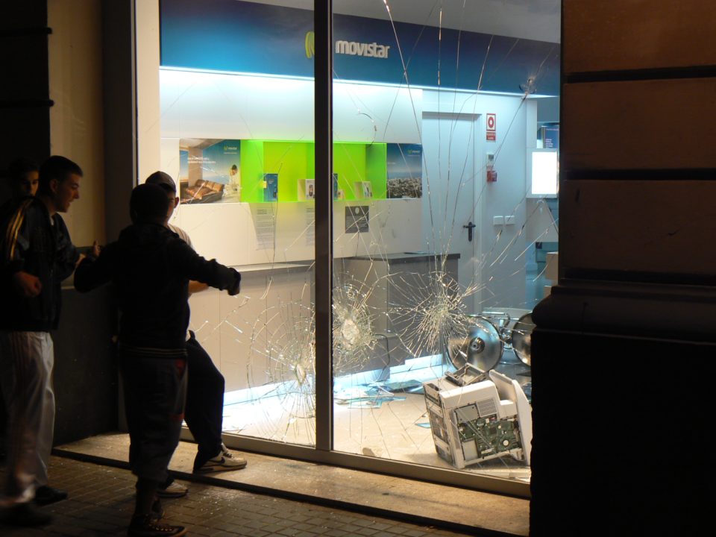

Slide 14
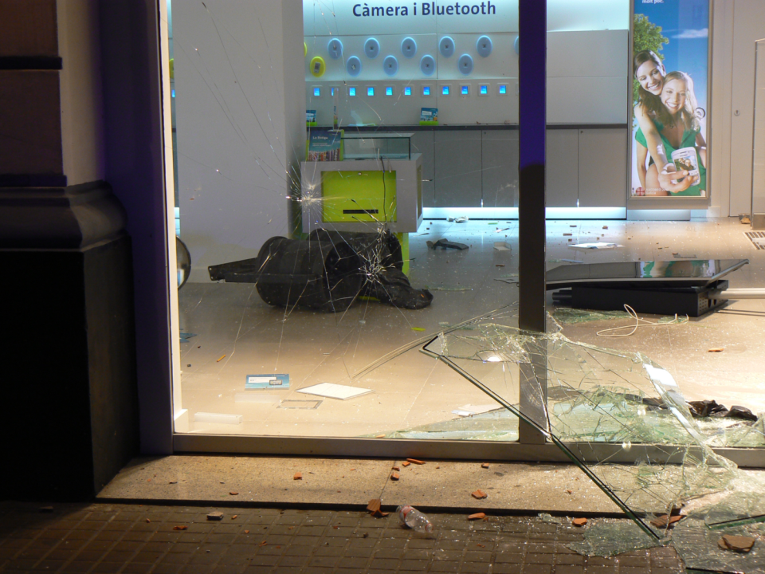

Slide 15
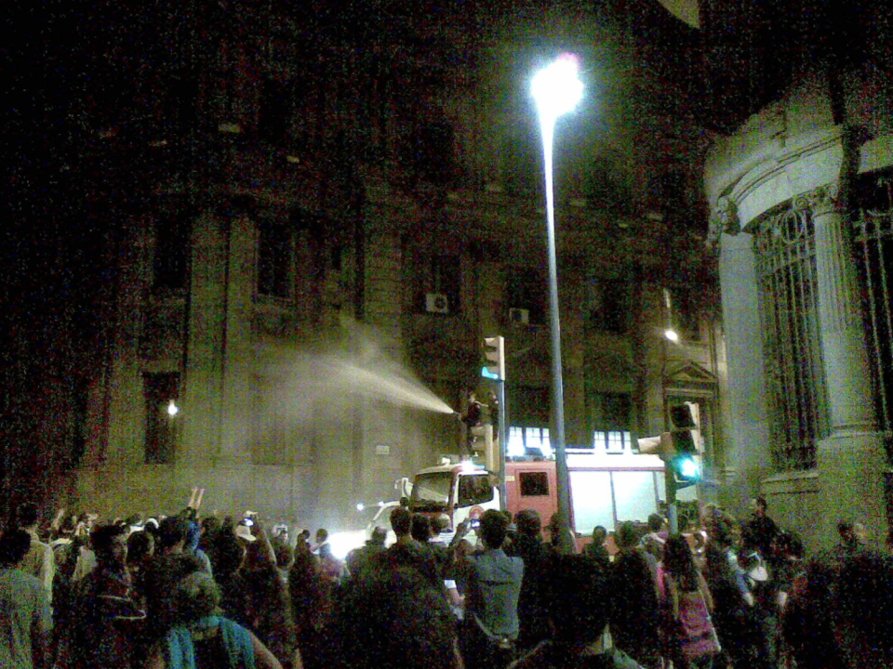

Slide 16
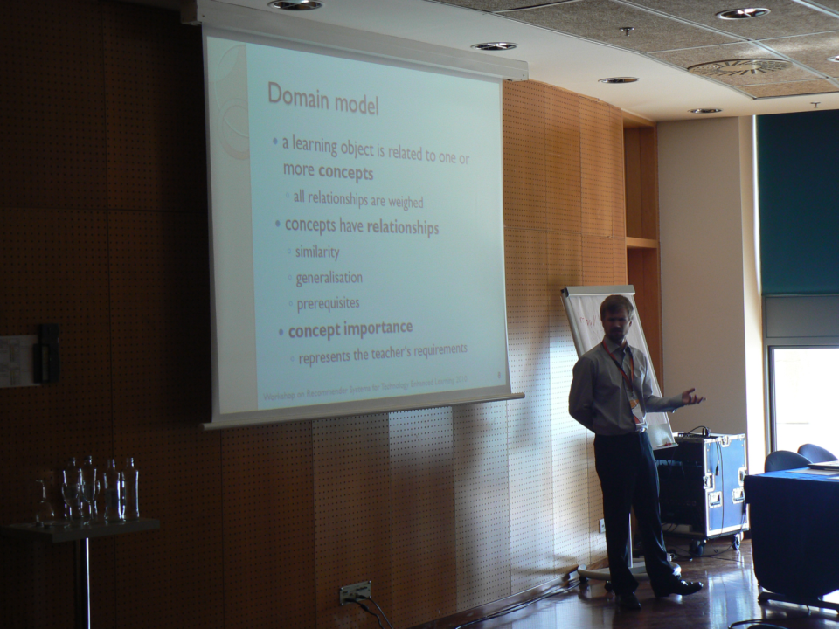

Slide 17
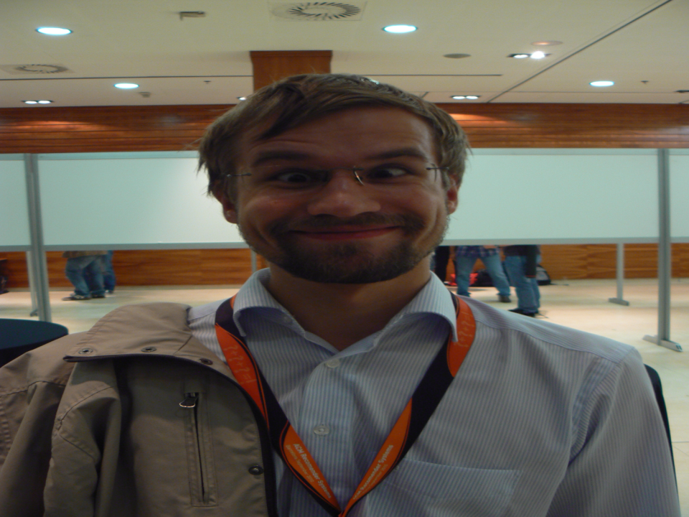

Slide 18
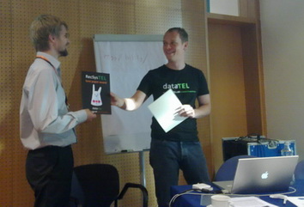

Slide 19
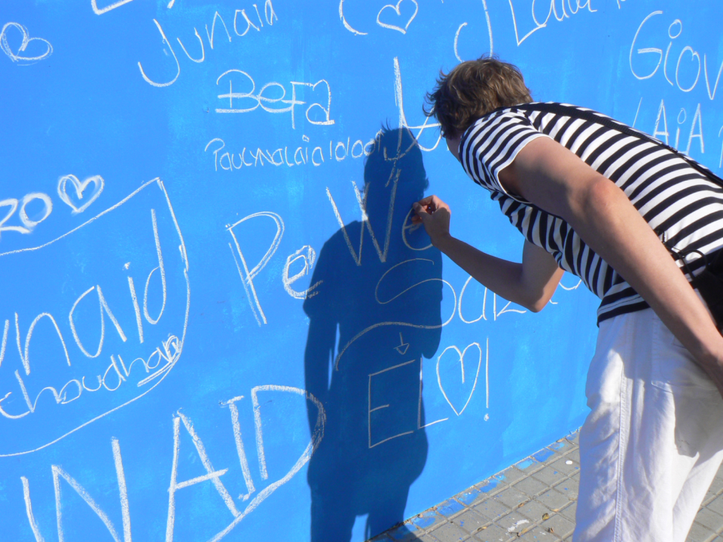

Slide 20
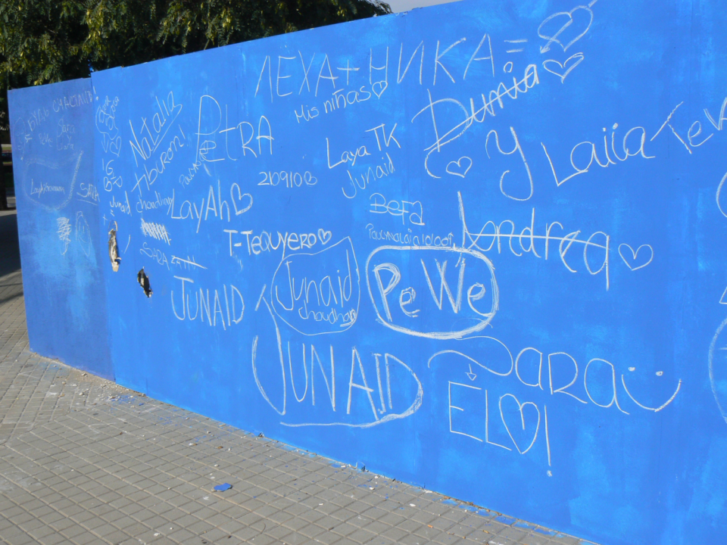

Slide 21
