Slide 1
Mária Bieliková
&
Jozef Tvarožek, Marián Šimko

Slide 2
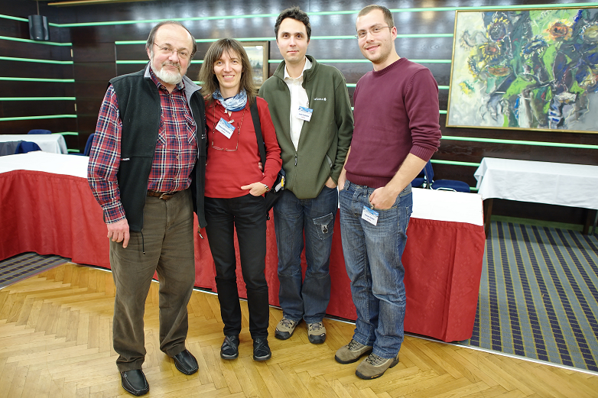

Slide 3
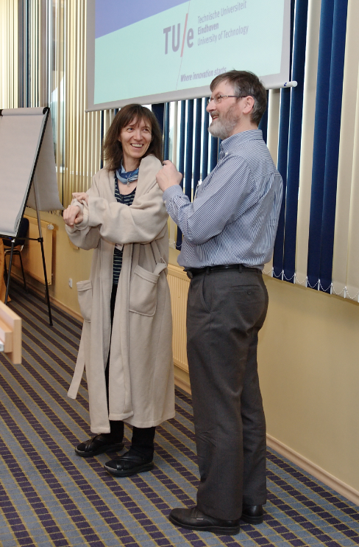
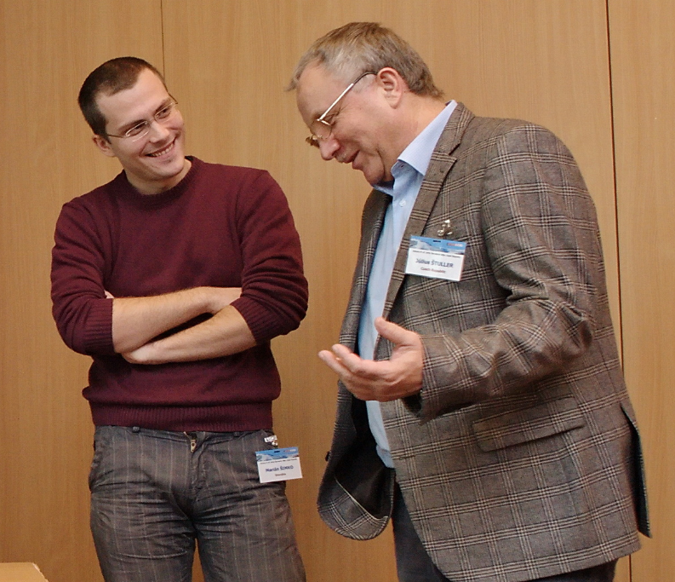

Slide 4
Invited Speakers (CS)
Foundations of Computer Science
Felipe Cucker: The Legacy of Turing in Numerical Analysis
Peter van Emde Boas: Turing Machines for Dummies
Jiří Wiedermann: Towards Computational Models of Artificial Cognitive Systems that Can, in Principle, Pass the Turing Test
Yuri Gurevich: What’s an Algorithm?
Giuseppe F. Italiano: Strong Bridges and Strong Articulation Points of Directed Graphs

Slide 5
Invited Speakers (SWE)
Software & Web Engineering
Paul De Bra: A Fully Generic Approach for Realizing the Adaptive Web
Pavel Zezula: Multi Feature Indexing Network (MUFIN) – Similarity Search Platform for many Applications

Slide 6
Invited Speakers (CRYPTO)
Cryptography, Security, and Verification
Orna Kupferman: Recent Challenges and Ideas in Temporal Synthesis
Krzysztof Pietrzak: Efficient Cryptography from Hard Learning Problems

Slide 7
Invited Speakers (AI)
Artificial Intelligence
Roberto Navigli: Don’t Take Shortcuts! Computational Lexical Semantics and the Turing Test
Kevin Warwick: Not Another Look at the Turing Test!

Slide 8
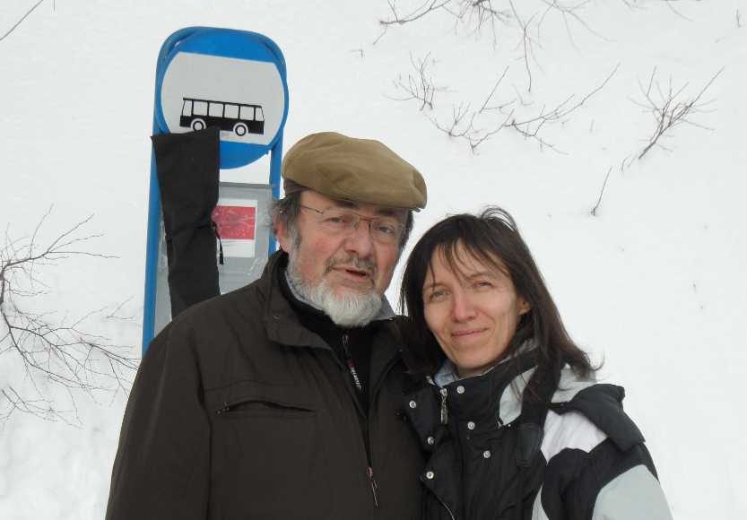

Slide 9
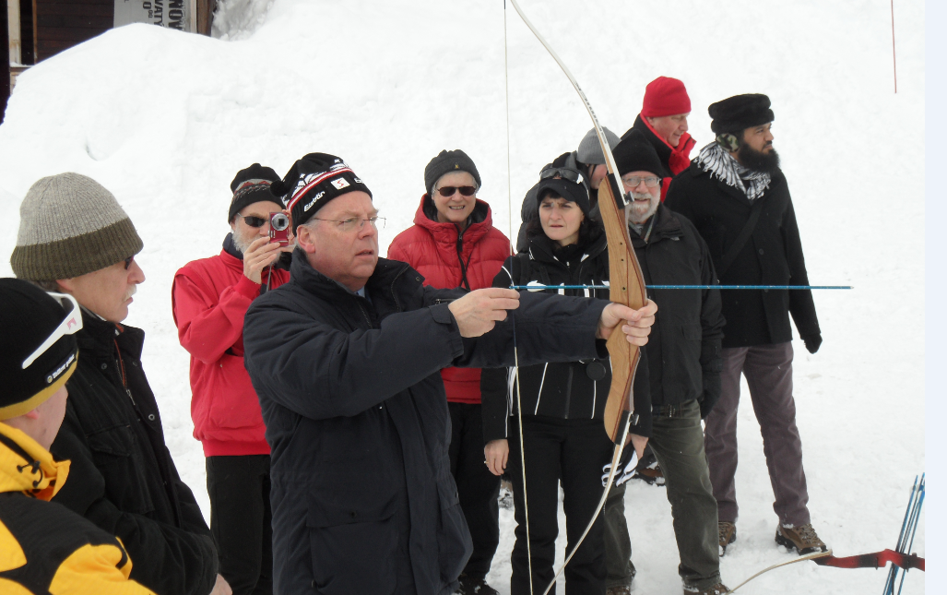

Slide 10
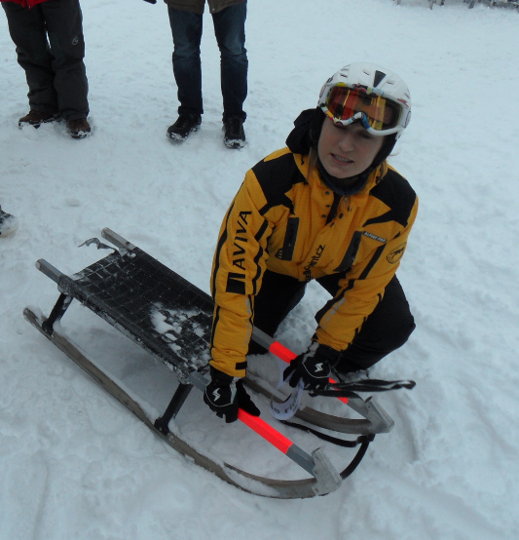
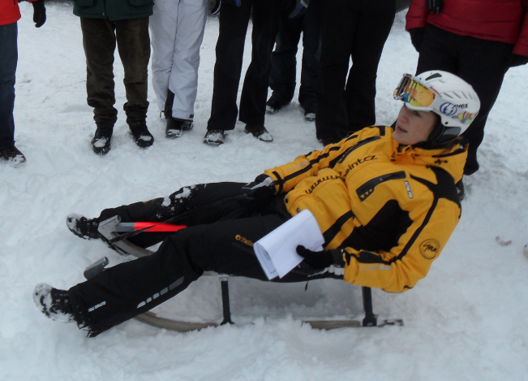
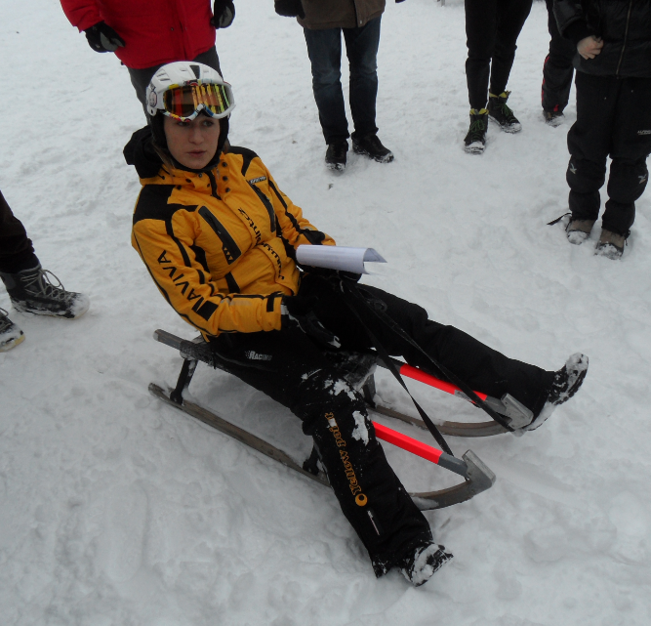

Slide 11
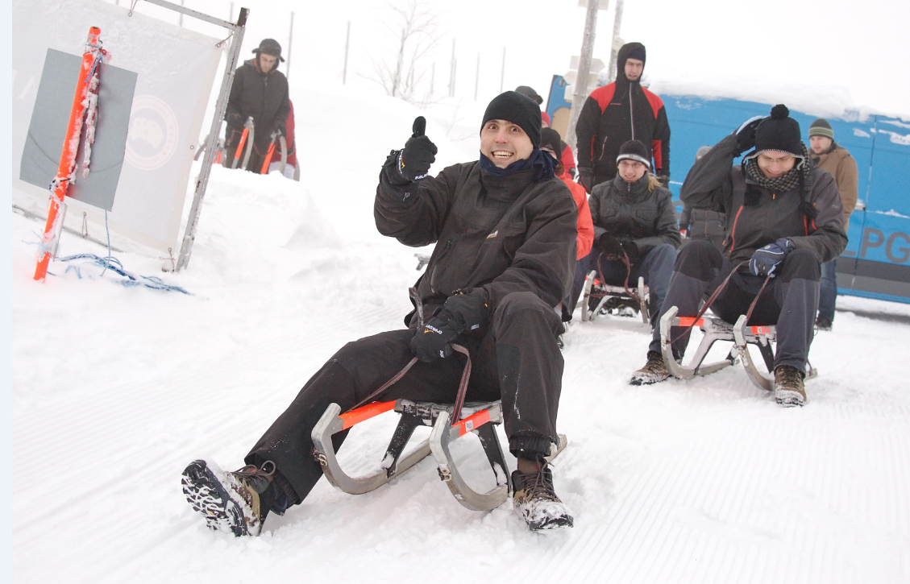

Slide 12
Turingov test
What did they think about the weather that morning? (male / female / machine)
A: I do tend to like a nice foggy morning, as it adds a certain mystery.
B: Not the best, expecting pirates to come out of the fog.
C: The weather is not nice at the moment,unless you like fog.

Slide 13
Don’t take shortcuts!
Shortcut 1: flatter the user (aka template matching)
Shortcut 2: insult the user (ah type something interesting or shut up)

Slide 14
Don’t take shortcuts!
Shortcut 3: keep away from natural language processing (aka: the intelligent parrot approach to the Turing test).
Commercial state-of-art … Google Translate: I like the chocolate, so I bought a bar in supermarket. … bar (nevie, že to je tablička čokolády)…

Slide 15
Don’t take shortcuts!
Shortcut 4: just use statistics (Aka: tons of data will tell you)
Q: I bought pens for my cattle in Perth, Australia? What do you think of that?
A: Are they going to write their next bestseller?
Swan having intercourse with a pen.
(* = female swan).

Slide 16
Knowledge-based WSD
Mapovanie vety na subraph Wordnetu, ktorý má najlepšiu konektivitu.
http://lcl.uniroma1.it/ssi
BabelNet == Wikipedia + WordNET 85% word sense disambiguation
Iný prístup: tzv. Lexical substitute pre slovo hľadám náhradne slovo, ktoré má rovnaký význam v tom kontexte

Slide 17
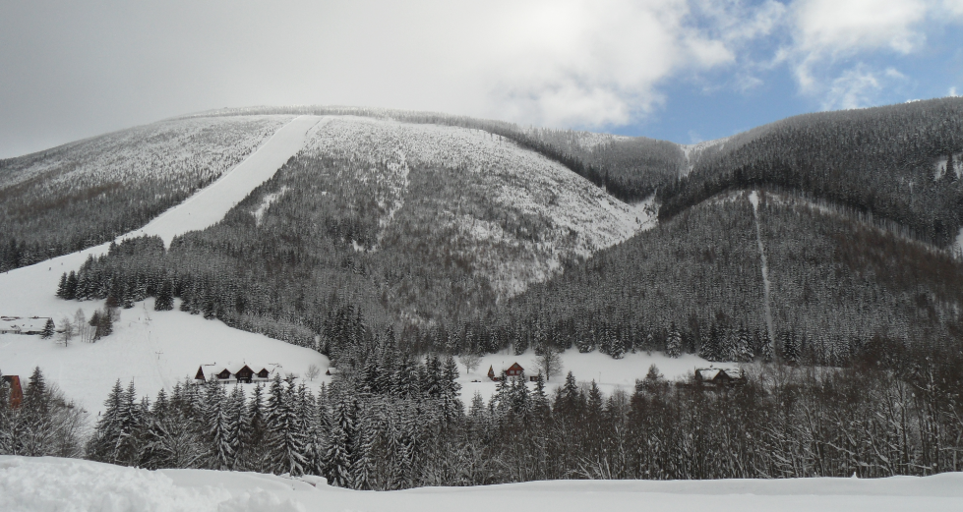

Slide 18
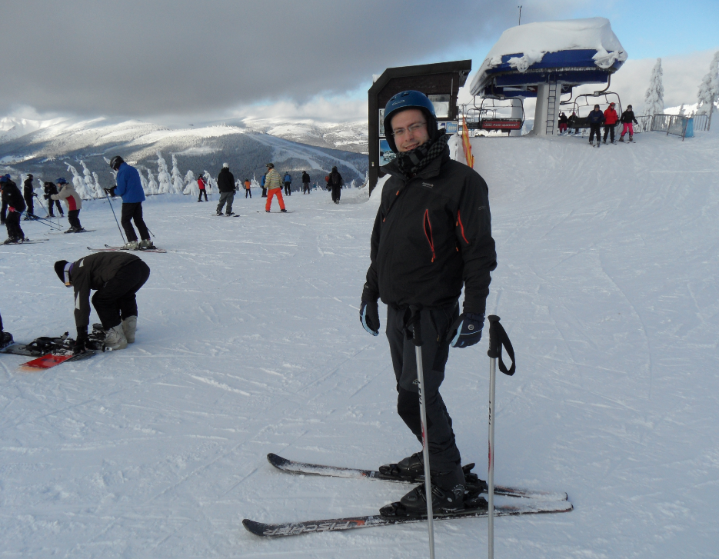

Slide 19
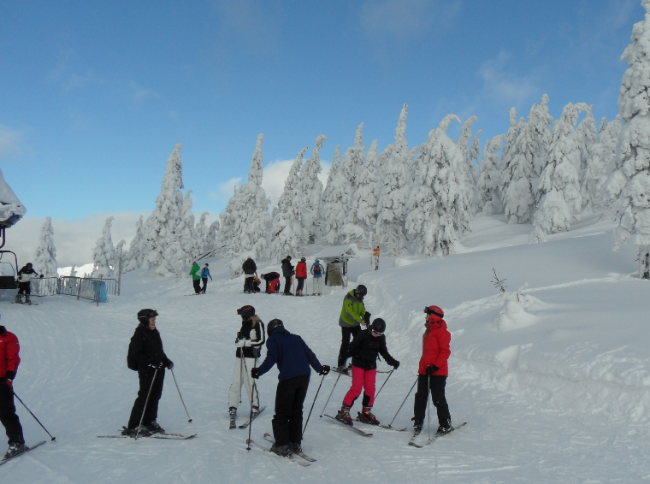

Slide 20
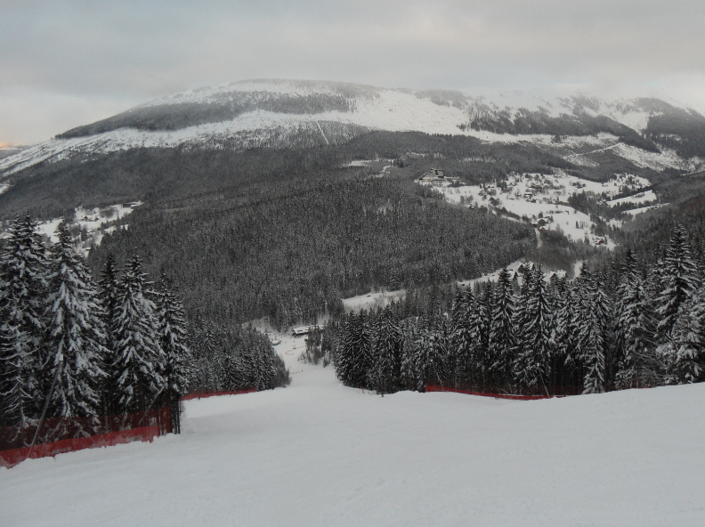

Slide 21
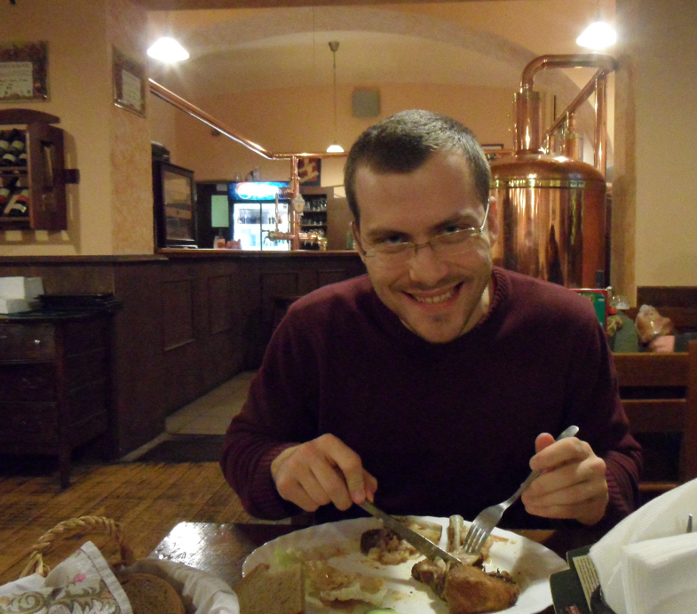
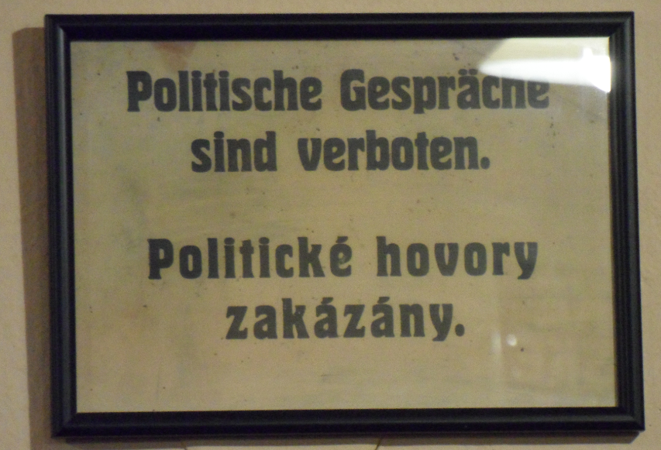

Slide 22
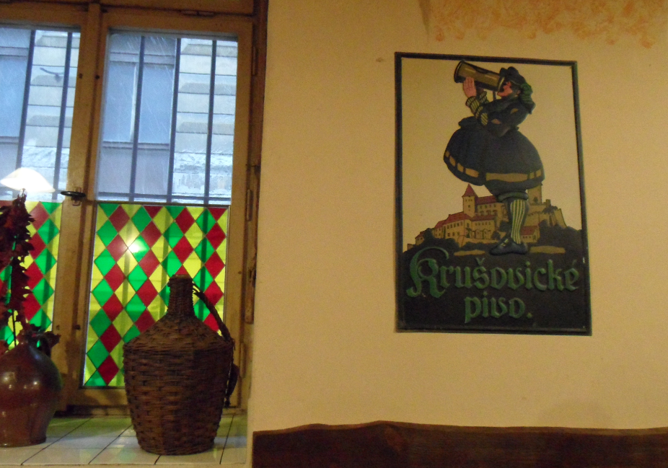
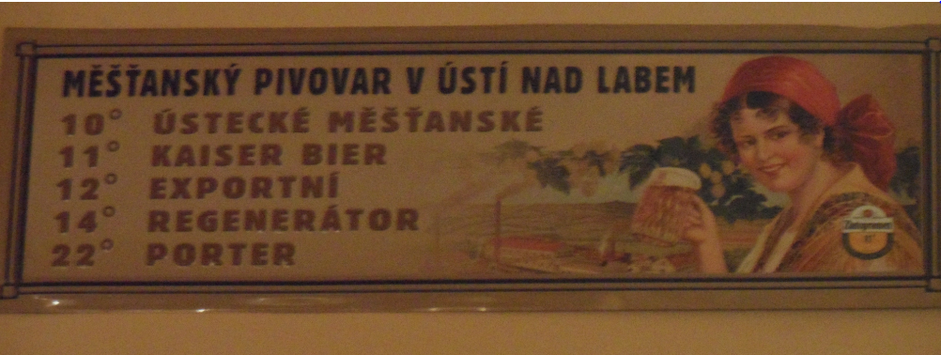

Slide 23
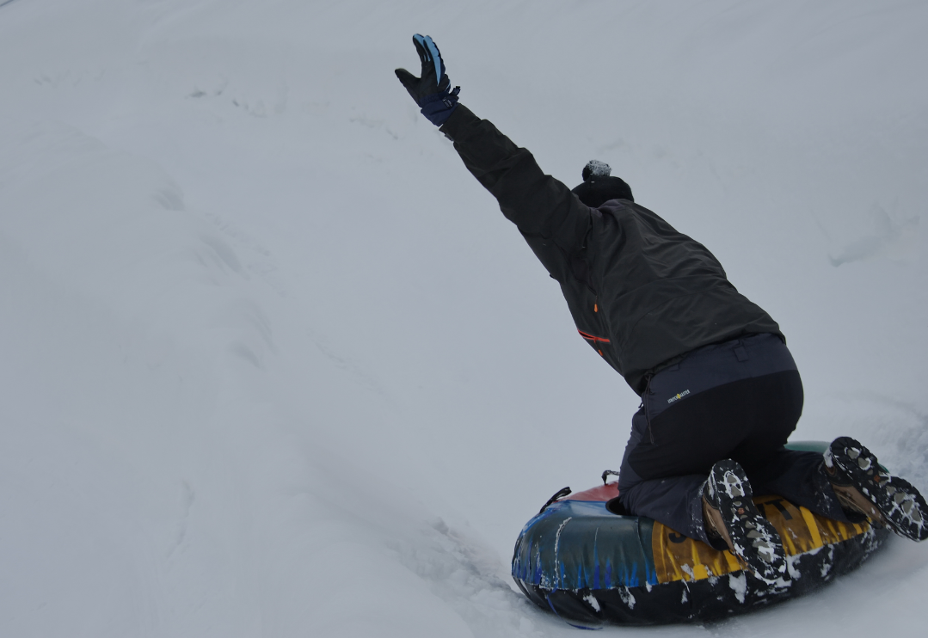
See you at SOFSEM 2013!

