Slide 1
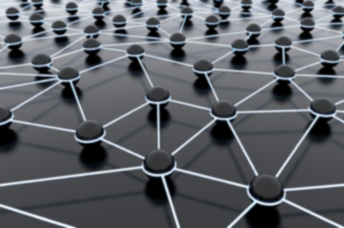
Decentralized User Modelling and Personalisation
Bc. Márius Šajgalík
Supervisor: Ing. Michal Barla, PhD.
12.5.2011
PeWe Seminar

Slide 2
Communication
Distributed hash tables
Channelled multicast
Private P2P (F2F & Group-based)
FIPA-ACL (Agent communication language)

Slide 3
User Modelling
UserML - to abstract user’s characteristics
GUMO – the General User Model Ontology (OWL language)

Slide 4
Searching the Web
User interest tags
User interest groups (groups’ channels)
Recommendations are based on the history of user, his belonging group and social connections

Slide 5
Development Support
Crossrider – cross-browser extension framework
Google Libraries API – All-in-one
Google Web Toolkit
Code in Java, deploy in JavaScript

