Slide 2
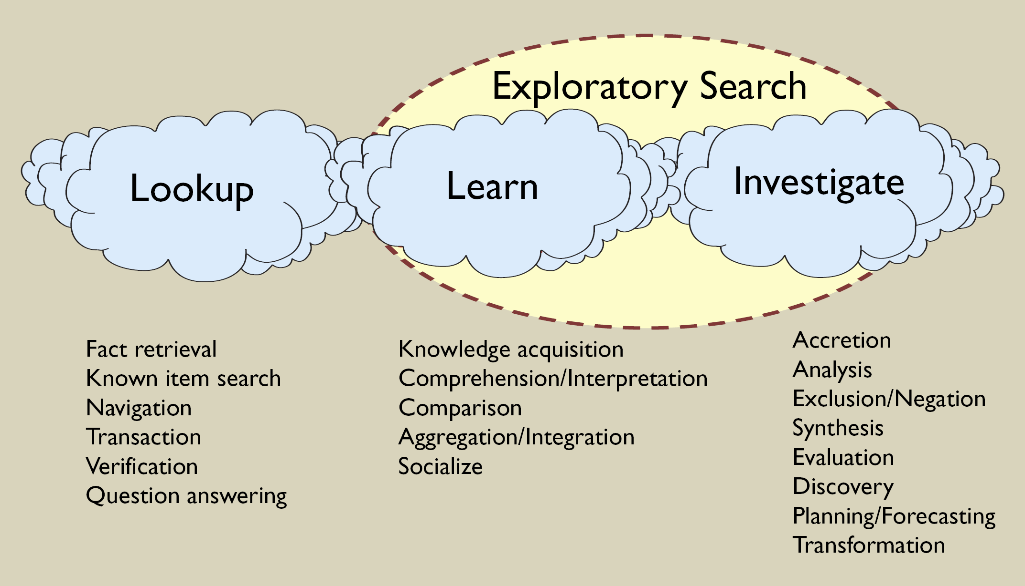
What is Exploratory search?
Gary Marchionini – EXPLORATORY SEARCH: FROM FINDING TO UNDERSTANDING, Com. of ACM, 2006

Slide 3
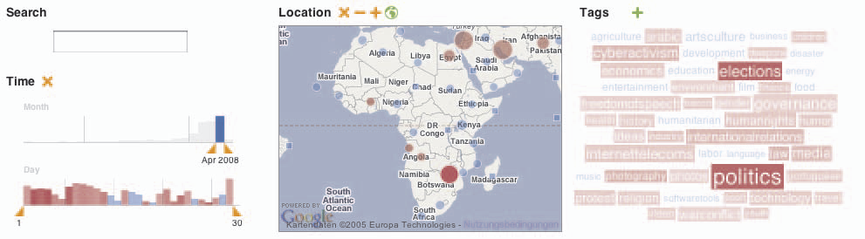
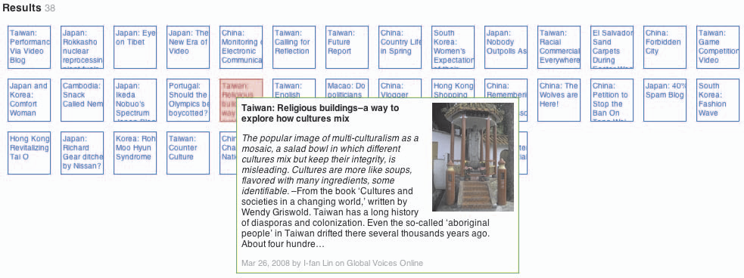
VisGets: Exploration and Discovery

Slide 4
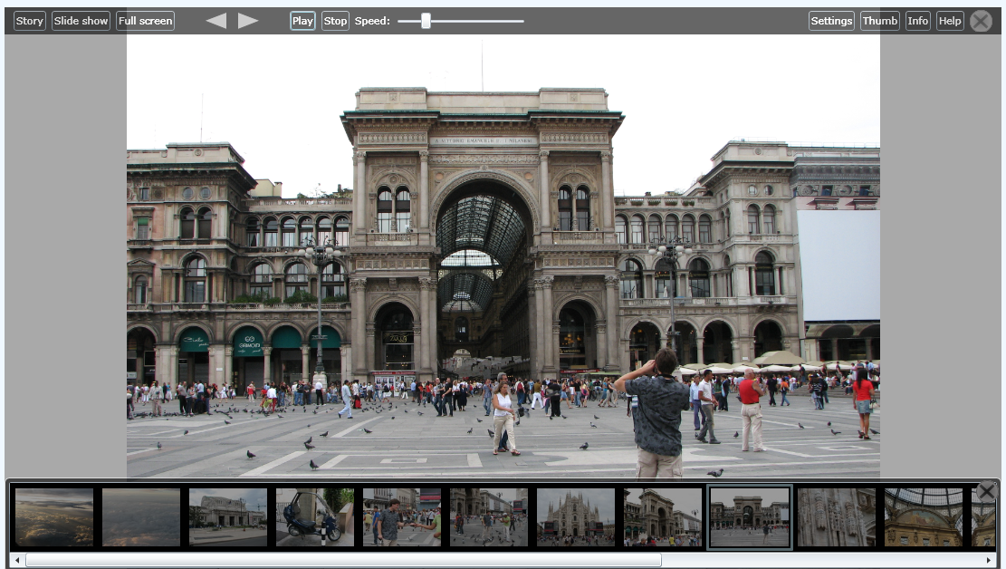
Another example…

Slide 5
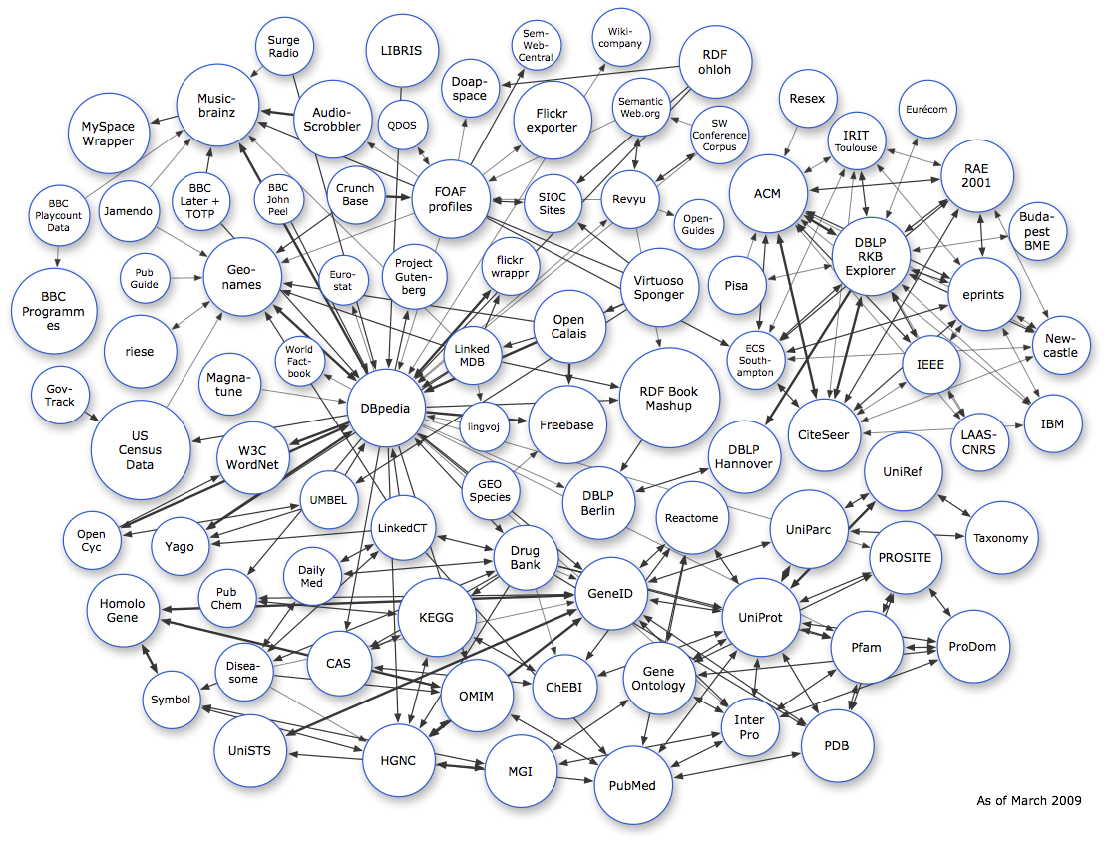
The Semantic Web today
Semantically annotated data
Search engines
  Sindice.com
Query builders
  OpenLink
Basic browsing
  Tabulator
  Zitgist Viewer
taken from linkeddata.org

Slide 6
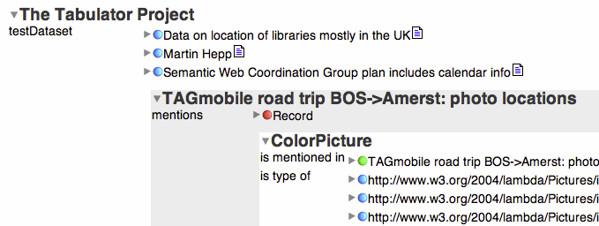
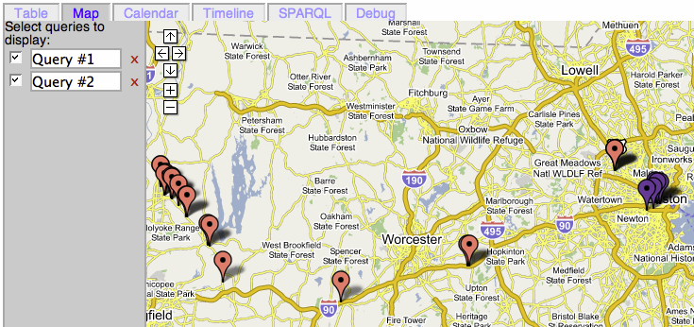
Tabulator: Browsing Linked Data

Slide 7
The end-user perspective
Tools not aimed at information consumers
Complex query construction
Limited end-user exploration
Information overload
No default end-user grade visualization

Slide 8
The broader web perspective
Adaptive Web (1996, 2001, 2007)
Semantic Web (2001, 2006)
Exploratory search (2006)
Social Web (2005)
Browser/search engine support for
  Searching (autocomplete, query disambiguation)
  Navigation (social tracks, other users visited …)
  Visualization (highlighting, hiding)

Slide 9
WI + IR + HCI ➔ WIRSS (2009)
WIRSS: currently insufficient user support
  Automated information retrieval
  Complex / gold plated interfaces
Need support for
  User decision making
  Effective “work” with in formation
You know why personalization is so important?
Because it makes people feel they are important :)

Slide 10
The beginnings
Faceted browsing of SW data (2005)
  Search + navigation + visualization = exploration
Personalized faceted browsing (2007)
  Provide search & navigation support
  Reduce information overload
  Cater to individual users

Slide 11
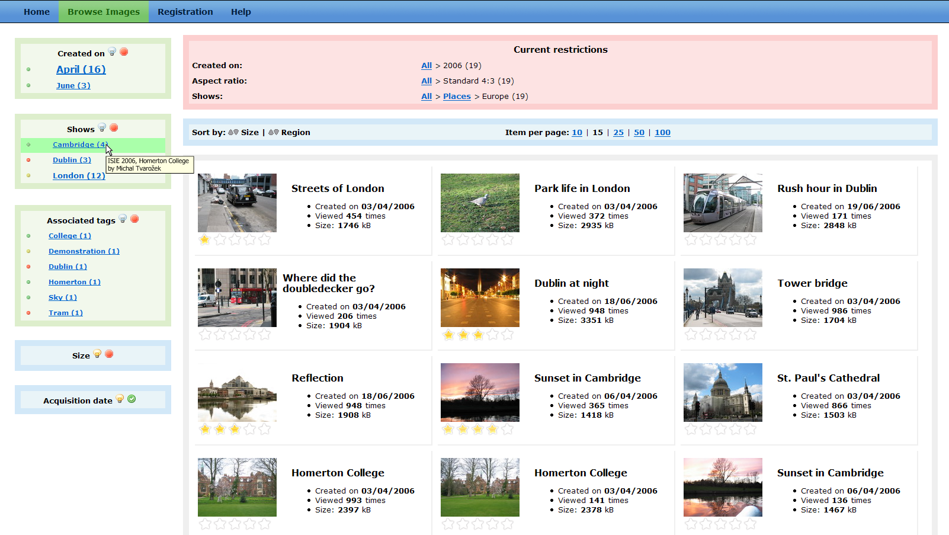
Facet adaptation & recommendation

Slide 12
“NextGen” Semantic Web Browser
Complex query construction
  ➔ Visual query construction
Limited end-user exploration
  ➔ Multi-paradigm exploration
Information overload
  ➔ Personalized recommendation
No default visualization
  ➔ Adaptive view generation

Slide 13
Typical client web browser
Downloads and renders data from the Web
Tracks and visualizes user history
Supports custom plug-ins adding functionality, rendering data
Serves as a front-end to search services

Slide 14
Revisiting the browser paradigm¹
End-user specific functionality in the browser
  Visualization, layout, templates
  Personalization and user modeling
  Identity and profile management
End-user specific information in the browser
  Personal profile information
  User action logs
  Derived user models

Slide 15
Revisiting the browser paradigm²
Facets and personalization as integral parts
Multiple search engine/repository front-end
  Delegate querying, indexing and crawling services to third-party providers (Google, Sindice, DBPedia)
Integrated support for
  Search (query construction & modification)
  Navigation (guidance, annotation)
  Exploration (content adaptation)

Slide 16
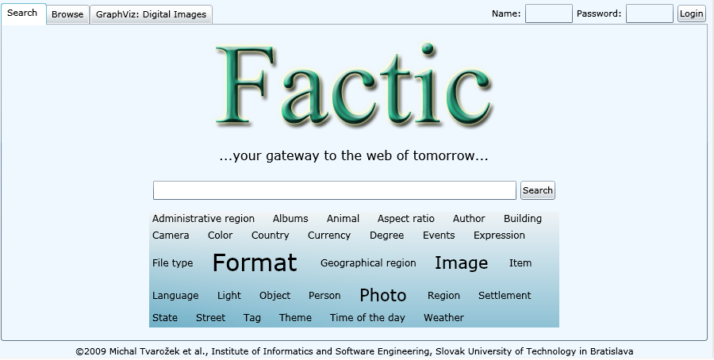
You might have already seen this…

Slide 17
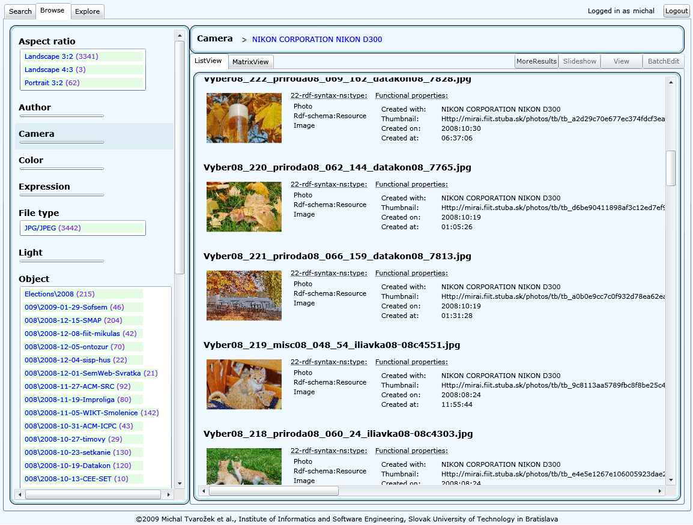
Personalized faceted search

Slide 18
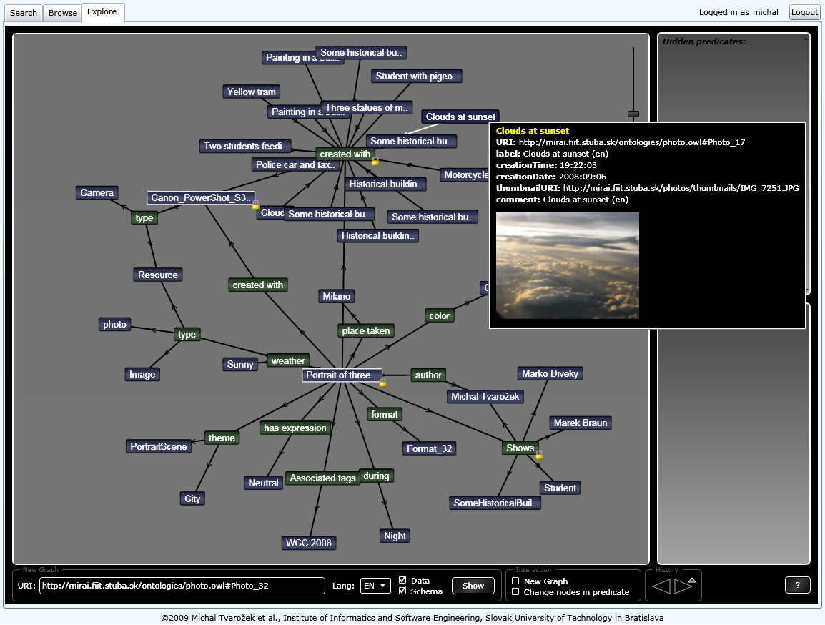
Incremental graph exploration

Slide 19
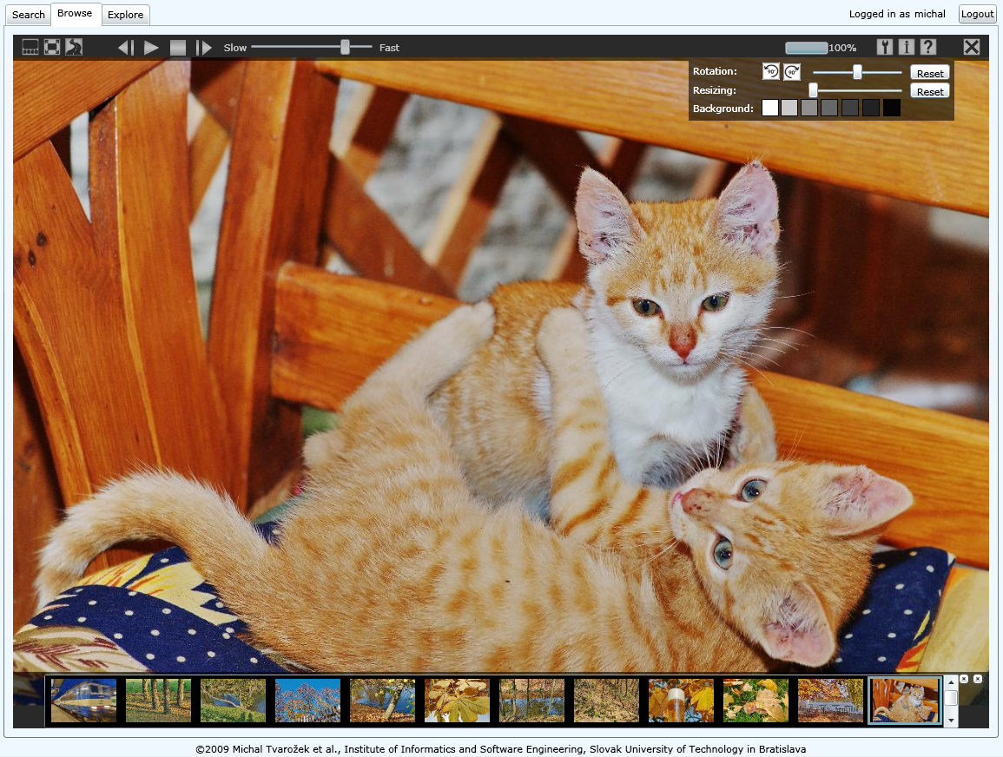
Content-specific content viewers

Slide 20
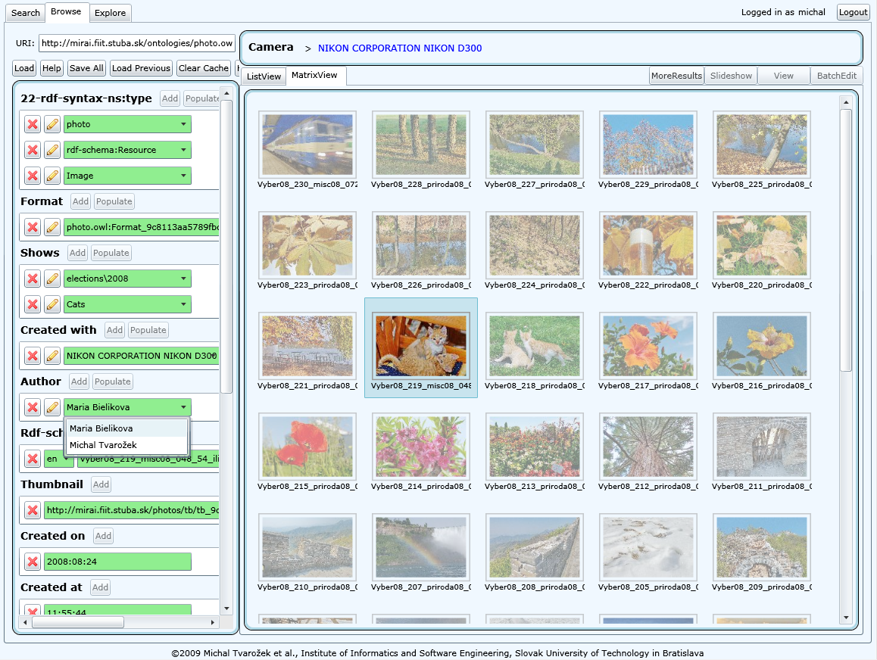
Collaborative resource annotation

Slide 21
Conclusions
Next Generation Web Browser (SW and LW)
Adaptive Social Semantic Web Exploration
Empowering end-users with access to semantic information spaces
Provides integrated support for
  Search
  Navigation
  Exploration

Slide 22
The Chicken or the Egg?
There may not be a killer application
End-user grade authoring tools
Manager Magic:
  Complexity, feasibility, technology
  ROI – Return on Investment
  (a.k.a. show me the money)

