Slide 2
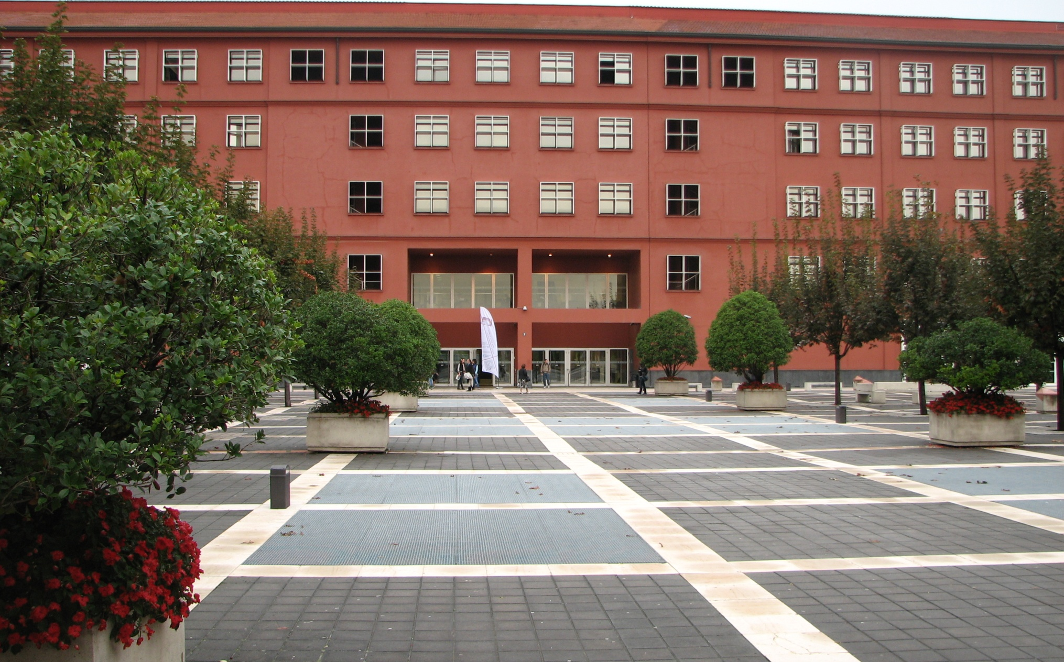
Universita Degli Studi di Milano Bicocca, Italy

Slide 3
Overview
15-18 September 2009
Participants from 40+ countries
600 submissions, ~17% rate, 3-4 reviews
WI/IAT, 4 parallel sessions, 10+ workshops
7 invited talks

Slide 4
Overall conference topics
Query logs
Click-stream analysis
Personalization and recommender systems
Tagging, social networks
Semantic Web, uncertainty
Agent technologies, cognitive science
Robotics, distributed technologies

Slide 5
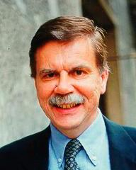
Search computing
Stefano Ceri
Politecnico di Milano
New multi-disciplinary science
Supposed to do the same things as SW (i.e. answer the toughest queries)
… but without the (online) semantics…
… bottom up = syntactic layer ➔ semantics

Slide 6
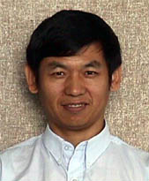
Actionable agent trading strategies
Chengqi Zhang
University of Technology, Sydney
Brokers and financial firms
Creating and combining actionable strategies for agent independent trading
Modeling domain knowledge

Slide 7
Intelligent social network modeling
Ronald R. Yager
Iona College, New Rochelle, U.S.A.
Supposedly in the 1% most cited guys out there (500+ papers, 7000+ citations)
Enriching social network modeling with uncertainty and fuzzy sets
Bridging human understanding and formal network models

Slide 8
From brain informatics to WI
Yulin Qin
WIC Institute, Beijing; CMU, U.S.A.
Relation between WI and BI
Granular reasoning
Too in-depth on BI knowledge and ACT-R

Slide 9
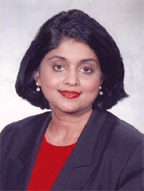
Malicious code detection
Bhavani Thuraisingham
University of Texas, Dallas
National and cyber security
Data mining for threats; intrusion detection
“Active defense” – we spread worms & viruses, obfuscate and try not to get caught
We cannot evaluate it as it is illegal and we would go to jail (but we aren’t the bad guys)

Slide 10
Swarm-bots and swarm intelligence
Marco Dorigo
Université Libre de Bruxelles, Belgium
Model robots based on ant swarms
What can many small/simple robots do?
Self-assembly
Morphology control
Path finding

Slide 11
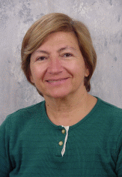
Agent based aiding of human teams
Katia P. Sycara
Carnegie Mellon University, U.S.A.
Adding agents to human teams to facilitate communication and collaboration
Focus on time stressed environments
Radar operators

Slide 12
References
Proceedings…
Mining negative relevance feedback for information filtering – Yuefeng Li et al.
Are clickthroughs useful for image labelling? – Helen Ashman et al.
The geographical life of search – Ricardo Baeza-Yates et al.
Novel item recommendation by user profile partitioning – Neil Hurley et al.
Time-dependent models in collaborative filtering rec. systems – Liang Xiang et al.
An experimental analysis of suggestions in collaborative tagging – Dirk Bollen et al.
Personalized recommenders integrating social tags and item taxonomy – Huizhi Liang et al.
A DBLP search support engine – Yi Zeng et al.
Differential tag clouds: highlighting particular features in docs – Geraldo Xexeo et al.
Utilizing images for assisting cross-language IR on the web – Yoshihiko Hayashi et al.
A query construction service for large-scale web search engines – Ioannis Papadakis et al.

Slide 13
Final impressions
Fact retrieval ➔ Exploratory search
Web IR ➔ Web IR Support Systems
Focus on the users’ perspective
Enable users to make good decisions quickly
Improve user experience… …not “just” precision & recall

Slide 14
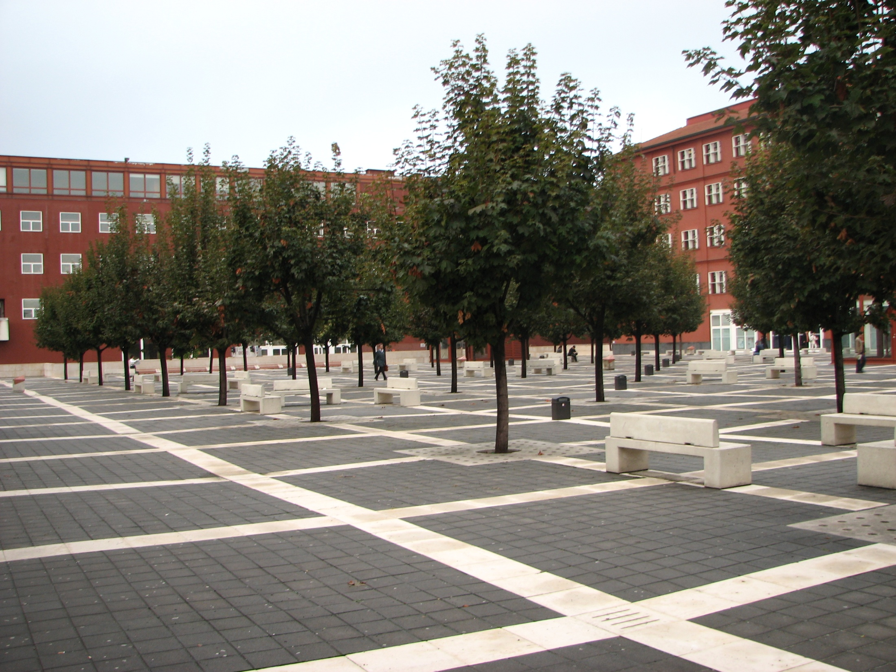

Slide 15
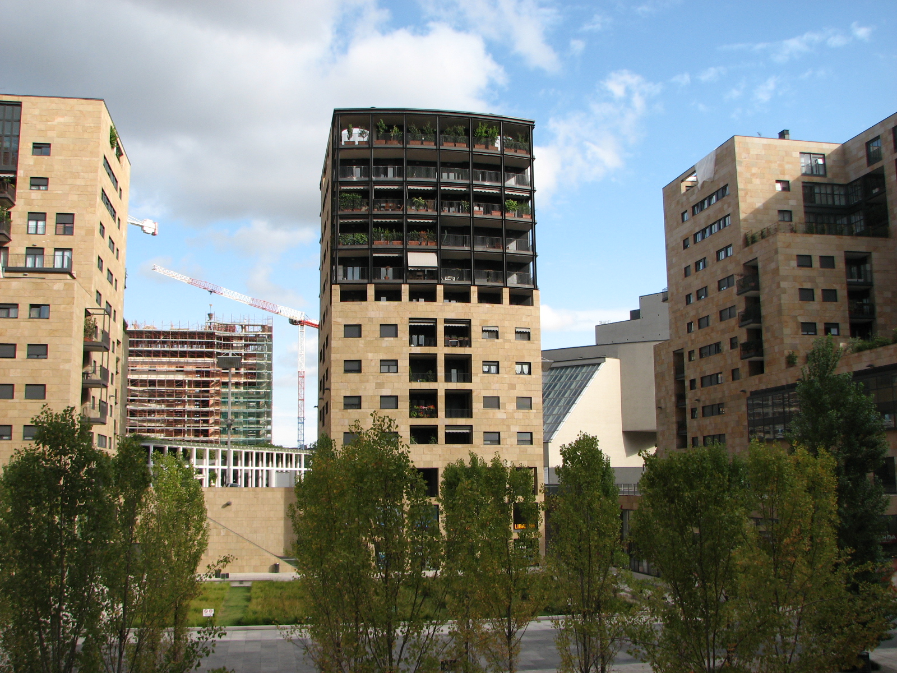

Slide 16
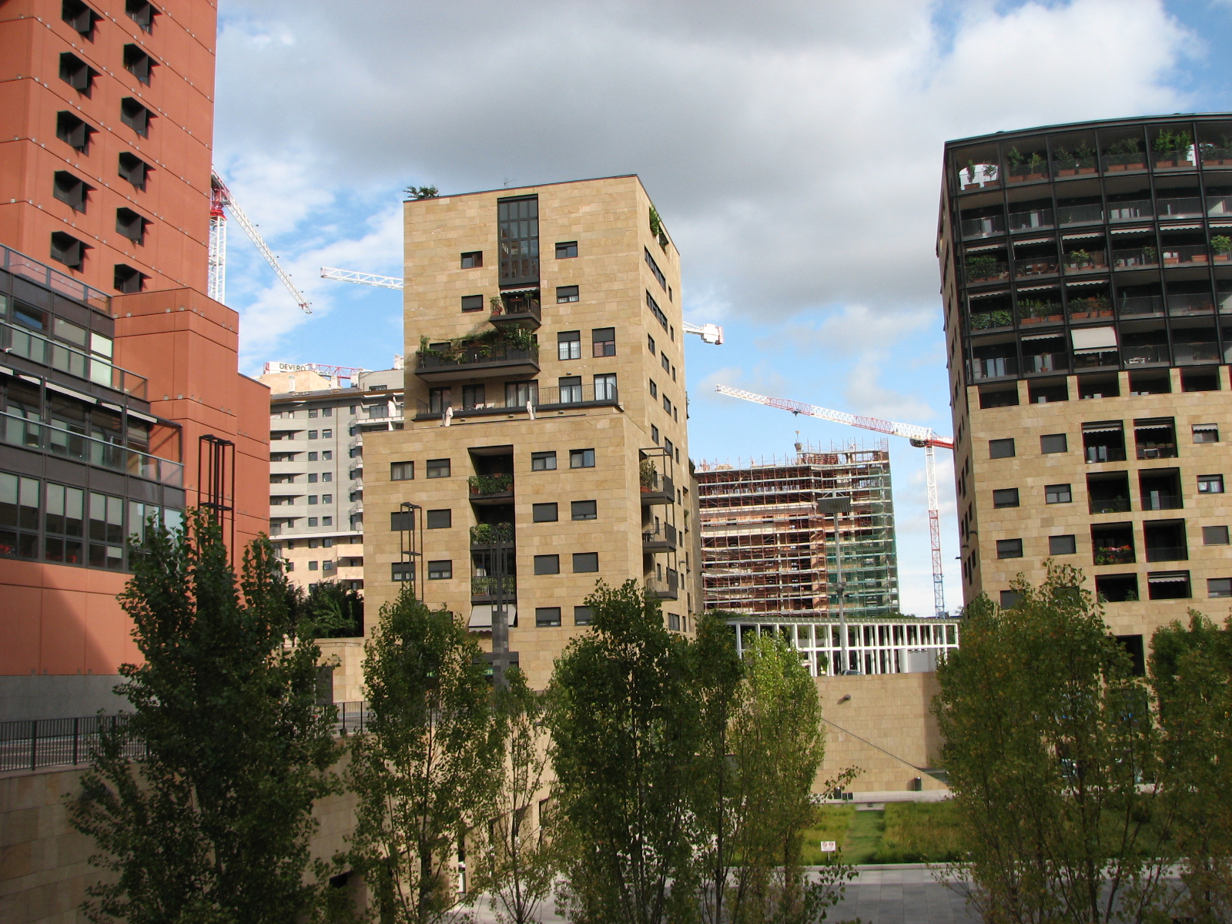

Slide 17
