Slide 1
Report from WSDM 2012
Tomáš Kramár

Slide 2


Slide 3
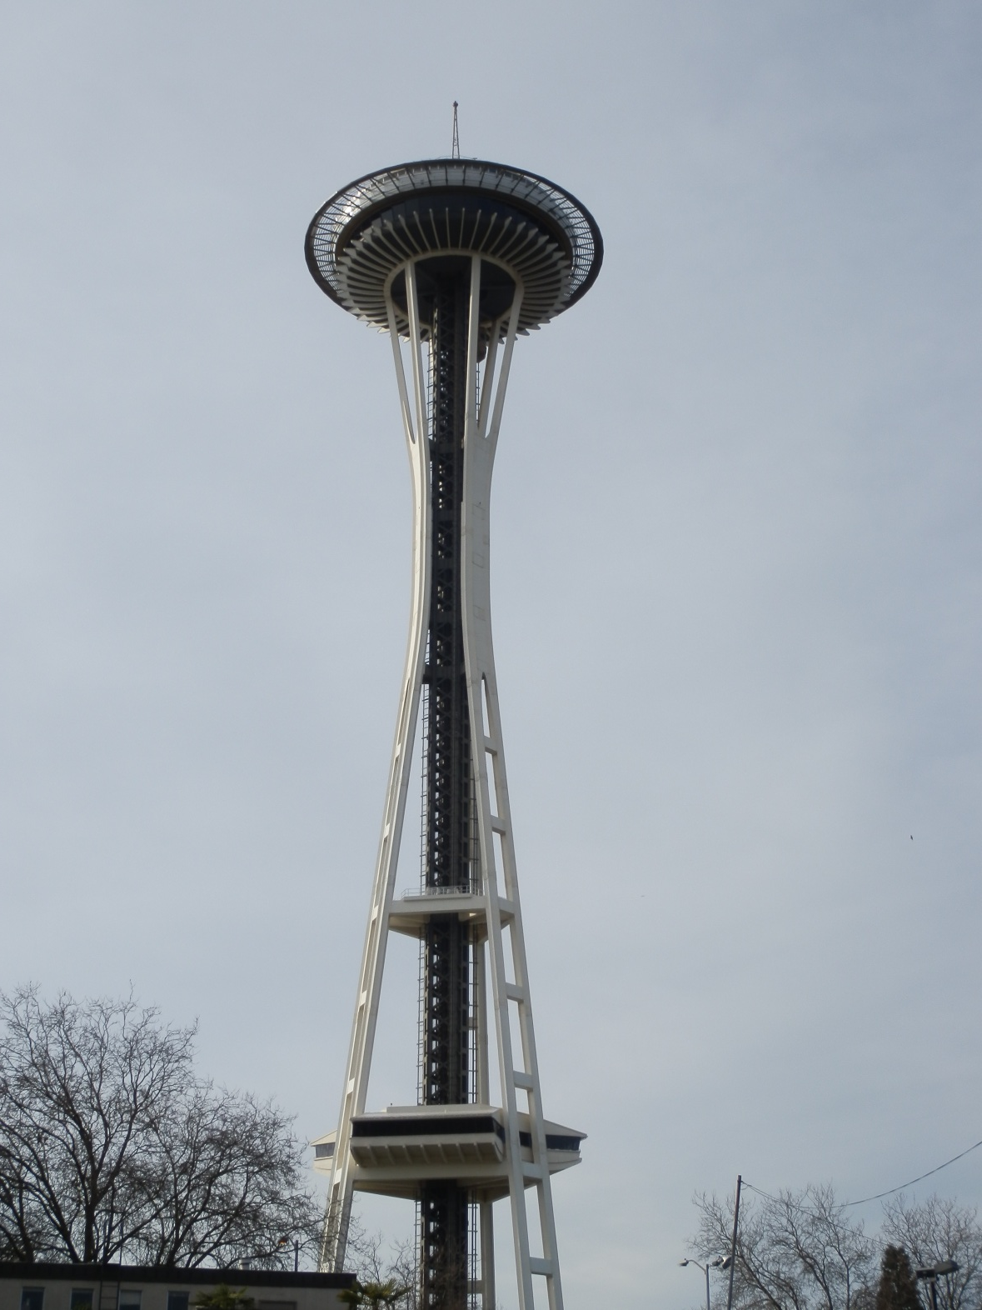

Slide 4
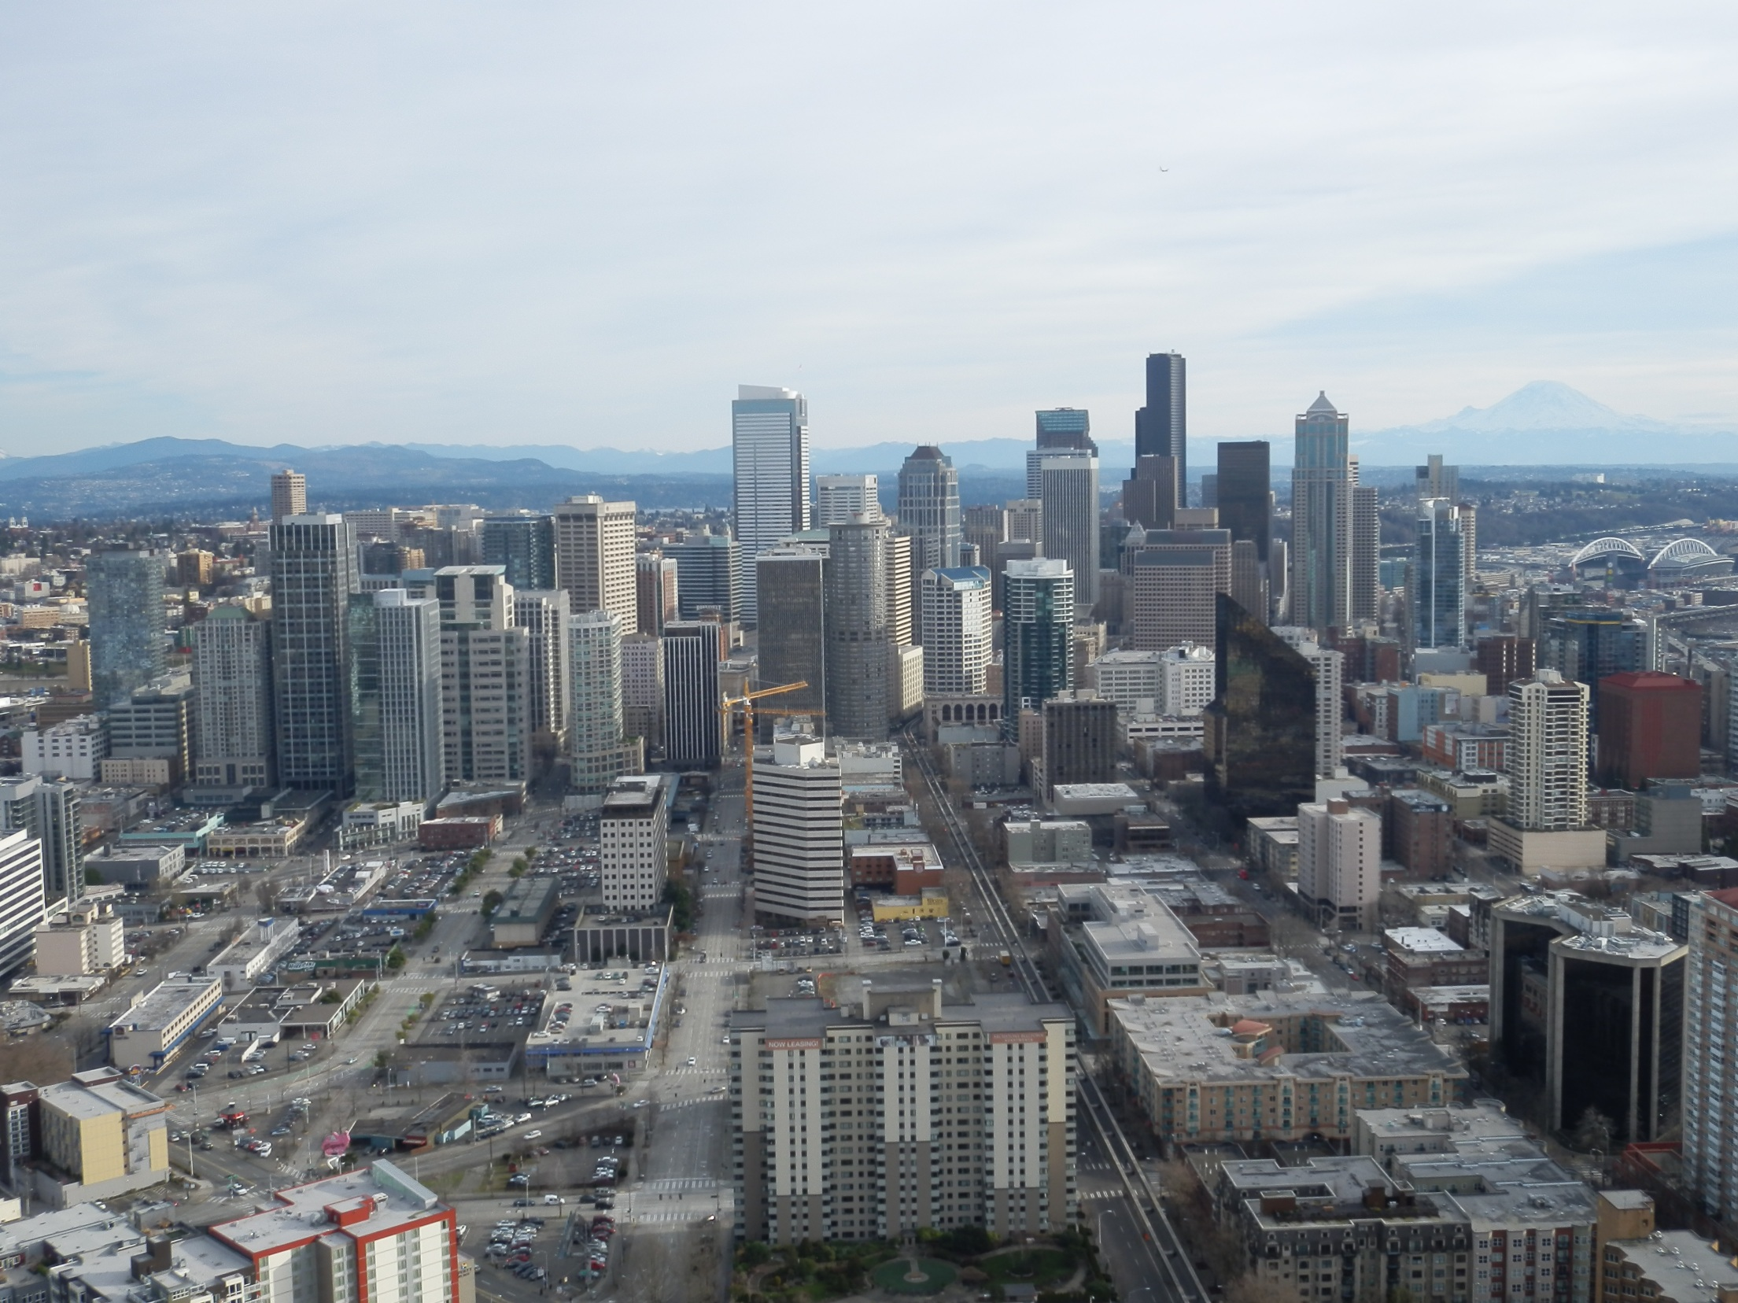

Slide 5
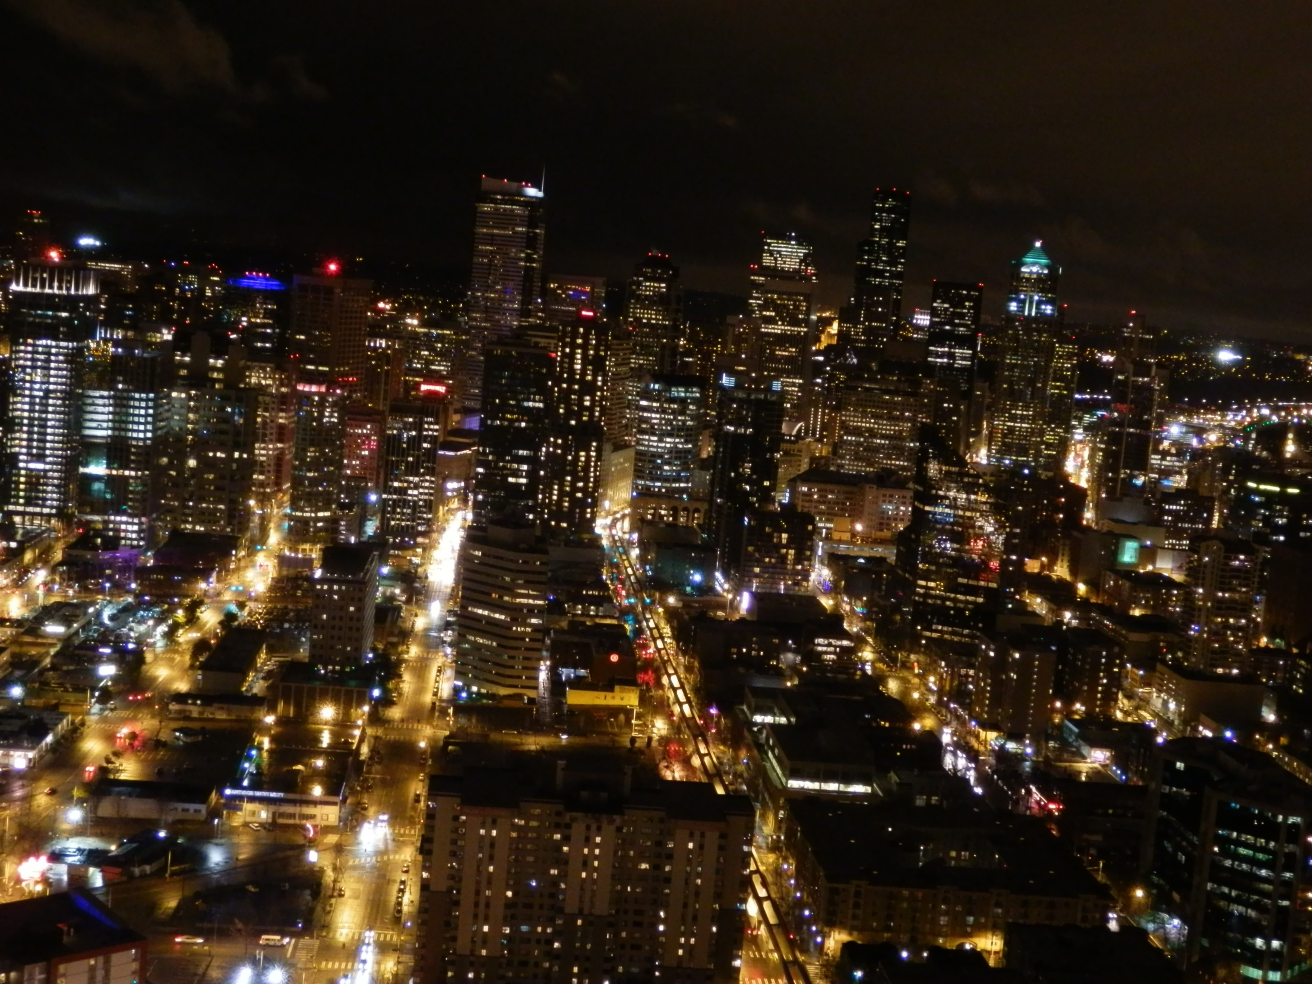

Slide 6
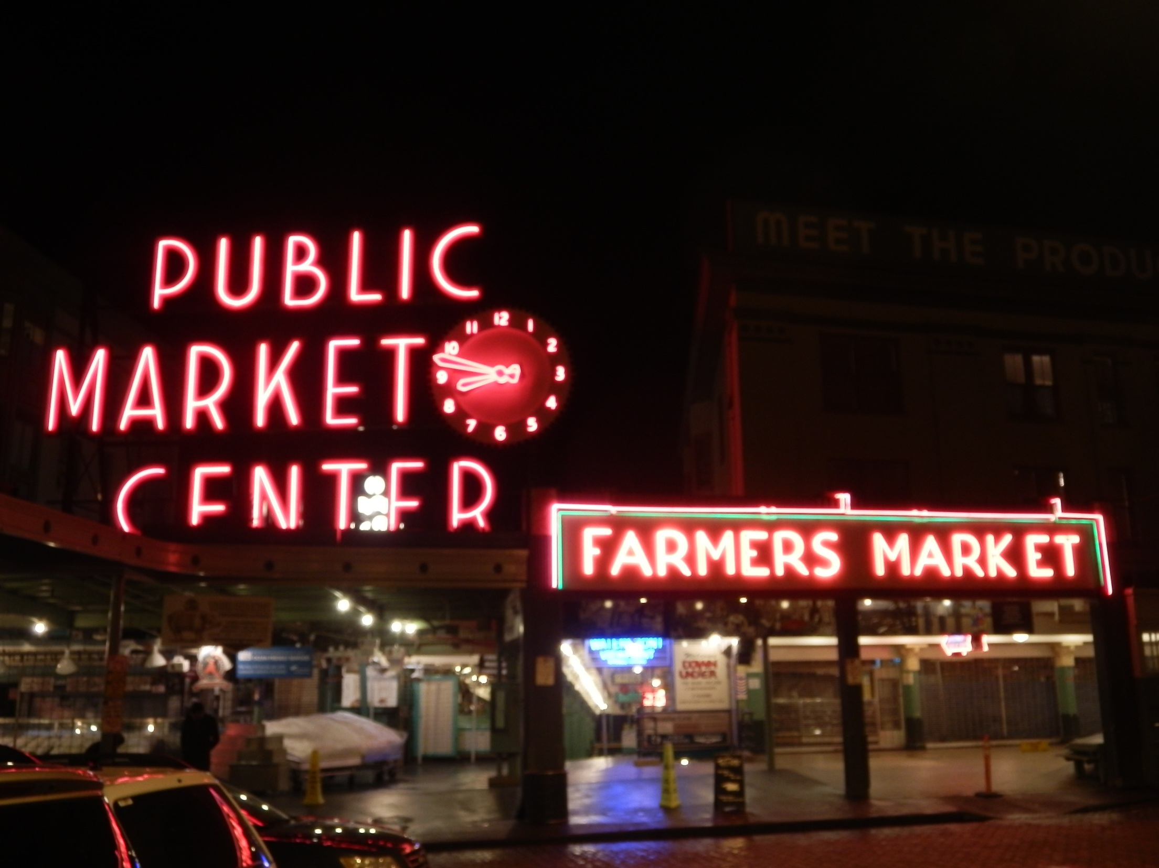

Slide 7
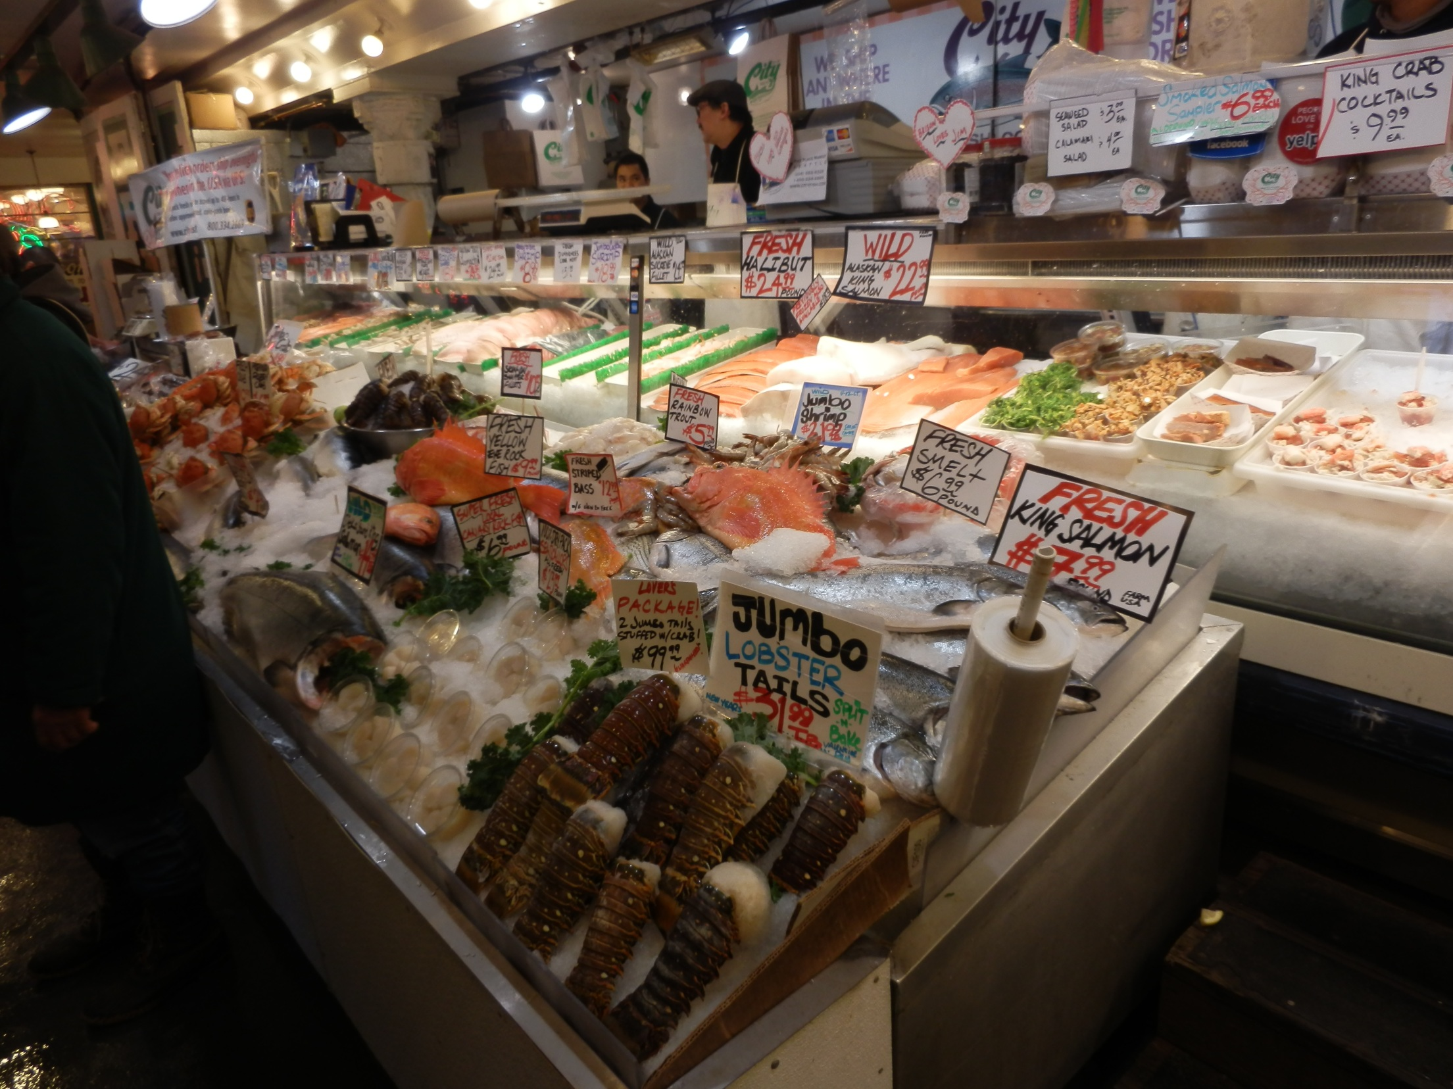

Slide 8
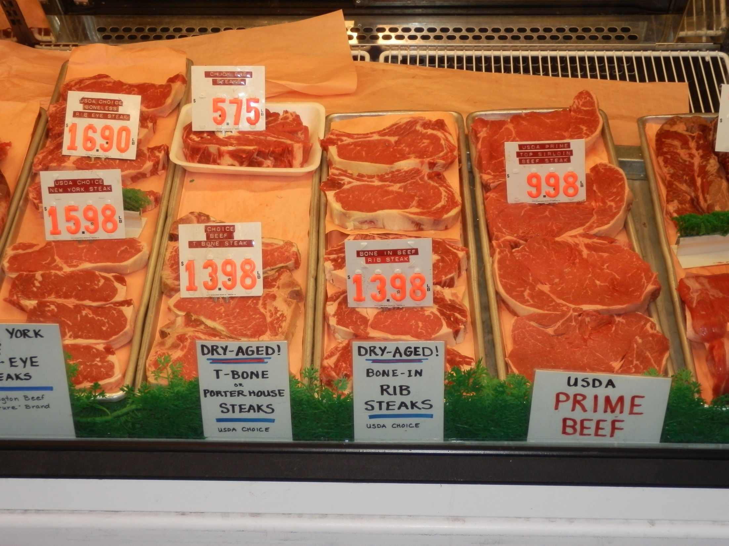

Slide 9
WSDM
75 papers
20.7% acceptance rate
30 of 20-minute talks
45 of 4-minute “spotlights”

Slide 10
Authors

Slide 11
Authors

Slide 12
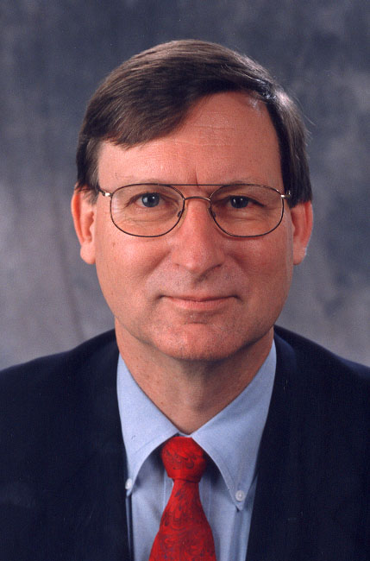
Keynote #1
Hal Varian: C?O @ Google
Nowcasting the Macroeconomy
with Search Engine Data

Slide 13
Keynote #1
Hal Varian: CEO @ Google
Nowcasting the Macroeconomy
with Search Engine Data

Slide 14
Keynote #1
Hal Varian: CEO @ Google
Nowcasting the Macroeconomy
with Search Engine Data
Google Trends & Correlate
hangover
initial claims
  job offers
  adult content
  predictor of recession end
tourism (not japan)

Slide 15
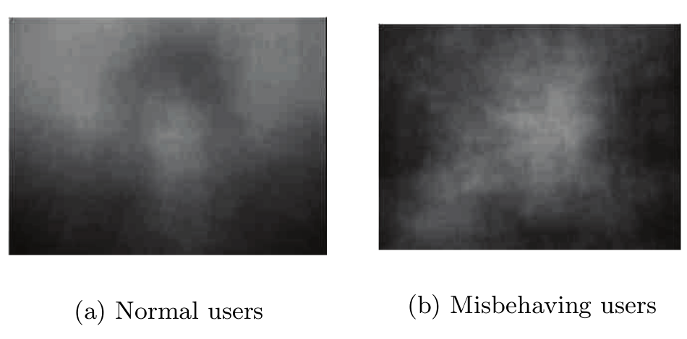
Efficient Misbehaving User Detection in Online Video Chat Services
  Chatroullete nudity detection
  Skin color
  Distribution of light

Slide 16
Overcoming Browser Cookie Churn with Clustering
  30% users reset cookies every month
  clustering cookies by activity patterns
Finding Your Friends and Following Them to Where You Are
  probabilistic model of human mobility
  reconstructs the entire friendship graph with high accuracy even when no edges are given
  infers people’s fine-grained location, even when they keep their data private and we can only access the location of their friends

Slide 17
How to Win Friends and Influence People, Truthfully: Influence Maximization Mechanisms for Social Networks
  cost vs. effect model
From Chatter to Headlines: Harnessing the Real-Time Web for Personalized News Recommendation
  recommending news based on twitter data

Slide 18
Comment Spam Detection by Sequence Mining
  new pattern of spam
  Yahoo News
  Happy 2011 to everyone....My friend Vanessa, a 25 yrs lady, has announced her wedding with a millionaire young man Ronald who is the CEO of a MNC. It’s amazing, she said she just posted her profile on a millionaire dating site called ———-CelebMingle.CM——– - and received his chat invitations a few days later. Then, everything went so well that I can’t believe it’s true! Every love story will unfold on it’s own... Happy to see she is progressing well. Also happy to see that most Americans reject the blame-the-conservatives crap that some (not all) liberals from all social strata were trying to promote for political gain.

Slide 19
To Each His Own: Personalized Content Selection based on Text Comprehensibility
  Alekhine’s Defence: grandmaster vs. novice
  text comprehensibility as important ranking feature
Large-Scale Analysis of Individual and Task Differences in Search Result Page Examination Strategies
  Exhaustive-active, exhaustive-passive, economic

Slide 20
Domain Bias in Web Search
  Position bias
  Snippet attractiveness bias
  25% of the time
Harmony and Dissonance: Organizing the People’s Voices on Political Controversies
  opinion mining
  build graph
  who changes opinions

Slide 21
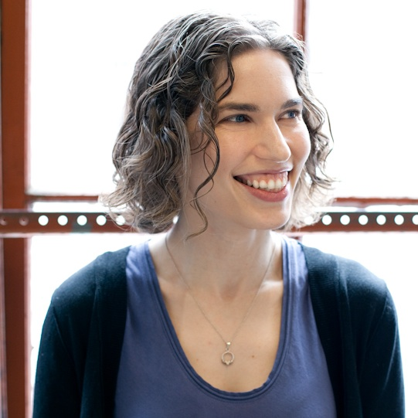
Keynote #2
Hillary Mason,
Chief Scientist @ bit.ly
The Secret Life of Social Links
  bit.ly search
  dragoneye
    hot phrases
    bursting phrases
  What is the half-time of a link? Factors?
  Revolution prediction
  Device usage

Slide 22
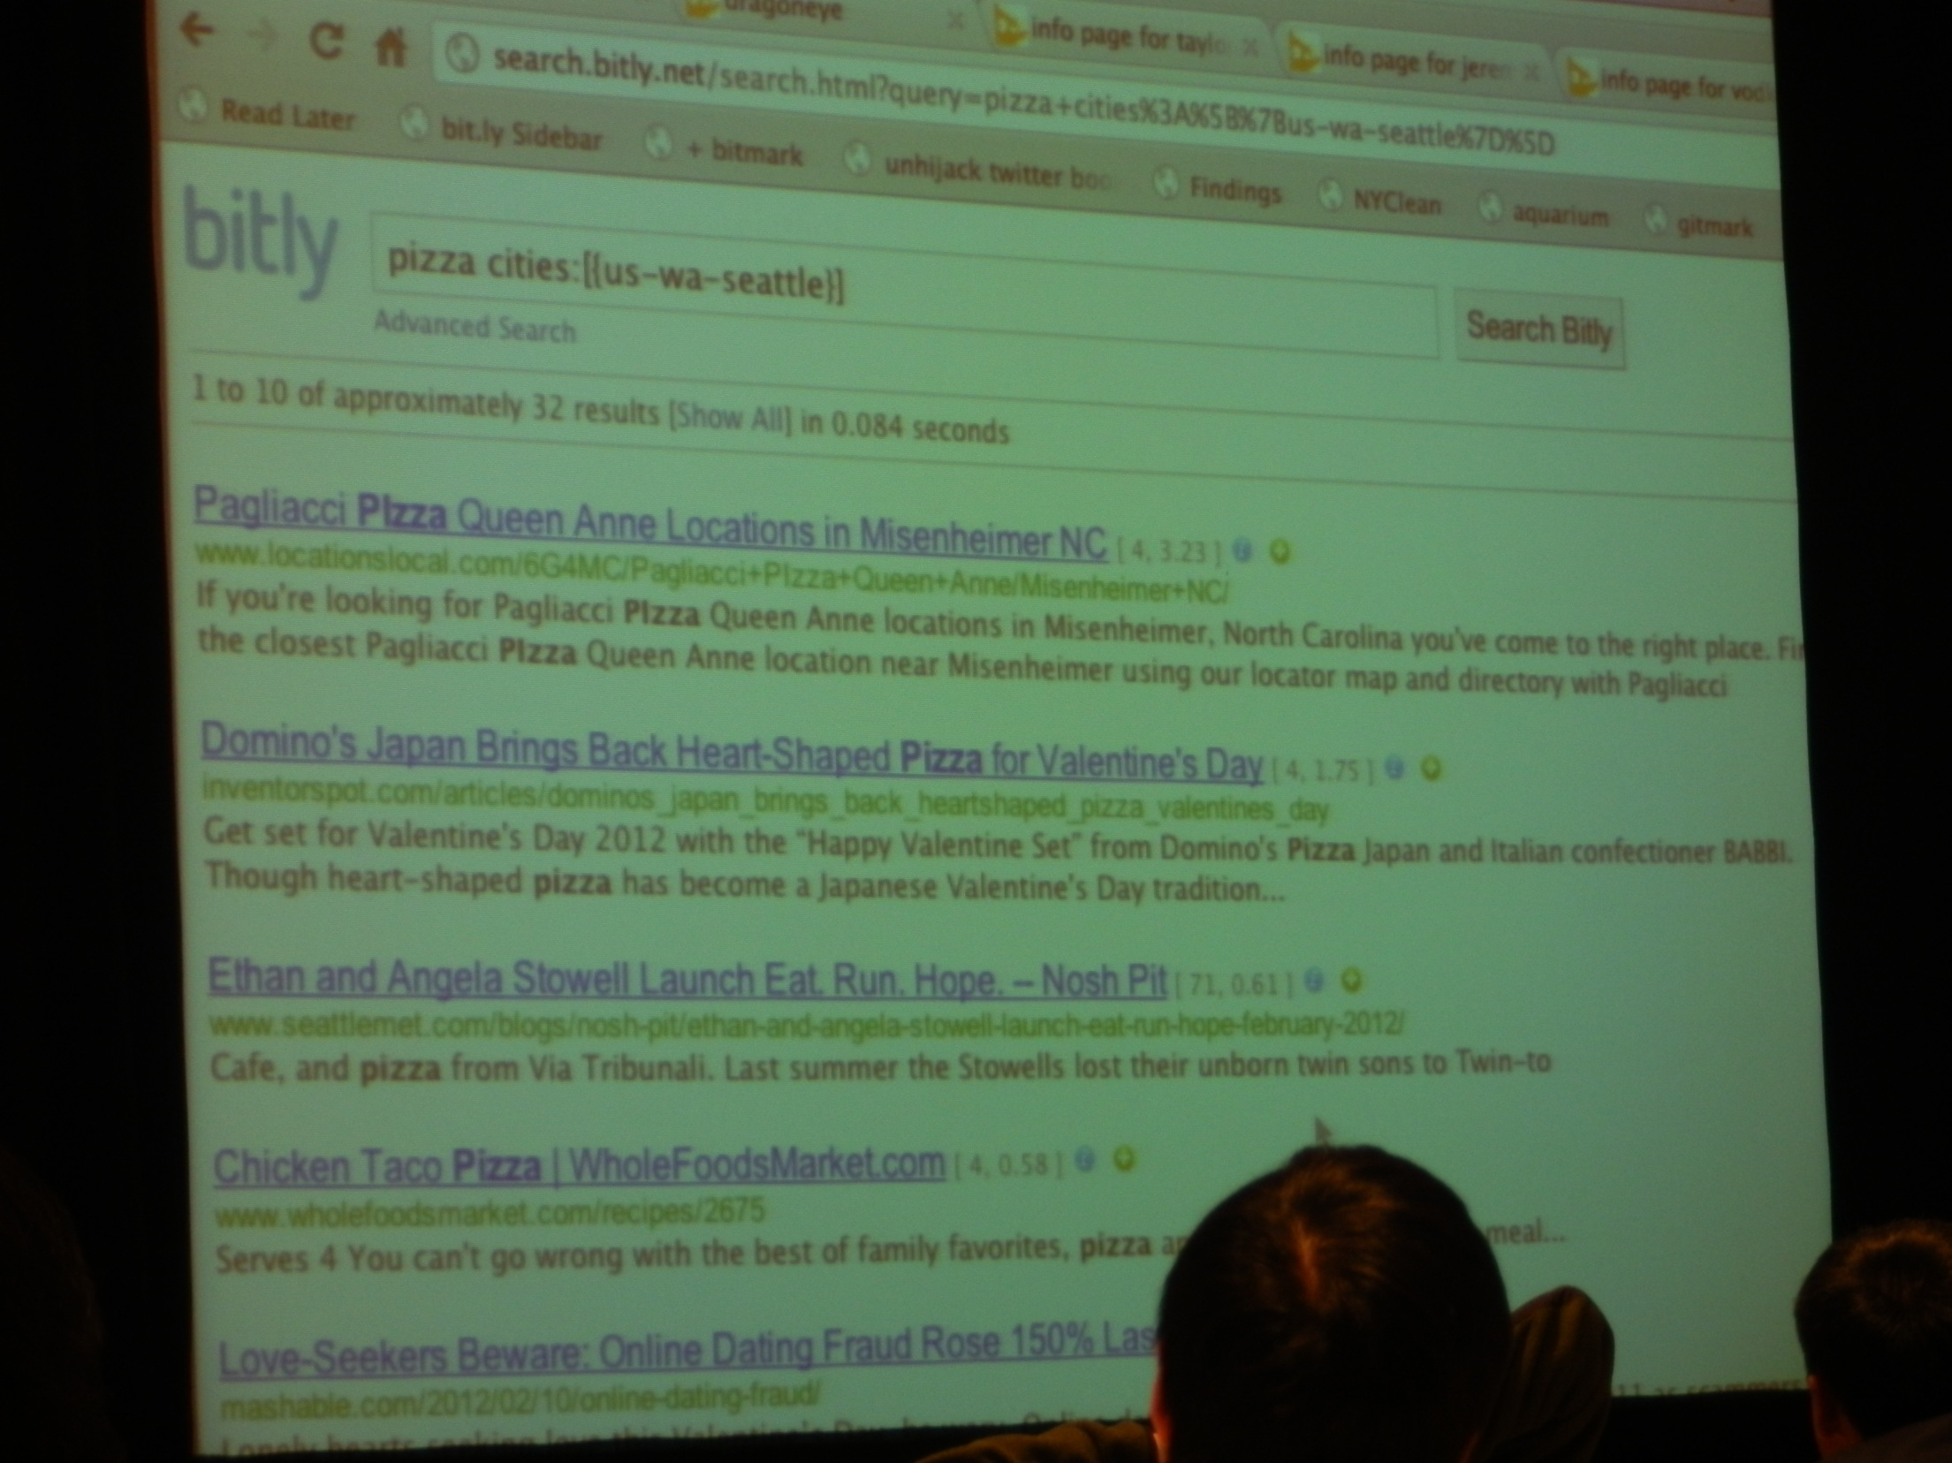

Slide 23
Reasons to read papers from WSDM

Slide 24
Reasons to read papers from WSDM
Reasons to not read papers from WSDM:

Slide 25
