Slide 1
Reading:
Pedro Domingos:
A Few Useful Things to Know about
Machine Learning
source: https://homes.cs.washington.edu/~pedrod/papers/cacm12.pdf
reading moderator: OK

Slide 2
INTRODUCTION
Machine learning algorithms can figure out how to perform important tasks by generalizing from examples.
As more data becomes available, more ambitious problems can be tackled.
The paper contains lot of “folk knowledge” that is needed to successfully develop machine learning applications, which is not readily available in ML textbooks.

Slide 3
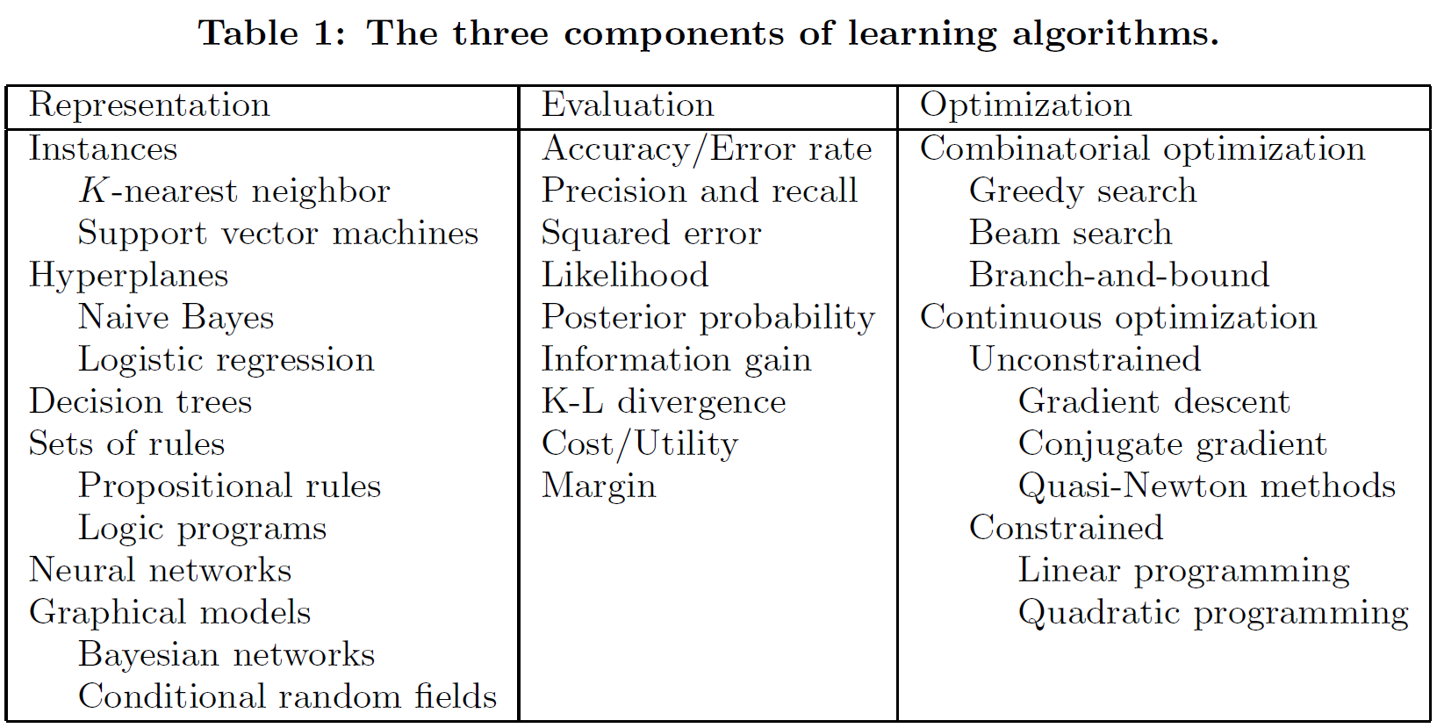
LEARNING = REPRESENTATION +
EVALUATION + OPTIMIZATION
Representation – algorithm, implementation
Evaluation – metric selection, results based on specific data
Optimization – from off-the-shelf to custom settings

Slide 4
IT’S GENERALIZATION THAT COUNTS
Distinguish between train and test data!
Reach good result on train data is easy
To use as many data as possible use X-validation

Slide 5
DATA ALONE IS NOT ENOUGH
Consider learning a Boolean function of (say) 100 variables from a million examples. There are 2¹⁰⁰ − 10⁶ examples whose classes you don’t know.
The functions we want to learn in the real world are not drawn uniformly from the set of all mathematically possible functions!
Similar examples have often similar classes, limited dependences, or limited complexity. This is often enough to do very well, and this is a large part of why machine learning has been so successful.

Slide 6
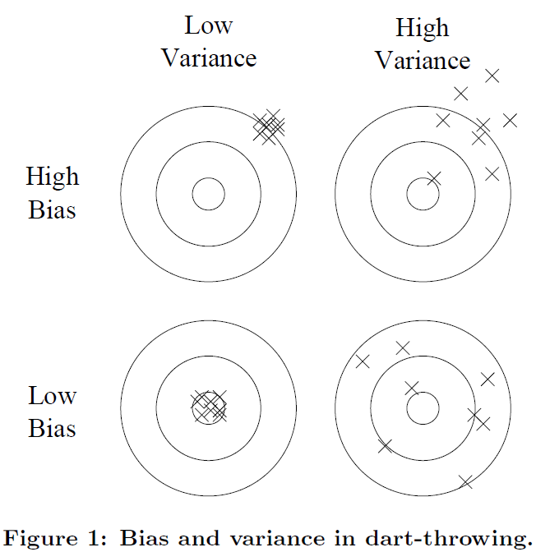
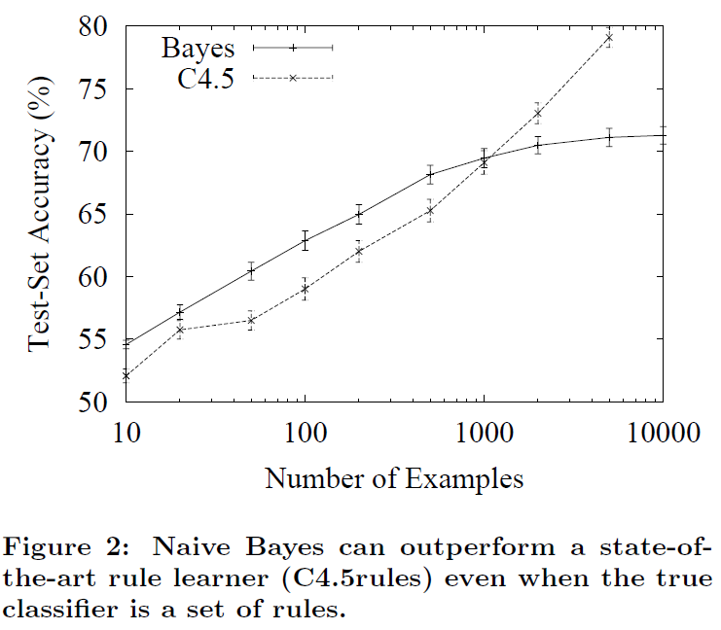
OVERFITTING HAS MANY FACES
What if the knowledge and data we have are not sufficient to completely determine the correct classifier?
Bias – e.g., linear predictors problem
Variance – e.g., decision trees problem
Strong false assumptions can be better than weak true ones, because a learner with the latter needs more data to avoid overfitting.
X-validation, regularization

Slide 7
INTUITION FAILS IN HIGH DIMENSIONS
Curse of dimensionality
Correct generalizing becomes exponentially harder as the dimensionality (number of features) of the examples grows, because a fixed-size training set covers a dwindling fraction of the input space.
When gathering more features, their benefits may be outweighed by the curse of dimensionality. For this reason add new attributes only if they bring new information (do not use highly correlatng features).

Slide 8
FEATURE ENGINEERING IS THE KEY I.
At the end of the day, some machine learning projects succeed and some fail. What makes the difference?
The most important factor of ML project is the features used.
  With many independent features that each correlate well with the predicted class, learning is easy.
  On the other hand, if the class is a very complex function of the features, you may not be able to learn it.
Constructing features is typically the part, where the most of the effort in a machine learning project goes. It is often also one of the most interesting parts, where intuition, creativity and “black art” are as important as the technical stuff.
ML is often the quickest part, but that’s because we’ve already mastered it pretty well!
  Feature engineering is more difficult because it’s domain-specific, while learners can be largely general-purpose.

Slide 9
FEATURE ENGINEERING IS THE KEY II.
One of the holy grails of machine learning is to automate the feature engineering process.
  Today it is often done by automatically generating large numbers of candidate features and selecting the best by (say) their information gain with respect to the predicted class. Bear in mind that features that look irrelevant in isolation may be relevant in combination.
  On the other hand, running a learner with a very large number of features to find out which ones are useful in combination may be too time-consuming, or cause overfitting.

Slide 10
MORE DATA BEATS A CLEVERER ALGORITHM I.
ML researchers are mainly concerned with creation of better learning algorithm, but pragmatically the quickest path to success is often to just get more data.
This does bring up another problem, however: scalability.
  In most of computer science, the 2 main limited resources are time and memory. In ML, there is a 3rd one: training data.
  Bottleneck changed from data to time

Slide 11
MORE DATA BEATS A CLEVERER
ALGORITHM II.
Try the simplest learners first (e.g., naive Bayes before logistic regression, k-nearest neighbor before support vector machines).
  More sophisticated learners are seductive, but they are usually harder to use, because they have more knobs you need to turn to get good results.
Learners can be divided into two major types: those whose representation has a fixed size, like linear classifiers, and those whose representation can grow with the data, like decision trees.
  Fixed-size learners can only take advantage of so much data.
  Variable-size learners can in principle learn any function given sufficient data, but in practice they may not, because of limitations of the algorithm (e.g., greedy search falls into local optima) or computational cost.
  Because of the curse of dimensionality, no existing amount of data may be enough. For this reason, clever algorithms — those that make the most of the data and computing resources available — often pay off in the end, provided you’re willing to put in the effort.

Slide 12
LEARN MANY MODELS, NOT JUST ONE
Ensemble, ensemble, ensemble
  Bagging - the simplest technique, which simply generate random variations of the training set by resampling, learn a classifier on each, and combine the results by voting. This works because it greatly reduces variance while only slightly increasing bias.
  Boosting - training examples have weights, and these are varied so that each new classifier focuses on the examples the previous ones tended to get wrong.
  Stacking - the outputs of individual classifiers become the inputs of a “higher-level” learner that figures out how best to combine them.

