Slide 1
Mis-information reading: an eye-tracking study proposal
Jakub Šimko, Martina Hanáková, Patrik Racsko

Slide 2
Context: the REBELION project

Slide 3
Primary goal: learn how the fake news and misinformation are consumed
In particular: we wish to learn some content features worth using for automated fake news detection

Slide 4
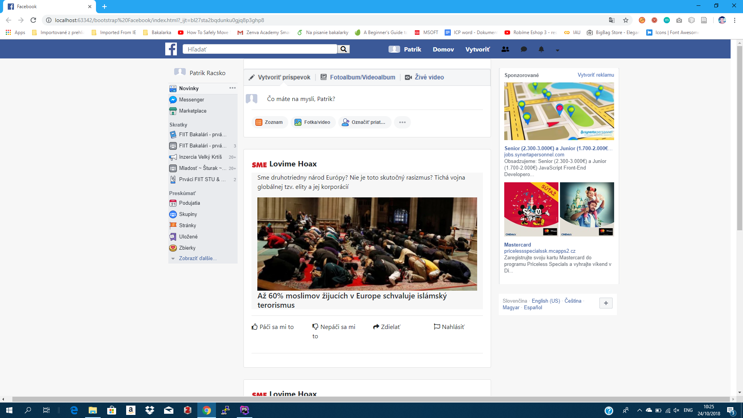
General experiment environment: a social network feed
Several polarizing topics
True and false (fake news) articles from both sides

Slide 5
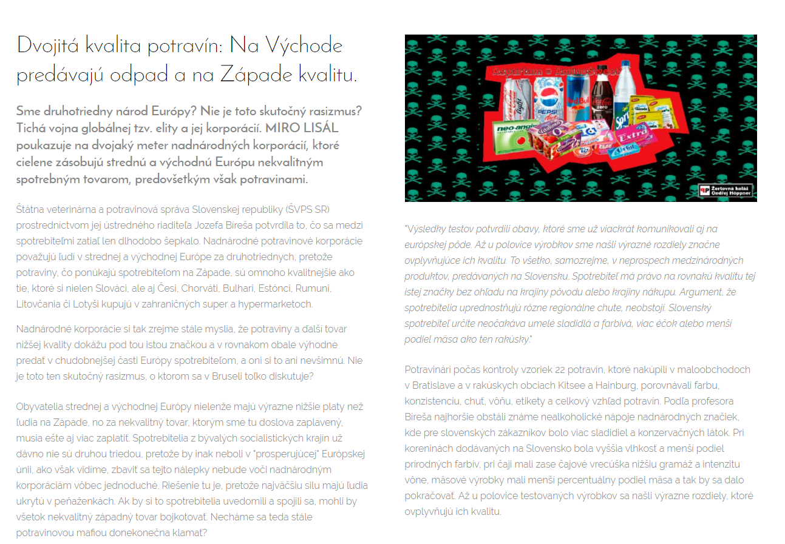
Participants will be allowed to open an article

Slide 6
With each post, there will be 4 optional actions available
Like it
Dislike it
Share it
Report it
(do nothing)

Slide 7
The task would be formulated as follows:
Casually scroll through this feed for the next XX minutes, relax and read what picks up your interest.
You can open the full article, if you wish.
If you feel, you’d have responded with a like or dislike, do it.
If you feel, that you’d share the post, do it.
If you feel, that you’d report the post, do it.

Slide 8
After the reading, we will issue several questionnaires asking/testing for:
Opinion stances on given article topics
Degree of interest on given article topics
Level of critical thinking
Demographics
... ?

Slide 9
We do not have any hypotheses yet, but we have some high-level research questions
Q1: Is there an effect on behavior induced by false nature of the content?
Q1a: Effects on the explicit behavior?
Q2: Is there an effect on behavior induced by previous user opinion on given topics?
Every feedback is appreciated

