Slide 1
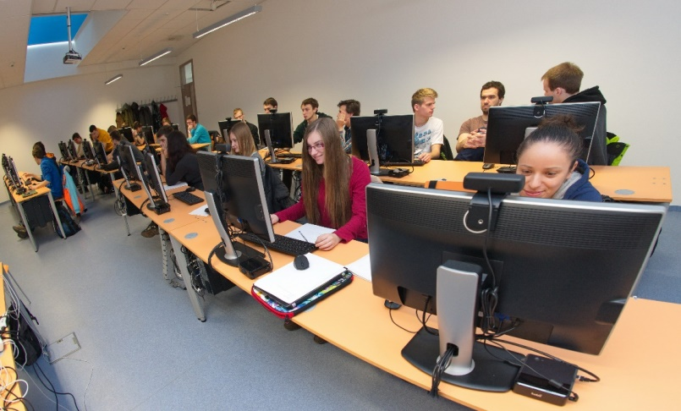
Data Analysis and Machine Learning: From Clicks, Gaze, Face to Evaluation of User eXperience
Mária Bieliková

Slide 2
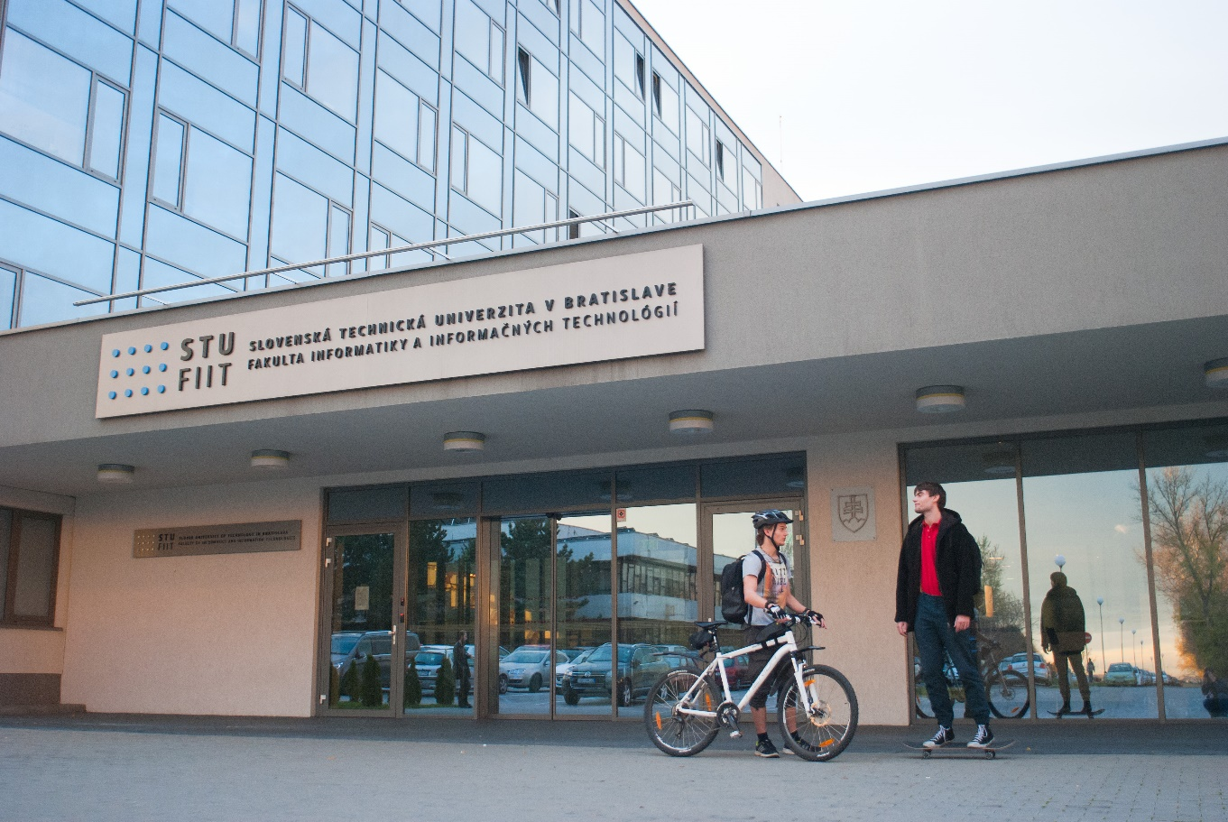
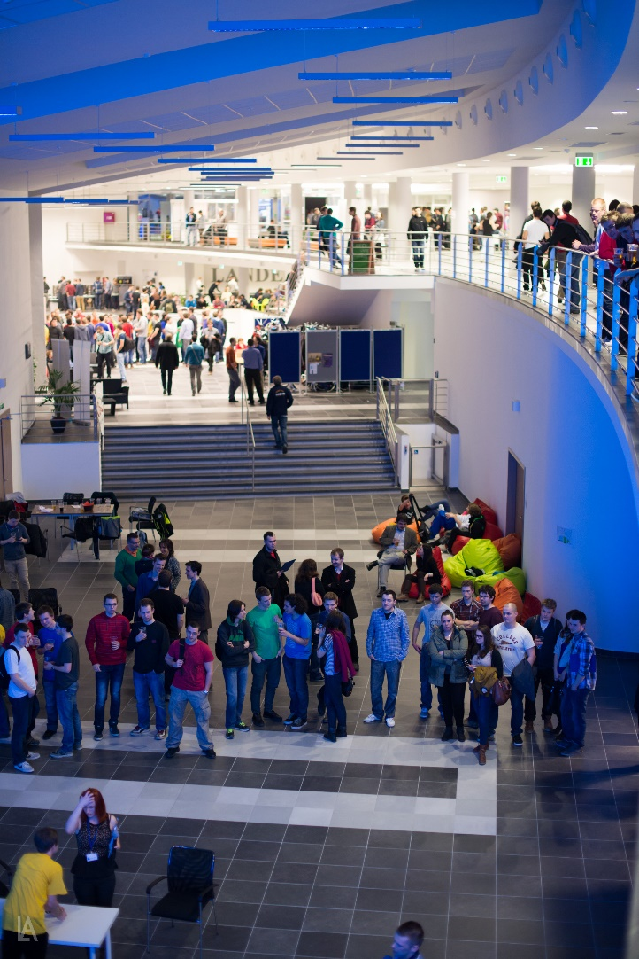
Faculty of Informatics and Information Technologies Slovak University of Technology in Bratislava

Slide 3
Research at FIIT STU
E-shop recommender
Internet of Everything
data analysis and machine learning
prediction
anomaly detection
classification and clustering
text processing
user experience and personalization
computer graphics and computer vision
security evaluation, secure access control in MANET
computer networks
(real-time) embedded systems
Bioinformatics
Education data mining
Web log analysis
Media and TV program recommendation
Sentiment analysis
Prediction of power load consumption

Slide 4
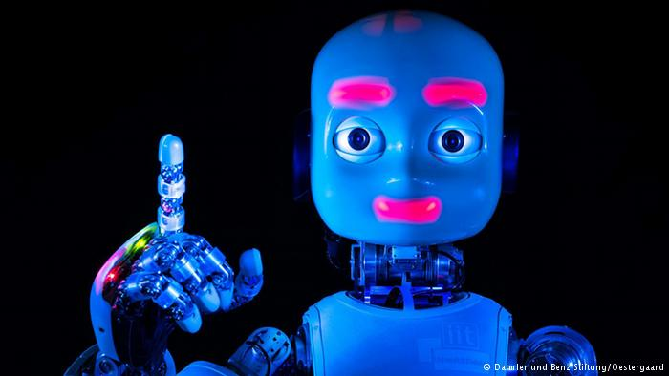
“The factory of the future will have only two employees, a man and a dog. The man will be there to feed the dog. The dog will be there to keep the man from touching the equipment.” —Autodesk CEO Carl Bass.

Slide 5
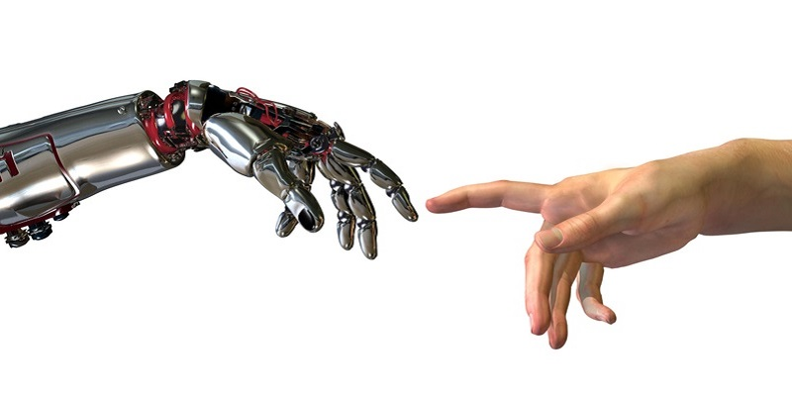
We should help people to communicate with computers

Slide 6
Interesting research topics
Researching models of behavior of users and groups based on monitoring of view, face, emotions, interactions with the keyboard and mouse
Examining the user behavior and user experience during the use of applications, including mobile and multimedia using qualitative and quantitative study based on research in machine learning and data mining
Design of adaptive, personalized and interactive software systems

Slide 7
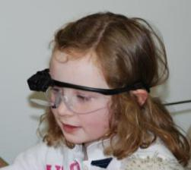
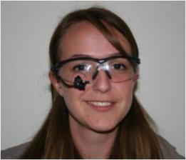
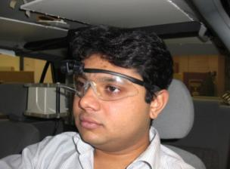
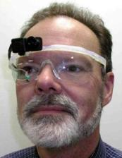
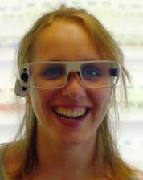
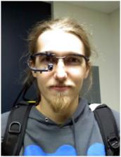
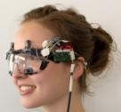
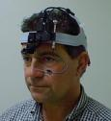
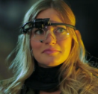
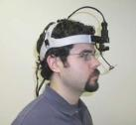
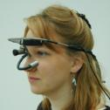
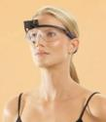
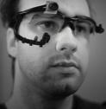
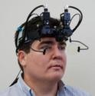
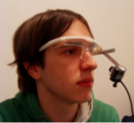
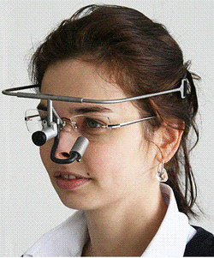
90% of information in our brain comes from visual stimuli

Slide 8
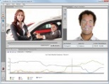
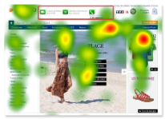
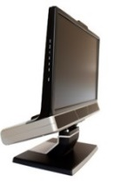
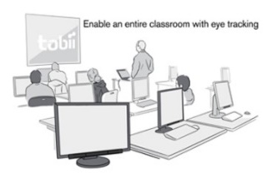
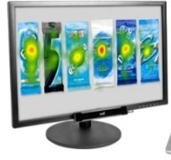
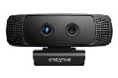
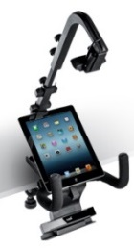
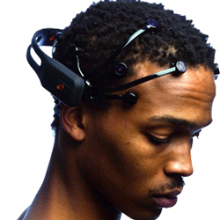
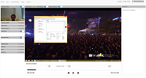
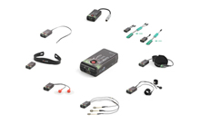
User eXperience and Interaction (UXI) Research Center @ FIIT STU
UX Sensor Lab
UX Group Lab
20x
emotion detection
Tobii studio
300 Hz
gaze tracking
3D depth camera
60 Hz gaze tracking
TV
3D depth camera
Emotion detection
EEG
ECG, GSR, FSR, °C
Smartphones, tablets
UX Research infrastructure software

Slide 9
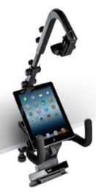
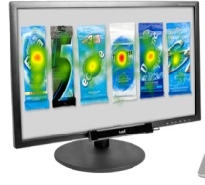
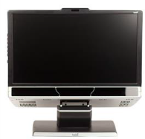
UXI@FIIT = three laboratories
Tobii X2-60 mobiles, TV, PC
Control
room
Tobii TX300 PC, EEG, ...
20x Tobii X2-60 gaze tracking PC

Slide 10
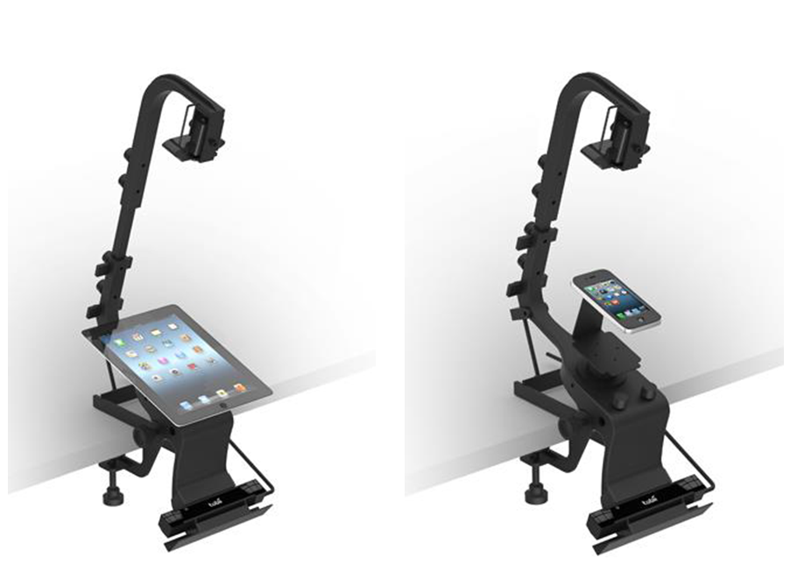
Analysis of user feedback in mobile applications
HD camera
60Hz
eyetracker

Slide 11
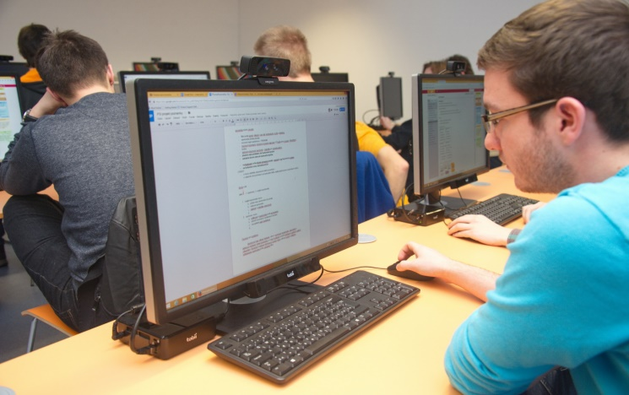
20 eye-trackers in one room (UXI Labs @ Slovak University of Technology)
20x Tobii X2-60 eye trackers
Screen recording
Face recording
+
Infrastructure for transferring all the data to the central server
3D depth camera
60Hz
eyetracker

Slide 12
Mass data collection is excellent for summative studies
Same conditions for every participant
Saving staff time

Slide 13
Our UX Group Research Software
Data collection from all UX nodes
Lifecycle management of user studies projects
Processing of gathered data
Annotations
Cleaning
Export
Archivation

Slide 14
People have different abilities and personal traits
cognitive abilities (velocity of perception, working memory, …)
personal traits
HCI literacy
Notes:
ziskanie dodatocnych informacii o pouzivateloch
indentifikacia individualnych rozdielov
interpretacia vysledkov so zohladnenim rozdielov

Slide 15
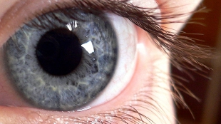
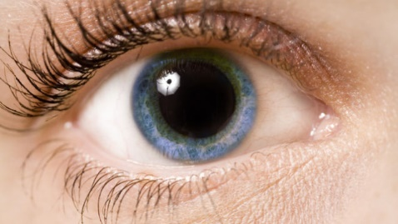
How much is this app frustrating?
Cognitive load is characterized by pupil dilation
Pupil changes also with color changes

Slide 16
http://www.uxi.sk

