Slide 1
Neural Networks Research Group @ PeWe
Group Introduction
21st September 2017

Slide 2
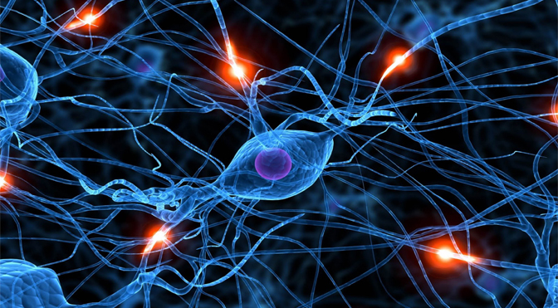
Neural networks

Slide 3
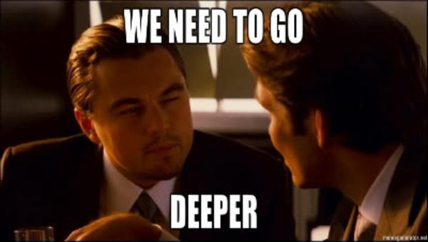
Neural networks

Slide 4
Deep netorks

Slide 5
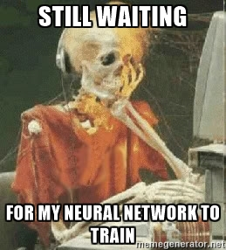
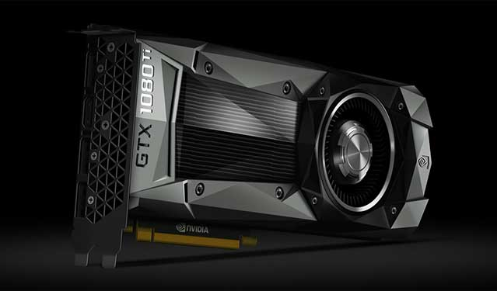
Deep networks

Slide 6
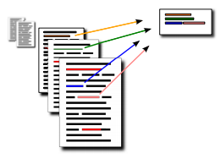
Natural language processing (NLP)

Slide 7
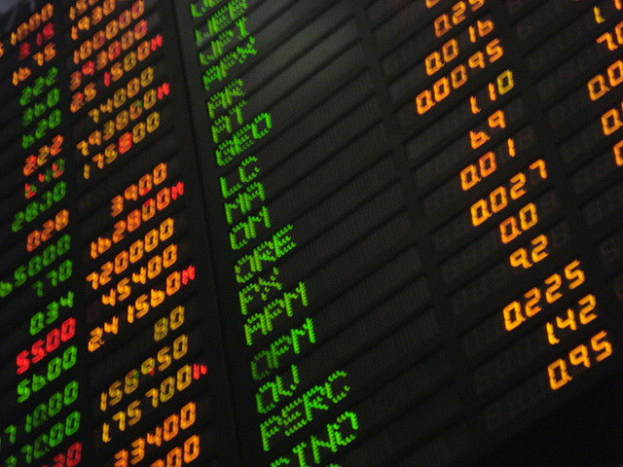
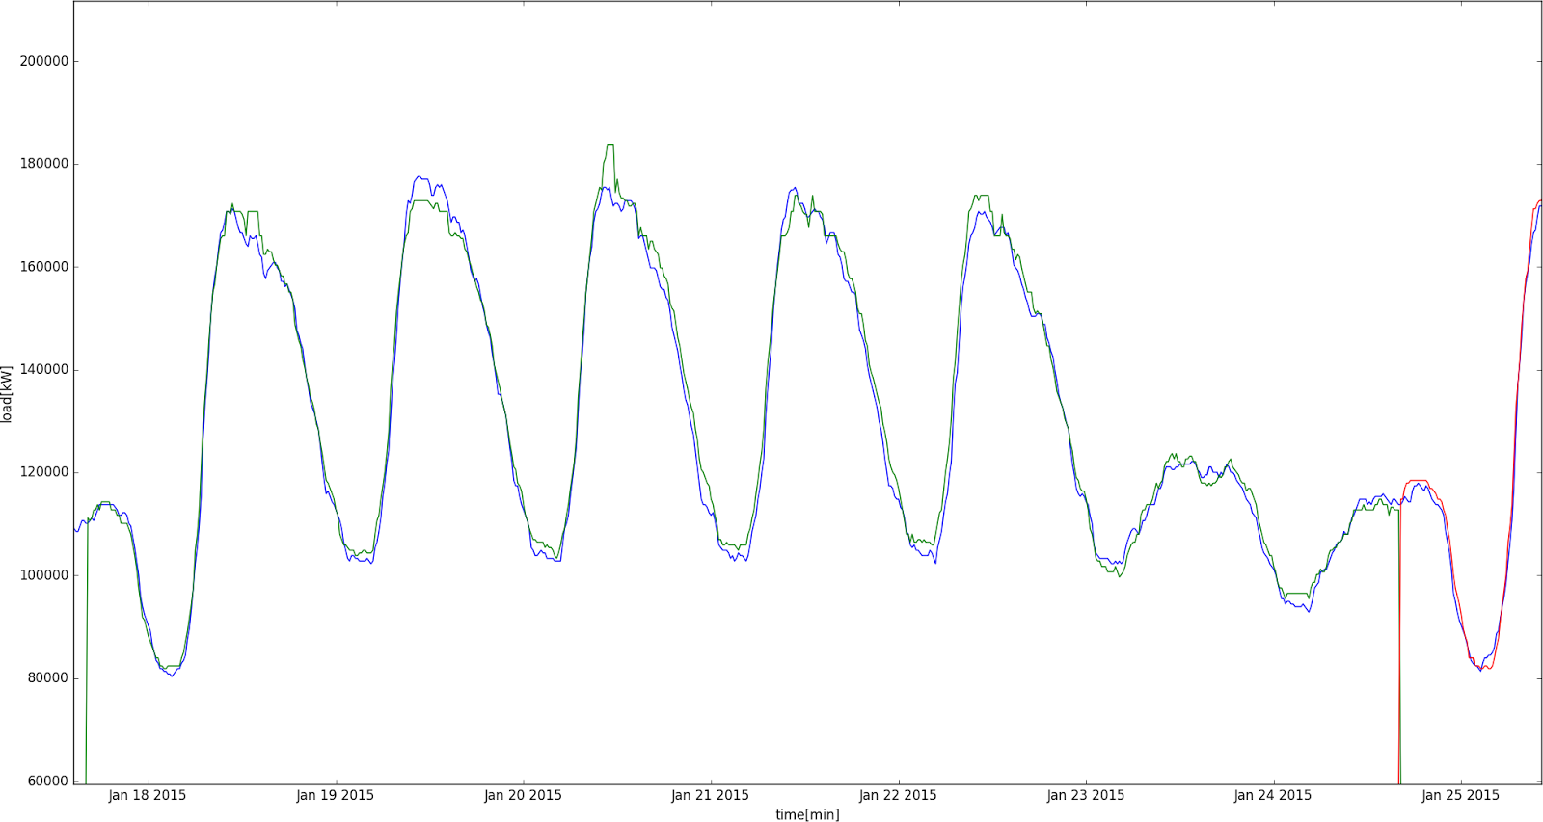
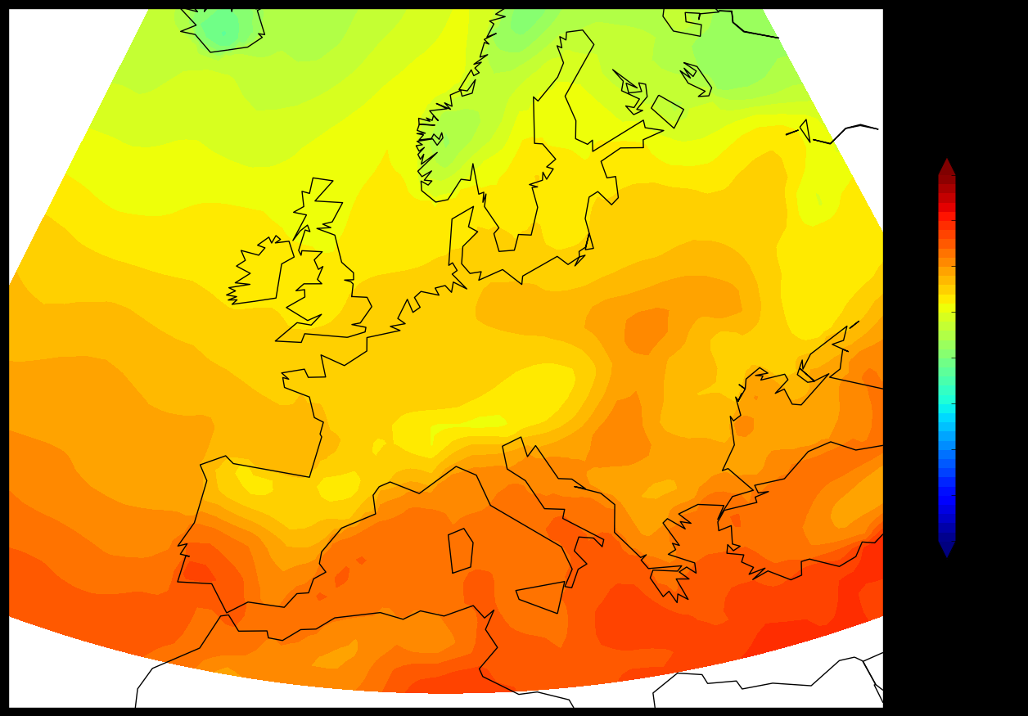
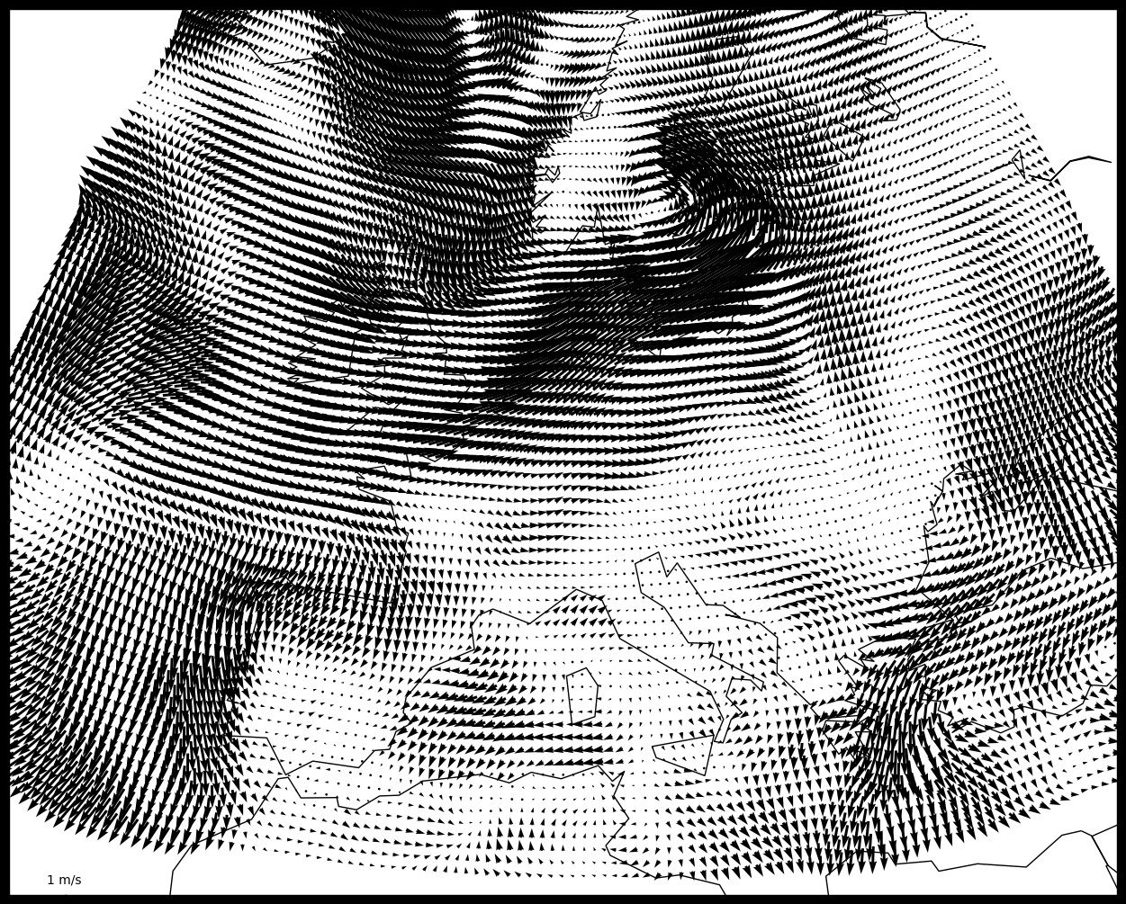
(Time) series prediction

Slide 8
Music analysis

Slide 9
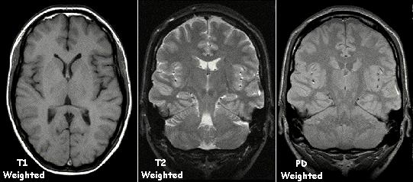
Image processing

Slide 10
Members
Staff
Viktor Bachratý
Michal Barla
Mária Bieliková
Peter Lacko
Doctoral students
Michal Farkaš
Lukáš Marták
Matúš Pikuliak
Martin Tamajka
+ everyone who wants to train his network

