Slide 1



UXI@FIIT
User eXperience and Interaction
Research center @ FIIT STU, Bratislava
Slovak University of Technology in Bratislava
www.uxi.sk

Slide 2
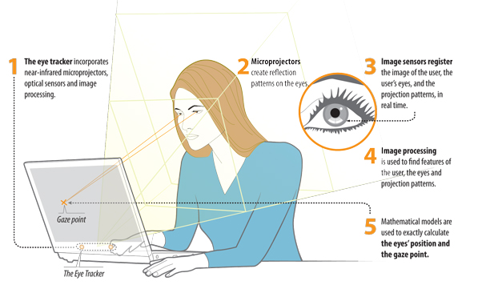
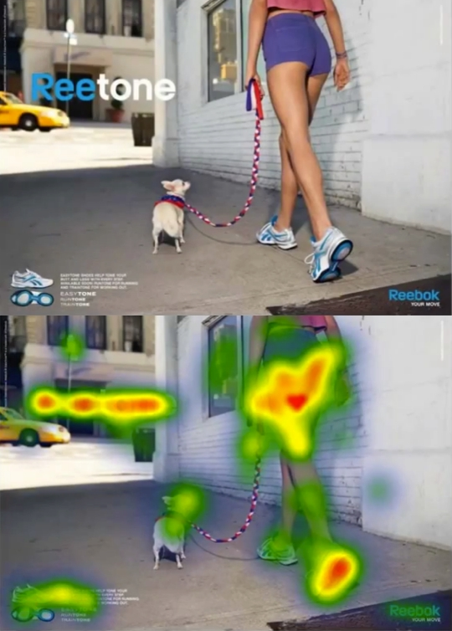
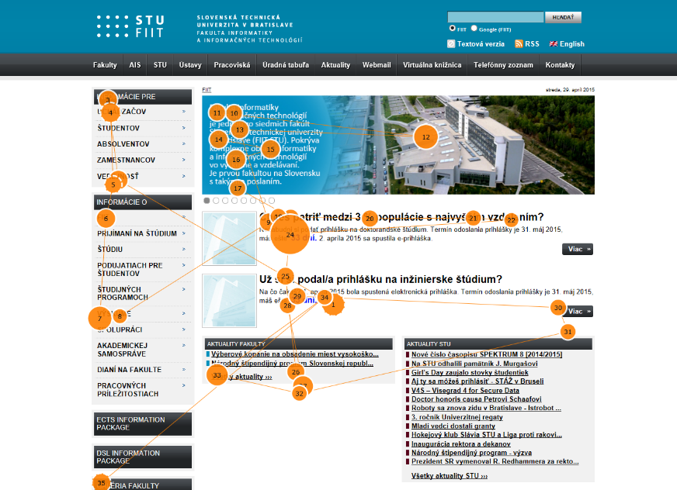
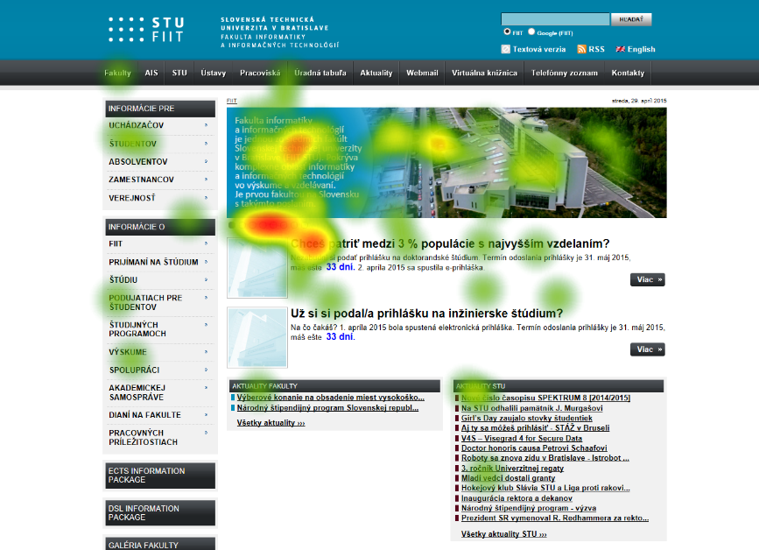
How does it work? & What can it measure?

Slide 3
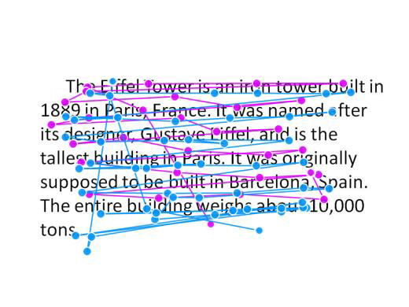
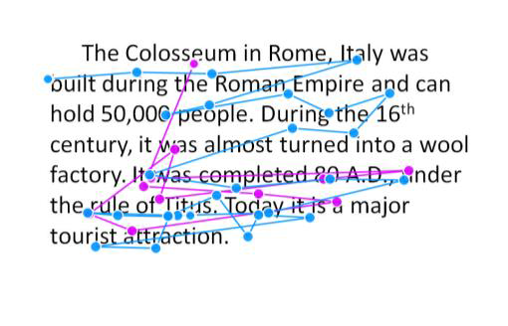
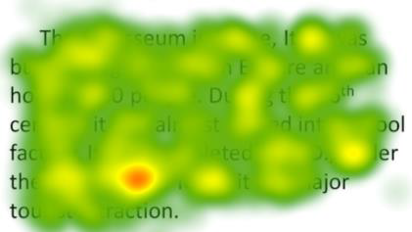
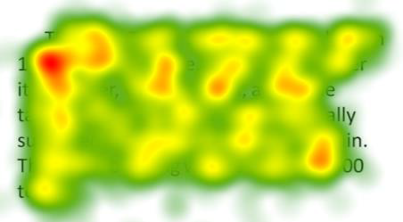
Example: Different types of reading
Skimming
Normal reading

Slide 4
UXI Research
Research of methods utilizing eye-tracking and other sensors either as the means of human-computer interaction or as the means for implicit feedback collection (especially for applications with adaptation and personalization features)
User studies examining the user behavior and experience during the use of information systems, web applications, mobile applications and multimedia.
  Individuals or groups of up to 20 persons
  Exploration of user preferences
  Evaluation of user interface designs
Collection of large quantities of user activity data
  Pageviews, clicks, gaze, mouse movement
Research of methods for gaze data analysis
  Event detection: fixations, saccades, smooth pursuit

Slide 5
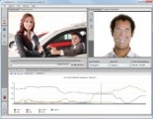
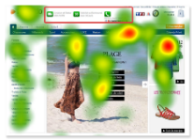
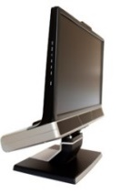
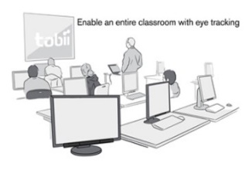
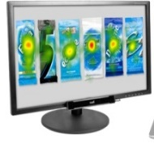

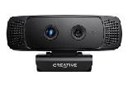

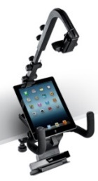
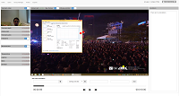
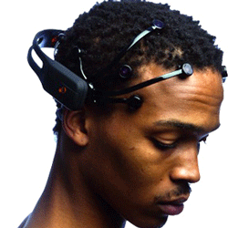
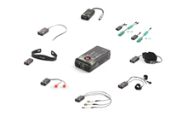
User eXperience and Interaction Research Center @ FIIT STU
UX Lab
UX Group
20x
emotion
detection
Tobii studio
300 Hz
gaze tracking
60 Hz gaze tracking
3D depth camera
TV
3D depth camera
Emotion detection
EEG
ECG, GSR, FSR, °C
Smartphones, tablets
UX Research infrastructure software

Slide 6
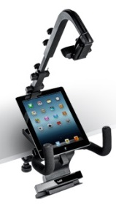
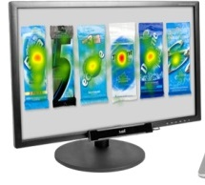
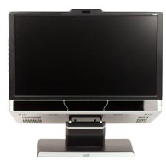

UXI@FIIT = three laboratories
60 Hz
mobiles, TV, PC
Control
room
300 Hz
PC, EEG, ...
20x 60 Hz
gaze tracking
PC

Slide 7
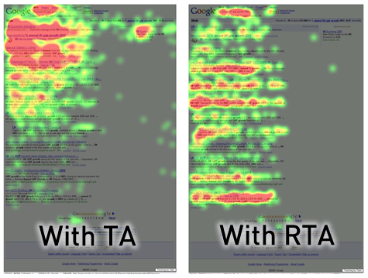
Methods
Think aloud (TA) vs retrospective TA (RTA)

Slide 8

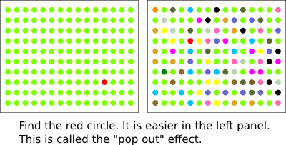
Visual Search
Perceptual task requiring attention involving active scanning for target

Slide 9
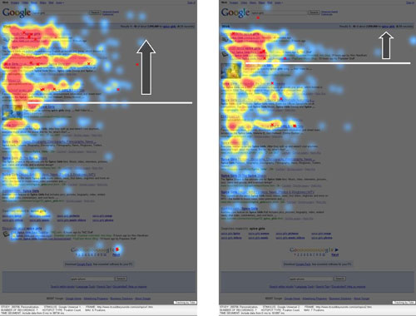
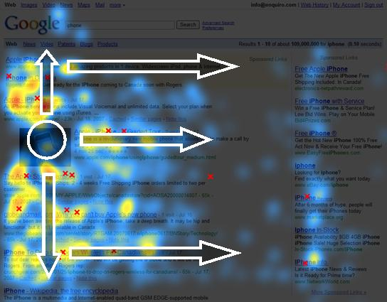
(Web) Usability
Search engine results: F-shaped pattern
Universal search:
E-shape pattern

Slide 10
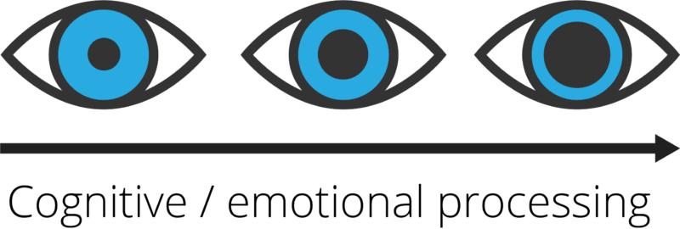
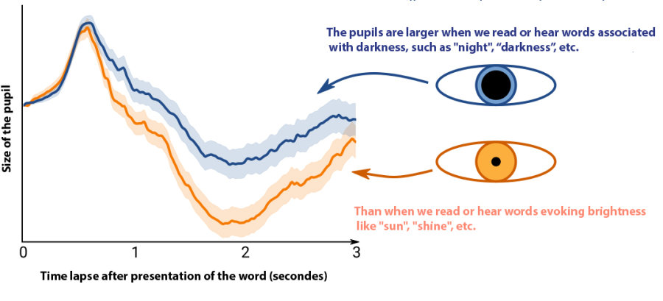
Pupillary response
Cognitive load
Excitement

Slide 11
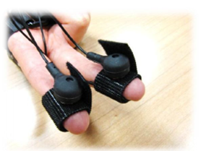
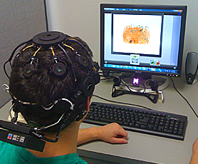
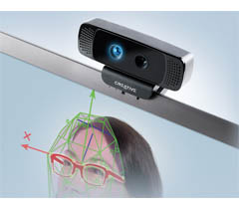
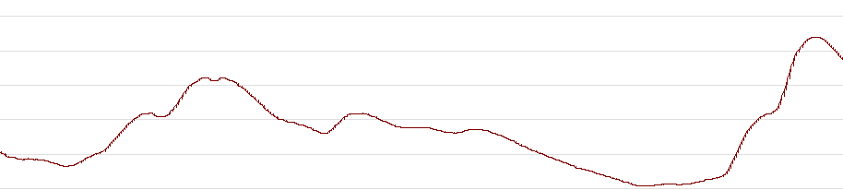
EEG aka “brain waves”, sensors, emotions
EEG response on stimulus onset
Pupillometry
Increased sweating
3D depth camera

Slide 12
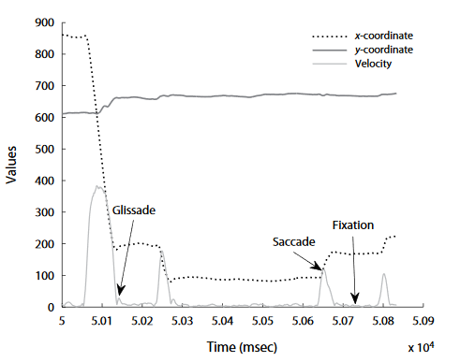
Event detection
Detecting events (fixations, saccades, glissades, smooth pursuit) from raw data
Rule-based
Data-driven
  Machine learning
  Deep learning

Slide 13
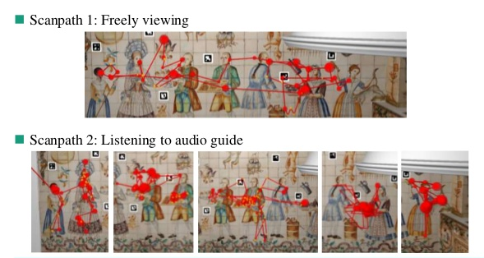
Gaze scanpaths

Slide 14
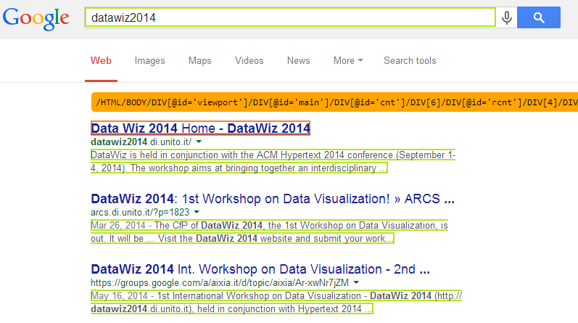
Dynamic web applications
Specifying AOI (area-of-interest) based on XPath

Slide 15
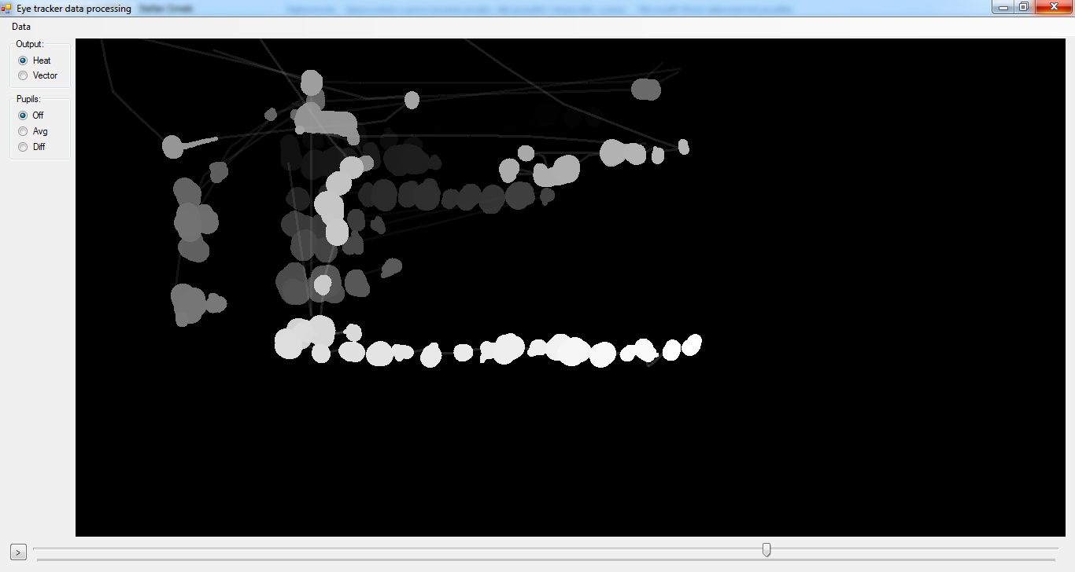
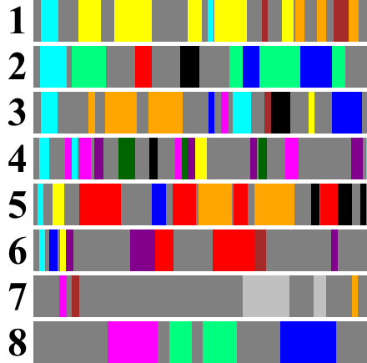
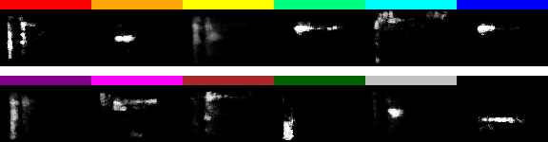
Deep learning: Automatic heatmap analysis
RBM (Restricted Boltzmann machine) neural network analyzes heatmaps into patterns of user interaction

Slide 16
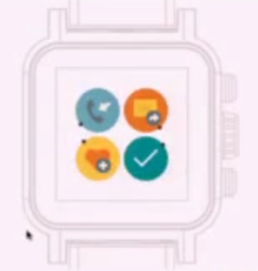

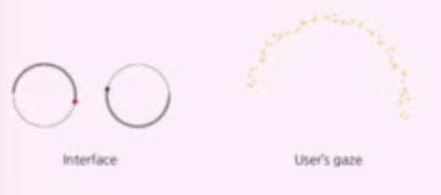
Gaze-based interaction
Gaze Interaction for Smart Watches
using Smooth Pursuit Eye Movements

Slide 17
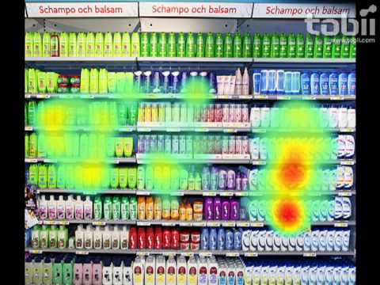
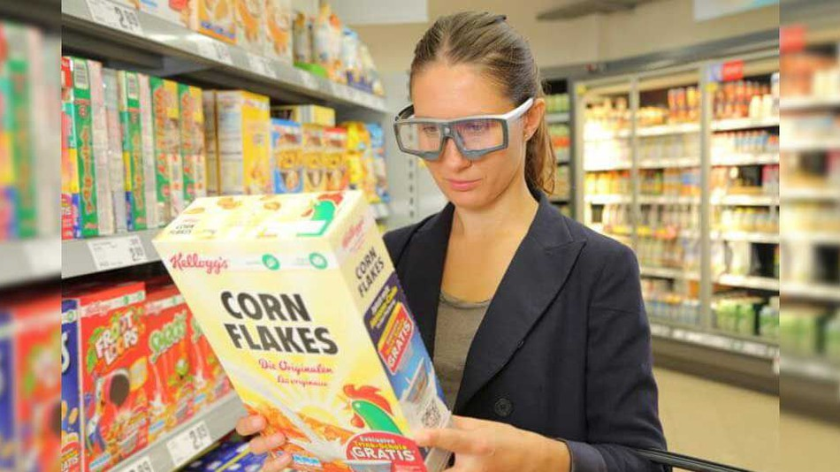
Eye tracking „in the wild“
Eye-tracking glasses

Slide 18
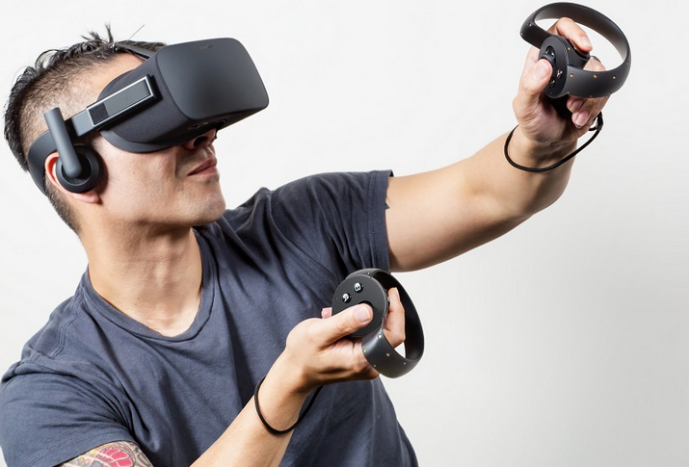
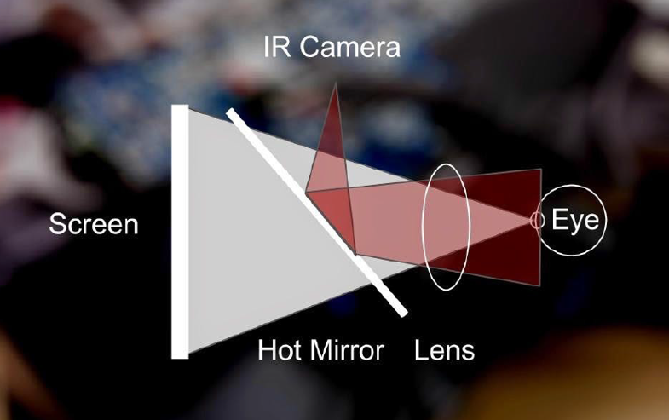
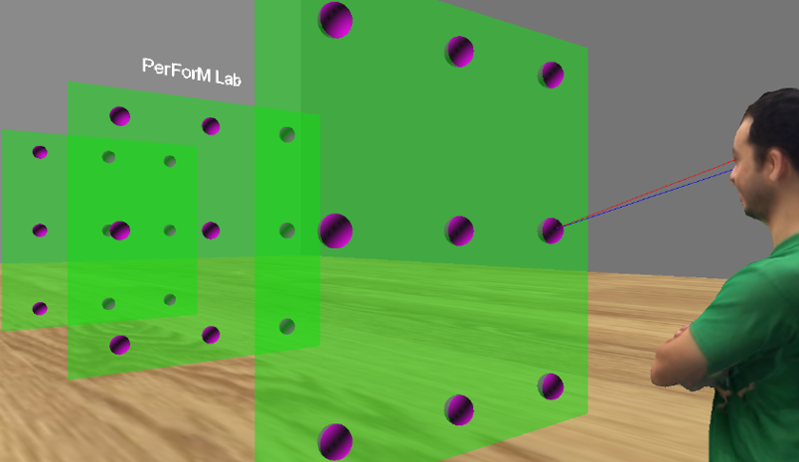
Virtual reality (VR)

Slide 19
People
Doctoral staff:
  Prof. Mária Bieliková
  Jakub Šimko
  Jozef Tvarožek
  Eduard Kuric
  Róbert Móro
  And other master and bachelor students ...
Doctoral students:
  Patrik Hlaváč
  Martin Konôpka
  Martin Svrček
Programming:
  Peter Demčák
  Martin Konôpka

Slide 20
Remaining slides
contain
Eye-tracking technology overview, UX lab description, and
example study

Slide 21
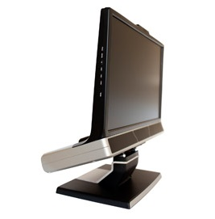
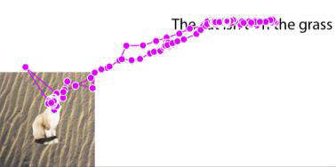
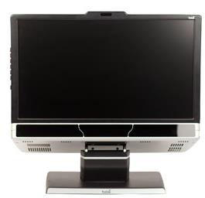
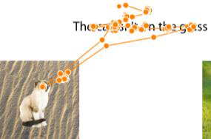
UX lab – detailed user observation
Detailed (300Hz) gaze tracking
  High accuracy and high precision
Tobii TX300
300 Hz
tracking
10 data points/saccade,
100 data points/fixation
Tobii X2-60 60 Hz tracking
1 data point/saccade
18 data points/fixation

Slide 22
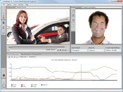
Comprehensive suite of sensors for UX research
Observing the user on multiple levels:
  Neurological sensors (EEG)
  Physiological sensors (wireless)
  ECG, GSR, FSR, °C
  Visual analysis, software-based
  facial expressions analysis
  (HD a 3D depth camera)
happiness,
sadness,
surprise,
fear,
anger,
disgust,
contempt
3D depth camera

Slide 23
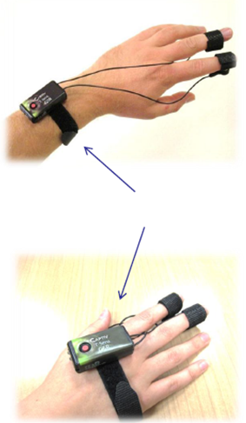
Example: GSR (Galvanic Skin Response) sensor
Observing galvanic skin response for analysis of stress via changes in sweating
Unit
Flexible wearing
Typical signal:
Increased sweating

Slide 24


Experiment
Observer in the other room, single-sided mirror
300Hz
eyetracker
3D depth camera
Experiment moderator
Experiment subject

Slide 25

Experiment as seen from the control room
observers

Slide 26

Experiment – Eyetracker calibration for the subject

Slide 27

Example experiment – Task description
Experiment moderator can observe the stimuli (same as subject) with an additional overlay of subject’s eye gaze

Slide 28

Example experiment – Performing the task
Experiment moderator can observe the stimuli (same as subject) with an additional overlay of subject’s eye gaze

Slide 29

Example analysis (gazeplot for 19 subjects)

Slide 30

Example analysis – Heatmap
Time: 2 seconds after initial view

Slide 31

Example analysis – Heatmap
Time: 6 seconds after initial view

Slide 32
Example: Different types of reading
Skimming
Normal reading

Slide 33

Example analysis – Clusters

Slide 34

Example analysis – Areas of Interest (AOIs)

Slide 35


UX research on mobile devices
Detailed (60 Hz) gaze tracking
HD camera
60Hz
eyetracker

Slide 36

During experiment (stimuli on tablet)
60Hz
eyetracker
Observers
subject
Experiment moderator

Slide 37
User eXperience and Interaction Research Center @ FIIT STU
UX Lab
UX Class
20x
emotion
detection
Tobii studio
300 Hz
gaze tracking
60 Hz gaze tracking
3D depth camera
TV
3D depth camera
Emotion detection
EEG
ECG, GSR, FSR, °C
Smartphones, tablety
UX Research infrastructure software

Slide 38
UXI@FIIT
User eXperience and Interaction
Research center @ FIIT STU, Bratislava
Slovak University of Technology in Bratislava
www.uxi.sk

